Slide 1
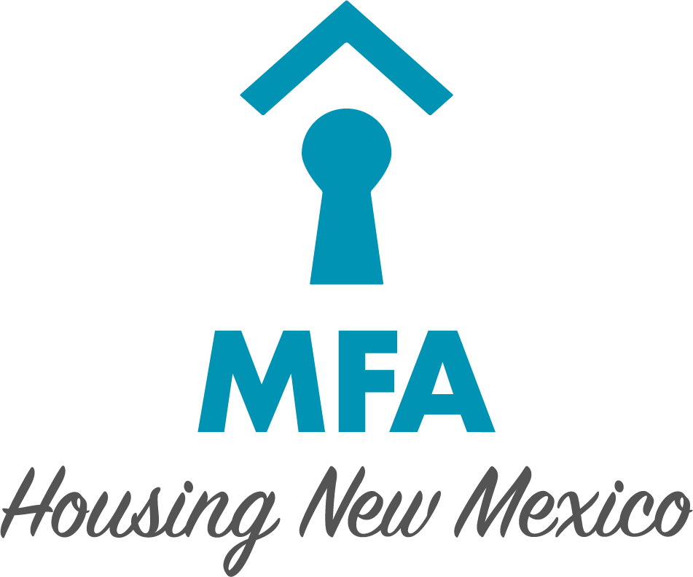
2023 New Mexico Affordable Housing Needs Assessment
Prepared by the New Mexico Mortgage Finance Authority
Justin Carmona, Community Relations Manager
Julie Halbig, Director of Compliance and Initiatives
July 7, 2023

Slide 2
Overview of the Statewide Housing Needs Assessment
Scope of New Mexico’s Housing Challenges
Homelessness
Special Needs
Renters
First-time Homebuyers
Homeowners
Conclusion

Slide 3
Homelessness
Estimated 19,000 – 20,000 homeless people throughout the year in the state according to the New Mexico Coalition to End Homelessness
According to HUD’s Annual Homeless Assessment Report Estimated 2,560 homeless people in New Mexico in 2022 on one night in January
Uses a point in time (PIT) count to determine this number
Likely undercounts the number of homeless people
Number of Sheltered and Unsheltered Homeless in New Mexico
Notes:
-The PIT count estimates the number of people in homeless shelters, transitional housing and unsheltered locations during a single night in January.
-These figures likely represent an undercount of the number of homeless people in NM; there may be as many as 5x more homeless then are officially counted.
-2021 data are not included in the chart because HUD did not include these numbers in their 2021 report

Slide 4
Homelessness
Percentage of New Mexico’s Homeless Population by Category
Notes:
*The numbers here do not add up to 100%, as it is possible for an individual to be counted in multiple categories.
**Chronic homelessness means these individuals have experienced homelessness for at least one year and have a severe physical or mental health condition.

Slide 5
Sheltered Homelessness in New Mexico January – May 2022
Homelessness by Gender
Homelessness by Age

Slide 6
Special Needs – Senior Households
Rio Arriba
38.2%
Senior household: a household with one or more members aged 65 years or older.
Counties with greater economic opportunities attract working-age adults, have proportionally fewer senior households
In Santa Fe County, a known retirement destination.
Rural counties tend to have more senior households
San Juan
36.1%
Taos
47.5%
Colfax
42.9%
Union
46.4%
Los Alamos
28.4%
Mora
51.1%
Harding
56.4%
McKinley
31.7%
Sandoval
35.0%
Santa Fe
42.8%
San Miguel
39.4%
Cibola
38.1%
Bernalillo
30.4%
Guadalupe
52.1%
Quay
45.3%
Valencia
36.6%
Torrance
38.2%
Curry
24.2%
De Baca
40.7%
Catron
70.8%
Socorro
41.9%
Roosevelt
29.3%
Lincoln
47.8%
Chaves
30.9%
Sierra
53.5%
Grant
46.4%
Lea
25.1%
Otero
32.6%
Dona Ana
31.7%
Eddy
28.9%
Luna
41.5%
Hidalgo
43.0%
Percentage of Households with Seniors in New Mexico Counties
Notes:
*Counties with greater econ. opportunity (and less seniors) include those with: large cities (Bernalillo, Sandoval, and Dona Ana, oil and gas production (Eddy, Lea, San Juan, and Chaves), or military bases or federal labs (Otero, Curry, and Los Alamos)
**Santa Fe County defies this trend, as it’s a retirement destination

Slide 7
Special Needs – Disabled Households
~335,000 New Mexicans have at least one disability
15.9% of New Mexicans have at least one disability, compared to 13.0% of the nation as a whole
Percentage of Population with a Disability in New Mexico and the United States
Notes:
“Hearing difficulty’: those who are “deaf or have serious difficulty hearing”
“Vision difficulty”: those who are “blind or have serious difficulty seeing even when wearing glasses.”
“cognitive difficulty”: people who “have serious difficulty concentrating, remembering, or making decisions due to a physical, mental, or emotional condition.”
“Ambulatory difficulty”: those with “serious difficulty walking or climbing stairs.”
“Self-care difficulty”: people who have “difficulty dressing or bathing”.
“Independent living difficulty”: people who “have challenges doing errands alone such as visiting a doctor’s office or shopping due to a physical, mental, or emotional condition.”

Slide 8
Renters - Affordability
Cost Burden for New Mexico Renter Households
22% of NM renters are cost burdened
Pay >30% but <50% of their income towards housing
21% are of NM renters severely cost burdened
Pay >50% of their income towards housing
57% of New Mexico renters can afford average rent, though this varies depending on the county they call home
San Juan
46.8%
Rio Arriba
56.4%
Taos
53.9%
Colfax
56.4%
Union
53.3%
Los Alamos
71.7%
Mora
75.9%
Harding
40.3%
McKinley
54.3%
Sandoval
56.5%
Santa Fe
45.3%
San Miguel
44.5%
Cibola
46.3%
Bernalillo
54.9%
Guadalupe
73.3%
Quay
50.5%
Valencia
43.2%
Torrance
42.3%
Curry
58.2%
De Baca
35.4%
Catron
35.0%
Socorro
49.8%
Roosevelt
50.2%
Lincoln
28.4%
Chaves
48.4%
Sierra
53.9%
Grant
32.1%
Lea
22.9%
Otero
59.8%
Dona Ana
36.0%
Eddy
52.0%
Luna
43.6%
Hidalgo
44.1%
Percentage of Renter Affordability in New Mexico Counties
Notes:
Renters are generally able to afford more in higher income counties (Sandoval, Los Alamos, Eddy, Otero) or lower rent counties (Mora, Guadalupe, McKinley).
Counties with the lowest affordability percentages have growing populations and not enough new housing development (Lea, Lincoln, Dona Ana).

Slide 9
Renters - Evictions
Number of Eviction Cases in New Mexico, 2022
Eviction case numbers in this figure are from the New Mexico Eviction Prevention & Diversion Program.
New program administered by the New Mexico State Courts starting in February 2022.
Program went in effect statewide in July 2022.
Eviction case rates are likely higher than the last few years, given that most pandemic-era eviction protection measures have now expired.

Slide 10
First-time Homebuyers – Home Prices and Building
Areas of NM with highest sale prices are those with many secondary homes or higher standard of living
Lowest sale price areas of NM are generally rural counties
The number of building permits issued in NM has increased by an average of 31% annually
Number of Building Permits Issued in New Mexico
San Juan
$244,500
Rio Arriba
$165,050
Taos
$450,000
Colfax
$448,750
Union
$99,750
Los Alamos
$500,000
Mora
$65,000
Harding
-
McKinley
$202,500
Sandoval
$340,000
Santa Fe
$500,000
San Miguel
$192,750
Cibola
$100,048
Bernalillo
$310,000
Guadalupe
$167,000
Quay
$130,000
Valencia
$260,000
Torrance
$340,000
De Baca
$80,000
Curry
$218,000
Catron
$270,000
Socorro
$170,000
Roosevelt
$160,000
Lincoln
$355,000
Chaves
$201,450
Sierra
$177,500
Grant
$271,000
Lea
$180,000
Otero
$220,000
Dona Ana
$295,000
Eddy
$246,000
Luna
$159,000
Hidalgo
$67,000
Average Home Sales Price for New Mexico Counties
Notes:
Building permit increase

Slide 11
First-time Homebuyers - Affordability
Figure shows the percentage of renter households in each county that can afford the median home price
Homeownership affordability has dramatically declined over the last year due to
the more than doubling of interest rates for mortgages in the past year
home prices remaining relatively high in NM
Acute problem across the entire state
San Juan
14.3%
Rio Arriba
14.3%
Taos
7.6%
Colfax
0.7%
Union
24.0%
Los Alamos
12.0%
Mora
75.9%
Harding
-
McKinley
18.2%
Sandoval
3.4%
Santa Fe
7.8%
San Miguel
8.3%
Cibola
46.3%
Bernalillo
13.3%
Guadalupe
3.8%
Quay
16.0%
Valencia
20.6%
Torrance
5.3%
Curry
22.9%
De Baca
35.4%
Catron
3.9%
Socorro
8.6%
Roosevelt
14.3%
Lincoln
1.4%
Chaves
14.8%
Sierra
15.9%
Grant
4.7%
Lea
14.4%
Otero
29.0%
Dona Ana
5.7%
Eddy
19.6%
Luna
11.0%
Hidalgo
44.1%
Percentage of Homeownership Affordability in New Mexico Counties
Notes:
Calculations were made using the following assumptions:
30% debt to income ratio
30-year fixed rate mortgage at 7.10% with a 5% down payment
Property taxes at 1% of purchase price
Homeowners’ insurance of $700 per year
Private mortgage insurance at 1% of the loan amount

Slide 12
Homeowners - Affordability
78% of NM homeowners are not cost burdened, significantly higher than this slice of renters
Pay <30% of their income towards housing
12% of NM homeowners are cost burdened
Pay >30% but <50% of their income towards housing
9% of NM homeowners are severely cost burdened
Pay >50% of their income towards housing
NM homeowners generally have higher incomes compared to renters, so cost burdened homeowners are less likely to be cutting back on other expenses versus cost burdened renters
Cost Burden for New Mexico Homeowner Households

Slide 13
Homeowners – Age of Housing
74.5% of NM’s homes were built before 2000, which is slightly lower than the national average of 75.6%
Generally, urban counties have more recently constructed homes, while rural counties have older homes
Rio Rancho (in Sandoval County) and Las Cruces (in Dona Ana County) have been building new homes at the fastest pace across NM
Older homes, particularly homes over 30 years old, are significantly more likely to need rehabilitation to remain habitable
San Juan
77.2%
Rio Arriba
83.1%
Taos
79.9%
Colfax
86.7%
Union
91.2%
Los Alamos
84.4%
Mora
90.5%
Harding
89.1%
McKinley
78.5%
Sandoval
58.0%
Santa Fe
72.7%
San Miguel
87.2%
Cibola
84.7%
Bernalillo
74.5%
Guadalupe
88.3%
Quay
94.7%
Valencia
71.4%
Torrance
87.6%
Curry
78.4%
De Baca
93.8%
Catron
76.8%
Socorro
87.5%
Roosevelt
79.2%
Lincoln
76.4%
Chaves
89.4%
Sierra
88.4%
Grant
88.4%
Lea
80.5%
Otero
78.1%
Dona Ana
65.2%
Eddy
80.1%
Luna
86.2%
Hidalgo
79.9%
Percentage of Homes Built before 2000 in New Mexico Counties

Slide 14
Homeowners – Manufactured Housing
San Juan
34.3%
Rio Arriba
35.2%
Taos
16.0%
Colfax
20.5%
Union
12.2%
Like in many western states, a significant portion of homes in NM are manufactured or mobile homes
Rural counties are generally have more manufactured housing due to its convenience and affordability
Los Alamos
5.7%
Mora
41.8%
Harding
25.2%
McKinley
25.3%
Sandoval
8.3%
Santa Fe
13.4%
San Miguel
35.9%
Cibola
23.9%
Bernalillo
5.3%
Guadalupe
22.9%
Quay
20.7%
Valencia
24.7%
Torrance
43.9%
De Baca
12.9%
Curry
8.0%
Catron
33.0%
Socorro
36.6%
Roosevelt
20.2%
Lincoln
30.8%
Chaves
13.9%
Sierra
38.0%
Grant
25.4%
Lea
22.2%
Otero
28.5%
Dona Ana
18.1%
Eddy
19.1%
Luna
32.3%
Hidalgo
41.7%
Percentage of Manufactured Homes in New Mexico Counties

Slide 15
Conclusion - Recap
The number of homeless people in New Mexico has declined from its 2020 peak based on the point in time count.
New Mexico is home to a significant number of senior and disabled households who could benefit from new housing developments equipped to meet their unique needs.
While rental evictions are low in New Mexico, nearly half of New Mexican renters are cost-burdened meaning, that affordable rental housing development is needed.
Most renters are unable to afford to buy a median priced home due to both higher interest rates and not enough new single-family housing development.
The overwhelming majority of homeowners can afford the home they live in, with many of those homes being older or manufactured homes.

Slide 16
Conclusion – MFA Program & Results (2022)
Homelessness – Over 2,000 persons were sheltered & housed across the year and nearly 850 households had homelessness prevented with around $2.7 million in shelter and rapid rehousing assistance.
Special Needs – Over 500 special needs households were assisted with $3.7 million in housing vouchers and services.
Renters – Approximately 5,200 low-income renters were assisted with project-based rental assistance totaling $32.5 million; Around 1,400 rental units were built and preserved with $136 million in MFA financing.
First-time homebuyers – Nearly 4,000 New Mexico families became homeowners with $430 million in MFA mortgage loans and nearly $14.7 million in down payment assistance.
Homeowners – 715 homes were rehabilitated or weatherized with $8.2 million in MFA funding; 664 homeowner households provided with $5 million in homeowner assistance funds to help those experiencing financial hardship.
Homelessness
EHAP
Special Needs
Linkages
First-time Homebuyers
Homeowners
CoC
YHDP
RAP
LCP
HOPWA
FirstHome
NextHome
FirstDown
NextDown
HomeNow
HOME Rehab
WAP
HAF
Housing Development
LIHTC
MFA-issued Bonds
NMHTF
HOME
NHTF
Primero
STC
Primero
Renters
Section 8
Section 811
Notes:
EHAP-Emergency Housing Assistance Program
CoC-Continuum of Care
YHDP-Youth Homeless Demonstration Program
RAP-Rental Assistance Program
LCP-Landlord Collaboration Program
HOPWA-Housing Opportunities for Persons with AIDS
WAP-Weatherization Assistance Program
HAF-Homeowner Assistance Fund

Slide 17
We’d be happy to answer any questions now. Thank You.
The full New Mexico Affordable Housing Needs Assessment report is available at: https://housingnm.org/resources/housing-needs-assessment

