Slide 1
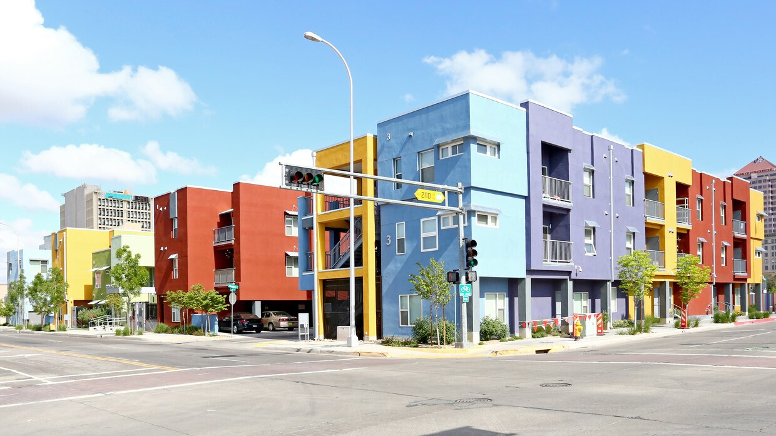

Housing New Mexico |
MFA
2026 Legislative Sessions – Outcomes for Housing
Prepared for the Ruidoso Housing Forum
April 9, 2026
Robyn Powell
Senior Director
Policy & Planning Department

Slide 2

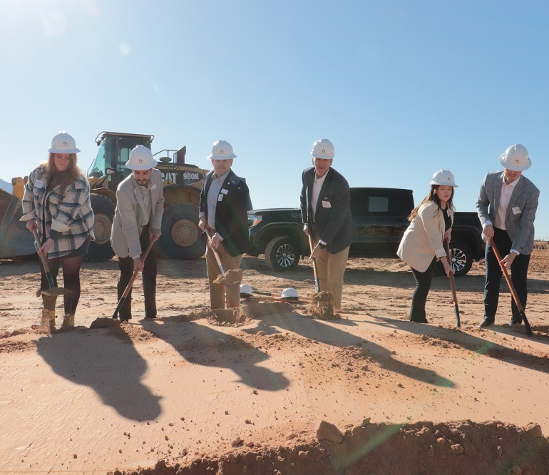
Contents
Highlights
Housing Related Appropriations
Funding by Agency
HB 200 – New Homes for New Mexico
SB 151 – Corporate Income Tax Changes
Other Housing Policy Bills Introduced
Where can the Legislature go from here?
Review of Housing Reports
Housing New Mexico staff and partners at the groundbreaking for Sandoval Flats, a 126-unit development in Rio Rancho. Housing New Mexico provided $45.1 million in financing to the project.

Slide 3
Highlights
23 housing-related bills were introduced
HB 200 “New Homes for New Mexico” and SB 151 “Corporate Income Tax Changes” included a GRT deduction for affordable multifamily construction were enacted.
All Funding for Housing – General Appropriations & Capital Outlay Projects – $196,695,299

Slide 4
Housing Related Appropriations
General Appropriations Act (House Bill 2) $152.4 Million for Housing Related Appropriations
$50 million to Housing New Mexico | To fund affordable housing, transitional housing, homelessness initiatives and the expansion of housing services statewide, including to fund downpayment assistance and interest rate buydown for for-sale housing and $500,000 for administration of the Affordable Housing Act. Any unexpended balances remaining at the end of fiscal year 2027 shall not revert and may be expended in subsequent fiscal years.
$20 million to the New Mexico Finance Authority (NMFA) | To continue funding affordable and attainable housing throughout the state, including $5,000,000 for tribal housing infrastructure in consultation with the Indian affairs department.
$30 million for the Department of Workforce Solutions (DWS) | To fund housing, affordable housing, transitional housing, homelessness initiatives and the expansion of housing services statewide.
$5,153,300 in the Government Results and Opportunity (GRO) Fund. | The GRO Fund is an expendable trust which funds three-year pilot programs before they are considered for permanent, recurring state funding. $1.3 million to DWS for Office of Housing operations $510,000 to Department of Finance and Administration (DFA) for homelessness and eviction prevention programs $3.310 million to various Councils of Governments for affordable programs and services
Capital Outlay (Senate Bill 240) - $44.3
$5,144,000 to DFA for Housing New Mexico | For various single family affordable housing projects statewide and a scattered site multifamily project. This funding was appropriated as eleven separate projects.
$26,575,000 to DWS | For housing and homelessness projects statewide.
Notes:
Our original legislative request was $135 million. This number is based on production forecast, pipeline projects and anticipated needs from the housing community.

Slide 5
Funding By Agency
All Funding for Housing – General Appropriations & Capital Outlay Projects – $196,695,299
Department of Finance & Administration/ Department of Workforce Solution
Affordable housing, transitional housing, homelessness initiatives, and expansion of housing services | $30,000,000
Office of Housing operations | $1,333,300
Homelessness and eviction prevention | $510,000
Housing and homeless projects statewide | $26,575,000
Transitional housing and domestic violence shelters | $10,000,000
Subtotal | $68,418,300
Housing New Mexico
Affordable Housing Activities | $49,500,000
Affordable Housing Act | $500,000
Fiscal Agent Projects - Various single family affordable housing projects, scattered site multifamily project | $5,144,000
Subtotal | $55,144,000
Other
COGS - Various Housing | $3,310,000
State Fair Housing - GSD | $30,000,000
Variety of Other | $14,822,999
Subtotal | $48,132,999
New Mexico Finance Authority
Affordable & Attainable Housing | $15,000,000
Tribal Housing Infrastructure | $5,000,000
Subtotal | $20,000,000

Slide 6
HB 200 – New Homes for New Mexico
The passage of House Bill 200 created the “New Homes for New Mexico” program, which provides downpayment assistance to low- or moderate-income households purchasing a newly constructed home. HB 200 tasks Housing New Mexico with creating and administering the program, which will be implemented through home builders selected through a competitive process. The bill stipulates the following terms:
Eligible Builders
Build homes for the program that do not to exceed 1,800 square feet and on lots that do not exceed 5,000 square feet
Complete homes to be sold with the program within three years of selection
Build homes for the program that are affordable to the borrower.
Eligible Borrowers
First time homebuyer
Annual income at or below 120% AMI
Home purchased will be the primary residence
Downpayment Assistance Loan Terms
Up to $50,000 for most counties and up to $75,000 for “high cost” counties of Santa Fe, Taos, and Los Alamos.
0% annual interest rate
Repaid in full upon sale of the property, failure to occupy home as the primary residence
Housing New Mexico is currently developing program rules and drafting a request for proposal to select builders to participate.
Notes:
If approved by the Board, the program should be available in July.

Slide 7
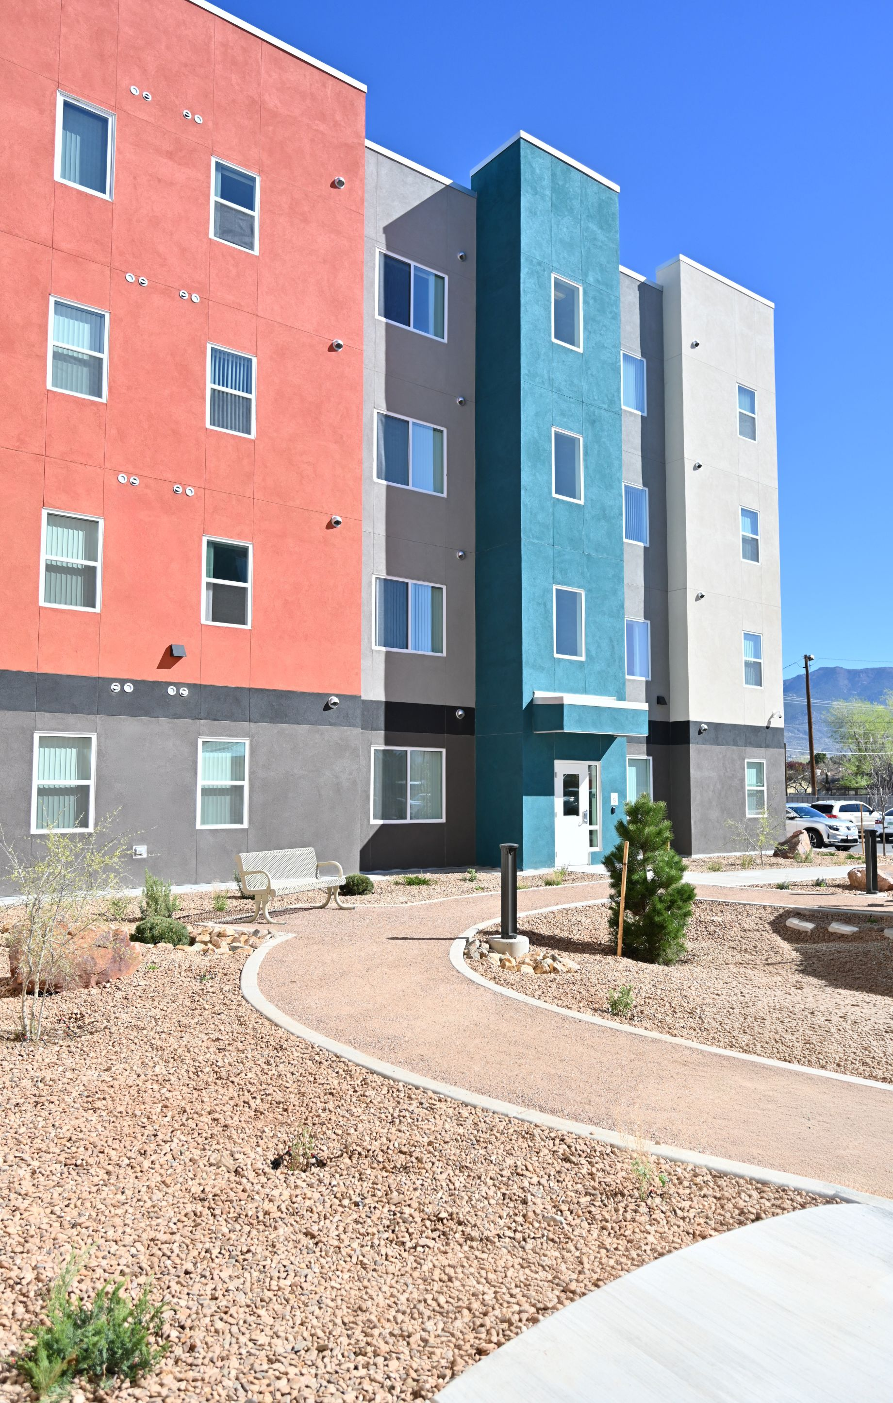
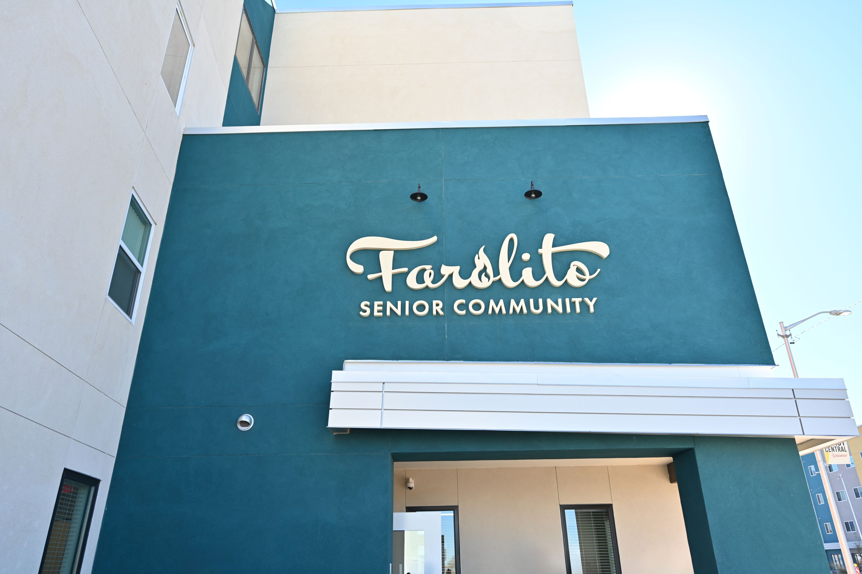
SB 151– Corporate Income Tax Changes
The passage of Senate Bill 151 “Corporate Income Tax Changes” created gross receipts tax exemption for construction materials and labor for affordable multifamily developments that meet the following requirements:
At least 80% of the units are income restricted to households earning no more than 80% area median income
Construction materials and labor are sold to a “qualifying grantee” as defined in the Affordable Housing Act
The purchase must provide the seller a “non-taxable transaction certification”
The taxpayer must comply with reporting required by the Department of Taxation and Revenue
Effective dates July 1, 2027, to July 30, 2030
Farolito Senior Community in Albuquerque open its doors in March 2026. The development offers 82 units to low and moderate income seniors. Housing New Mexico provided $1.6 million in tax credits to the project.
Notes:
Originally introduced as Senate Bill 92, rolled into SB 151 after creates a gross receipts tax deduction for the sale of construction materials and labor used for the development of affordable housing multifamily residential housing projects.

Slide 8
Other Housing Policy Bills Introduced
Land Use
HB 17 Accessory Dwelling Units in Certain Areas
HB 138 Zoning Lot Requirement
Tax Bills
HB 77 Affordable Housing Revitalization Tax Credit
Regulatory
HB 167 Notice of Sale of Mobile Home Parks
HB 194 Expand Metro Redevelopment Code
HB 103 Residential Property Valuation Increase
SB 114 Investment Ownership of Residential Properties
HB 110 Housing Development Data Reporting
The legislature continued to demonstrate a strong interest in improving housing affordability as evidenced by the number of housing policy-related bills introduced. These bills can generally be categorized as being related to either land use, tax, or other regulatory.
Notes:
Many piece-meal land use policy bills were introduced aimed broadly at increasing density and easing building restrictions through state level land use regulation. Some states, like Montana and Oregon, have passed more comprehensive land use polices
Land Use
HB 17 requiring home rule municipalities to allow accessory dwelling units (ADUs) and multifamily housing in designated areas
Was not heard in committee
House Bill 138 amends state zoning regulations to prohibit county and municipality zoning authorities from imposing lot size requirements for residential properties.
Was not heard in committee
House Bill 194 expands the state’s Metropolitan Redevelopment Code to include “housing shortage areas” as eligible targets for redevelopment actions.
Was not heard in committee
Tax Bills
House Bill 77 creates a temporary corporate income tax credit to incentivize the rehabilitation of vacant buildings and lots into affordable housing for projects started in 2026 to 2037. The taxpayer can receive 30% of the rehabilitation expenses on buildings that have been vacant between two to five years or 40% of rehabilitation expenses on a building that has been vacant more than 5 years. The taxpayer may apply for certification of eligibility of this corporate income tax credit with the New Mexico Mortgage Finance Authority within one calendar year of the project being complete.
Passed both committees, not heard by the full House
House Bill 103 amends New Mexico’s property tax status to protect homeowners from large tax valuation increases when zoning changes.
Passed the House, was not heard by the Senate
Regulatory
House Bill 167 proposes adding a new section of the Mobile Home Park Act to require notice to tenants before the sale of a mobile home park and providing an opportunity to purchase for the residents with enforcement mechanisms. HB 167 increases the state capital gains tax deduction to 50% for owners who sell a mobile home park it its residents.
Was not read in, this bill has been run for several years but has not yet been successful.
Mobile home parks are an important form of naturally occurring affordable housing. In the updated housing strategy data, we know that Senior renters in mobile homes have seen the sharpest increase in cost burden (from 41% in 2019 to 54% in 2023), driven by a 53% increase in average rents for that type of housing between 2019 and 2023.
Senate Bill 114 prohibits hedge funds, private equity firms, corporations, or any other business entity from purchasing single-family residences with the exemption of limited liability companies (LLCs).
Not heard in committee
House Bill 192 prohibits a foreign corporation, including an in-state subsidiary of the foreign corporation from purchasing single-family residential properties to make them into an investment rental property in the state.
Not read in
House Bill 110 proposes class A counties or municipalities, with a population greater than 30,000 people, will publish a quarterly report containing information on residential development and residential building permits. The county or municipality will provide the report to the economic development department and the legislative finance committee.
Passed first committee, not heard in a second committee

Slide 9
Statewide Reports on Housing
New Mexico Housing Strategy Recommendations to Effect Housing Policy and Regulations
Incentivize and/or require that planning commissions consider housing needs documented in local or regional housing needs assessments when making zoning and land use decisions;
Incentivize and/or require that economic development incentives, such as those offered through LEDA, include a workforce housing component for production and/or preservation;
Incentivize by right or administrative approval for developments with a significant share of affordable units including casitas/ADUs and plexes;
Allow density bonuses and/or fast track approval for homes that meet energy efficiency requirements (to offset higher costs of green building);
Create a model development code that includes feasible land use incentives for affordable housing, mixed-income housing, and mixed-use development;
Create an incentive program that provides funding to local governments that adopt policies that facilitate flexibility and efficiency in development approval, infill development, income-diverse development, and efficient zoning. Funding could be used for: community revitalization, economic development, or infrastructure expansion activities
Create a program to mitigate resistance to affordable housing at the local level, including training to build community awareness and support of needs.
Notes:
Published in 2022, The Housing Strategy intended to leads the state, New Mexico local governments, and private and nonprofit partners toward the highest impact actions to address challenges in:
Producing housing across the income continuum;
Preserving and improving existing affordable housing, both privately and publicly owned, and redeveloping underutilized and vacant properties to increase supply and catalyze economic development;
Building homeownership opportunities to retain the state’s high homeownership rate, especially among low and moderate-income, and racially and ethnically diverse, households;
Creating housing stability for people vulnerable to and experiencing homelessness and residents with special housing needs; and
Advocating for effective federal housing policies and regulations.
The backdrop of the New Mexico Housing New Strategy was a housing market that has become increasing difficult for all but the highest income New Mexicans to afford. Affordability has only gotten worse, increasing costs for insurance and taxes, along with a lack of supply for affordable housing continues to impact the state and the nation.
Lack of affordable housing not only impedes the ability of households to be self-sufficient and invest in economic growth for their families—it also has negative consequences for state and local economic development and growth. The latter can be easy to overlook, as it is often hidden, but the impacts are significant.
Without adequate affordable housing:
New Mexico’s urban areas cannot continue to attract new businesses,
Existing businesses, particularly small businesses, cannot keep standard operating hours and cannot grow;
Low-income renters are forced to move more frequently, disrupting community ties, stable employment, and educational consistency for their children;
Moderate-income renters cannot achieve ownership and pass on wealth to their families; and
Persons with special needs—including seniors, New Mexicans with disabilities, residents vulnerable to and experiencing homelessness—are caught in a perpetual and costly cycle of housing instability.

Slide 10
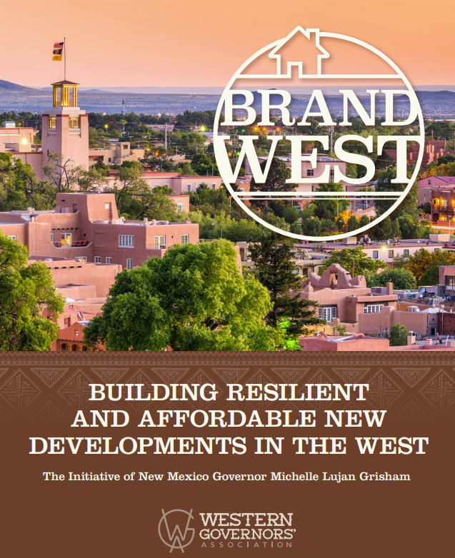
Statewide Reports on Housing
Western Governors Association Brand West Report
Four Key Pillers of Housing Access
Reducing the cost of homebuilding.
Supporting families through initiatives that help renters and homebuyers.
Investing in strategic, innovative, and data-informed initiatives across the housing ecosystem.
Simplifying and streamlining housing development.
https://westgov.org/images/files/Brand_West_Report_2025_1.pdf
Notes:
BUILDING RESILIENT AND AFFORDABLE NEW DEVELOPMENTS IN THE WEST
The Initiative of New Mexico Governor Michelle Lujan Grisham
This report was published in the summer of 2025 - examined strategies and policies to address housing availability and affordability and promote smart and sustainable development in communities throughout the West.
Simplifying and streamlining housing development. Best practices from our western states include the modernization of land use regulations, expedited plan and permit review processes, and support for manufactured and modular homes. The federal government can advance these efforts by expanding programs like the U.S. Department of Housing and Urban Development’s (HUD) Pathways to Removing Obstacles to Housing (PRO Housing) Program, revisiting requirements for federally funded infill housing projects, and eliminating outdated regulations that hinder the adoption of manufactured and modular housing.
Reducing the costs of homebuilding. Western states and territories have shown leadership in this area by creating targeted tax credit and funding programs. The federal government can contribute to this goal by expanding and creating tax incentives and evaluating the costs of federal housing regulations.
Supporting families through initiatives that help renters and homebuyers. Western states and territories have instituted a number of programs to increase access to rental homes and support homeownership. The federal government’s role may include improving rental assistance and enhancing programs that provide pathways to homeownership.
Investing in strategic, innovative, and data-informed initiatives across the housing ecosystem. Recognizing that housing challenges do not exist in a bubble, initiatives in western states and territories are focusing on capacity-building and workforce development programs, sustainability and resilience efforts, enhanced cooperation, and expanded access to publicly owned parcels of land. The federal government can support these efforts by strengthening the skilled construction workforce, funding community resilience programs, promoting interagency coordination, and increasing opportunities for the smart and responsible development of appropriate federal parcels.

Slide 11
Statewide Reports on Housing
Simplifying and streamlining housing development.
Zoning and land use laws are too complex, blocking and slowing housing development.
Examples of Enacted Legislation in Other Western States
New Mexico 2026 Session Legislation Introduced
Statewide Land Use Legislation that requires cities and counties to adopt comprehensive land use plans and zoning ordnances
“Shot Clocks” for housing approvals and mandated expanded options for multi-family development
Increased density requirements, along with planning and development funding
Co-living and micro communities legalized for multi-family zones, adaptive reuse of commercial buildings
Phase out short-term rentals, by right ADUs (accessory dwelling units) statewide
HB 17 requiring home rule municipalities to allow accessory dwelling units (ADUs) and multifamily housing in designated areas.
HB 138 amends state zoning regulations to prohibit county and municipality zoning authorities from imposing lot size requirements for residential properties.
New Mexico 2025 Session Legislation Introduced
House Bill 571 directs the Department of Finance and Administration to create a program that awards certificates to municipalities that adopt or establish one or more department-approved strategies to increase housing affordability and accessibility.
HB 554 requiring home rule municipalities to allow accessory dwelling units (ADUs) and multifamily housing in designated areas.
SB 310 seeks to amend New Mexico Statute Section 3-21-1 by requiring municipalities and counties to remove building height restrictions, except in historical districts, and to permit duplexes and townhouses in residential zones.
SB 312 seeks to amend New Mexico Statute Chapter 3, Article 19, Section 3-19-8 by restricting who can appeal zoning and planning decisions. Only the property owner directly affected, or owners of adjacent properties would have the right to appeal.
SB 131 amends state zoning regulations to remove height restrictions, allows for one ADU in SF zoning, shall no prohibit multifamily apartments in commercial areas, allow small scale commercial uses in residential zones.

Slide 12
Statewide Reports on Housing
Government permitting and approval systems are too slow and complicated.
Western state and local governments have demonstrated the value of strategic reviews of permitting and approval systems, which weed out duplication and unnecessary administrative burdens.
Examples of Enacted Legislation in Other Western States
New Mexico 2026 Session Legislation Introduced
Hawai'i's Affordable Housing Proclamation provides a streamlined process for affordable housing projects on land owned by state and local governments to receive certain environmental review, zoning, parking requirement, fee, and density exemptions, and waivers of certain impact fees.
New Mexico 2025 Session Legislation Introduced
HB 571 directs the Department of Finance and Administration to create a program that awards certificates to municipalities that adopt or establish one or more department-approved strategies to increase housing affordability and accessibility.
California, Montana, and Hawaiʻi have adopted multifamily housing by right in commercial zones widely, while Arizona has adopted certain components, allowing projects to proceed without discretional review.
Streamlined public comment periods requiring early-stage public participation in the planning process for certain cities and counties, including permitting decisions.
Washington allows cities and counties to hire or contract hearing examiners to approve preliminary plans and amendments to zoning ordinances and manage the community engagement process.
Although technology for manufactured and modular homes has advanced tremendously, the rules for these homes remain a barrier.
Currently, Idaho, Washington, and Oregon have a reciprocity agreement that allows manufacturers located in these three states to receive shared plan review and inspection services.
The DakotaPlex Program addresses the need for affordable multifamily housing in rural communities while imparting construction skills to prison inmates
HB 110 proposes class A counties or municipalities, with a population greater than 30,000 people, will publish a quarterly report containing information on residential development and residential building permits. The county or municipality will provide the report to the economic development department and the legislative finance committee.
HB 194 expands the state’s Metropolitan Redevelopment Code to include “housing shortage areas” as eligible targets for redevelopment actions.
SB 293 would require that an affordable housing study be conducted and provided with a petition to a governing body of an approved tax increment development.
Notes:
IDEAS WORTH EXPLORING
 States may develop model zoning and land use codes that localities are incentivized to adopt to receive state funding for housing projects. This could preserve local autonomy while ensuring that funds are deployed in a timely fashion.
 State and local governments may fully maximize the benefits of technology and AI to streamline parts of the permitting process, including adopting digital permitting systems and video inspections where appropriate.
 States may provide incentives to encourage local jurisdictions to offer increased density allowances to developers in exchange for deed-restricted housing units reserved for the local workforce.

Slide 13
Statewide Reports on Housing
Reducing the Cost of Homebuilding.
Financing tools that incentivize affordable housing development and preservation are effective, but we need more of them.
Examples of Enacted Legislation in Other Western States
New Mexico 2026 Session Legislation Introduced
Eleven western states have established a state low-income housing tax credit to supplement federal tax credits, increasing investment and gap financing
New Mexico 2025 Session Legislation Introduced
HB 325 introduces tax deductions for businesses on labor costs related to new residential construction in New Mexico, capping at $125,000 for for-sale homes and $75,000 for rentals, excluding renovations. It also includes a "hold harmless" provision to reimburse local governments for lost revenue.
HB 139 appropriates $135,000,000 from the general fund to the New Mexico Housing Trust Fund.
The cost of building homes has skyrocketed, in part due to outdated policies and a lack of proactive strategies.
Low interest loans to developers who develop attainable starter homes (ZIHP and NMHTF loans are available at Housing New Mexico)
Arizona offers state tax credits, subsidies, and low-interest loans to developers building affordable housing. Additional incentives are allotted to owners who participate in housing assistance programs and commit to serving certain at-risk populations.
New Mexico has allocated record funding in recent years with over $400 million in the 2024 and 2025 legislative sessions.
Community land trusts use deed restrictions or renewable land leases to ensure that homes remain permanently affordable, meaning that the down payment assistance and funding invested in the first purchase are not lost, even when homes are sold.
New Mexico’s Economic Development Site Readiness Act also expressly included housing availability in the site characterization studies that will occur across the state as a precursor to certifying properties as “strategic economic development sites.” The Site Readiness Act was coupled with $24 million over three years to fund these predevelopment activities
HB 472 is an amendment to the Corporate Income and Franchise Tax Act that adds new material that creates a tax credit for an individual who incurs expenses for rehabilitation of an abandoned building.
HB 24 creates a housing loan program to be administered by the New Mexico Mortgage Finance Authority to qualified professionals for down payment assistance or closing costs associated with purchasing a home in New Mexico in exchange for the qualified professional practicing for ten years in the state.
SB 114 prohibits hedge funds, private equity firms, corporations, or any other business entity from purchasing single-family residences with the exemption of limited liability companies.
HB 176 proposed to create a zero interest down payment assistance loan fund by amending distributions to certain other funds.
Hl 251 would amend the Affordable Housing Act by adding new material that would create the “new homes development program.” The “new homes development program” would be administered by the New Mexico Mortgage Finance Authority to provide grants to eligible homebuyers to purchase new homes.
Notes:
IDEAS WORTH EXPLORING
 Regional purchasing cooperatives for common goods and services needed for all housing projects may reduce both the time and expense of local and state procurement regulations.
 Innovation is key to supporting the development of new building materials and technologies that are more cost-effective and sustainable. States may work with universities and other research partners to ensure this research is adequately funded.
 Strategies may leverage employer and workforce-related capital to support the development and preservation of affordable housing. These investments may be structured as long-term capital, low-interest loans, or construction financing, all aimed at improving housing access for workers.
 States may consider enabling local governments to offer property tax exemptions to developers in exchange for the creation or preservation of income-restricted housing.

Slide 14
Statewide Reports on Housing
Supporting Families Through Initiatives That Help Renters And Homebuyers.
Building new housing is critical to bringing down costs, but it is not always enough to make housing attainable.
Examples of Enacted Legislation in Other Western States
New Mexico 2026 Session Legislation Introduced
Eviction prevention and rental assistance programs
Local programs
AHA compliant jurisdictions can provide programs and funding for rental assistance and eviction prevention.
HB 139 appropriates $135,000,000 from the general fund to the New Mexico Housing Trust Fund.
Homeownership remains a primary goal in affordable housing strategies, even as speculative ownership continues to drive housing prices above sustainable levels.
The NMHTF funds downpayment assistance with below market interest rates
Housing New Mexico is currently developing an interest rate buy-down program and the New Homes for New Mexico program (HB 200)
GRO Fund $150,000 for eviction prevention services and housing stability in Bernalillo county
New Mexico 2025 Legislation Introduced
HB 215 amends the Uniform Owner-Resident Relations Act by incorporating a ban on the use of artificial intelligence (AI) to manipulate rent pricing.
HB 442 limits rent increases in mobile home parks to once per year, capping increases at 3% in fiscal year 2026 and 5% thereafter.
HB 418 provide certain rights to tenants for termination of leases for non-payment of rent and in cases of eviction due to zoning changes.
Notes:
IDEAS WORTH EXPLORING
States may explore opportunities to enable low-income homeowners to successfully sustain homeownership over the long term. This could include expanding homebuyer education programs and housing counseling services to support prospective homebuyers through the process; creating assistance programs for home modifications and repairs; and tax relief.
 Providing protections against the displacement of renters is key, and states and localities may consider policies that prioritize keeping renters in their homes. For example, states and localities may adopt right of first refusal policies that give tenants the option to purchase their building.
Access to mortgage financing remains a challenge for prospective homebuyers. A potential solution may be to use alternative underwriting criteria, such as rental payment history, utility bills, and car payment history.
State and local governments may support nonprofits that promote cooperative land ownership in manufactured and mobile home communities to enhance stability and resident control.

Slide 15
Statewide Reports on Housing
Investing In Strategic, Innovative, And Data-informed Initiatives Across The Housing Ecosystem
Examples of Enacted Legislation in Other Western States
In 2024, Governor Lujan Grisham issued Executive Order 2024-152 to address the urgent need for a skilled infrastructure and climate ready workforce in New Mexico. The Executive Order identifies the goal for Partnership Agencies to collectively facilitate and support the training of 2,000 workers in infrastructure and climate-ready professions by December 31, 2026.
Housing development is also constrained by a significant shortage of construction workers and a lack of capacity, slowing the pace of new projects and increasing costs each year.
Oregon’s General Housing Account Program provides grants, training, and technical assistance opportunities to help build capacity in individuals, organizations, geographic regions, and systems toward the development and sustainable operation of affordable multifamily rental housing.
Affordable housing development does not always reflect the challenges of sustainability and resilience.
Designating high-risk areas like the wildland-urban interface and following associated codes in these areas
To reduce barriers and promote resilience, the Northern Marianas Housing Corporation emphasizes operational efficiency and sustainable practices.
Colorado is investing in proactive risk reduction measures that helps enhance community safety and resiliency from wildfires through the development and local adoption of model codes and standards tailored to Colorado.
Publicly owned parcels that may not have other strategic purposes or intrinsic values are not readily available for housing development.
Congress and states may explore new tax incentives and credits for developers building on public land to ensure long-term affordability for the housing they build and maximize the public value of these projects
States may finance regional housing needs assessments to support datadriven insights that inform planning and policy decisions related to current and future housing needs.

Slide 16
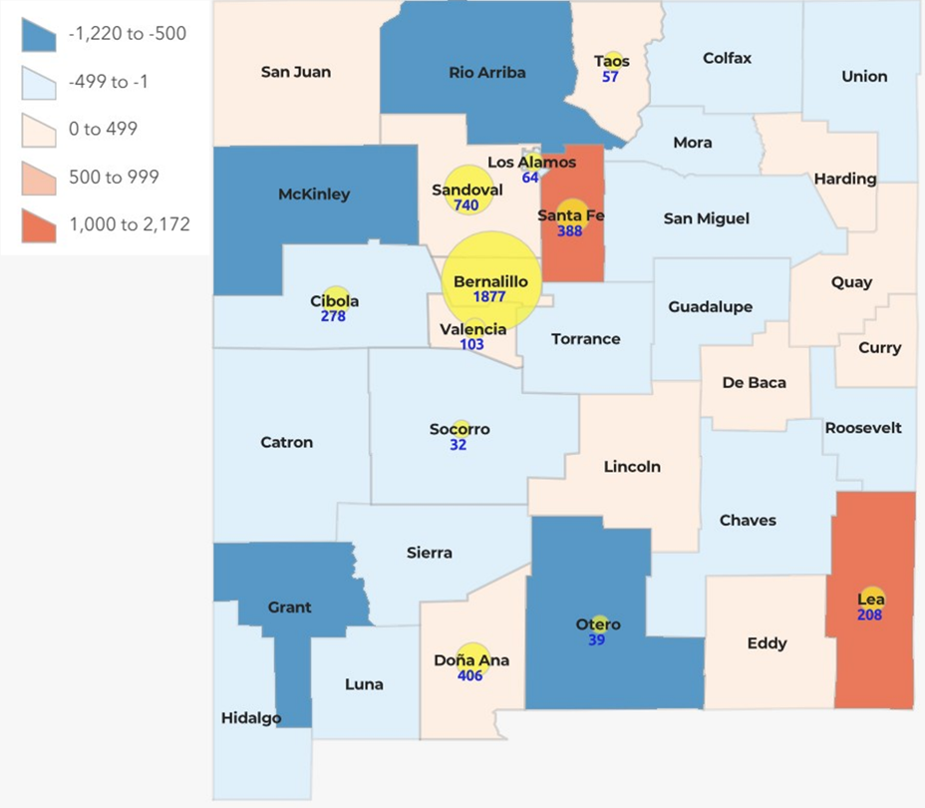
Where can the legislature go from here?
Direct investments in affordable housing—like New Mexico and localities have recently achieved—have the most immediate and targeted impact on affordable housing shortages.
Change in Rental Gap for Households Below 30% AMI and Tax Credit Units Produced by County, 2019-2023
Source: 2019 and 2023 5-year ACS, and Root Policy Research, Housing New Mexico.
The statewide rental gap for households below 30% AMI grew from approximately 32,000 units in 2019 to 34,000 in 2023.
Given the significant increase in rents, a widening of the gap was expected.
The growth of the rental gap is modest, which is reflective of the state’s efforts to add housing affordable to very low income households.
Notes:
It is important that the legislature is recognizing the multitude of factor that impact housing affordability, such as land use policy. And as other states implement such regulation, New Mexico can learn from what works and doesn’t work. And avoid any unintended consequences. In the meantime, we applaud the legislature for its commitment to direct investment in affordable, which yields the most immediate and targeted relief to the state’s most cost burdened households. Ensuring that this funding continues to be predictable, allows developers to plan and build a pipeline results in more affordable units for our residents.

Slide 17
Questions?
Robyn Powell
Senior Director
Policy & Planning Department
Email: rpowell@housingnm.org
7425 Jefferson St. NE, Albuquerque, NM 87109
Tel: 505-843-6880
www.housingnm.org
We Are Housing New Mexico
Notes:
George

