Slide 1


Housing New Mexico
MFA
2025 QAP Workshop
For 4% Applications
Housing Development Department

Slide 2

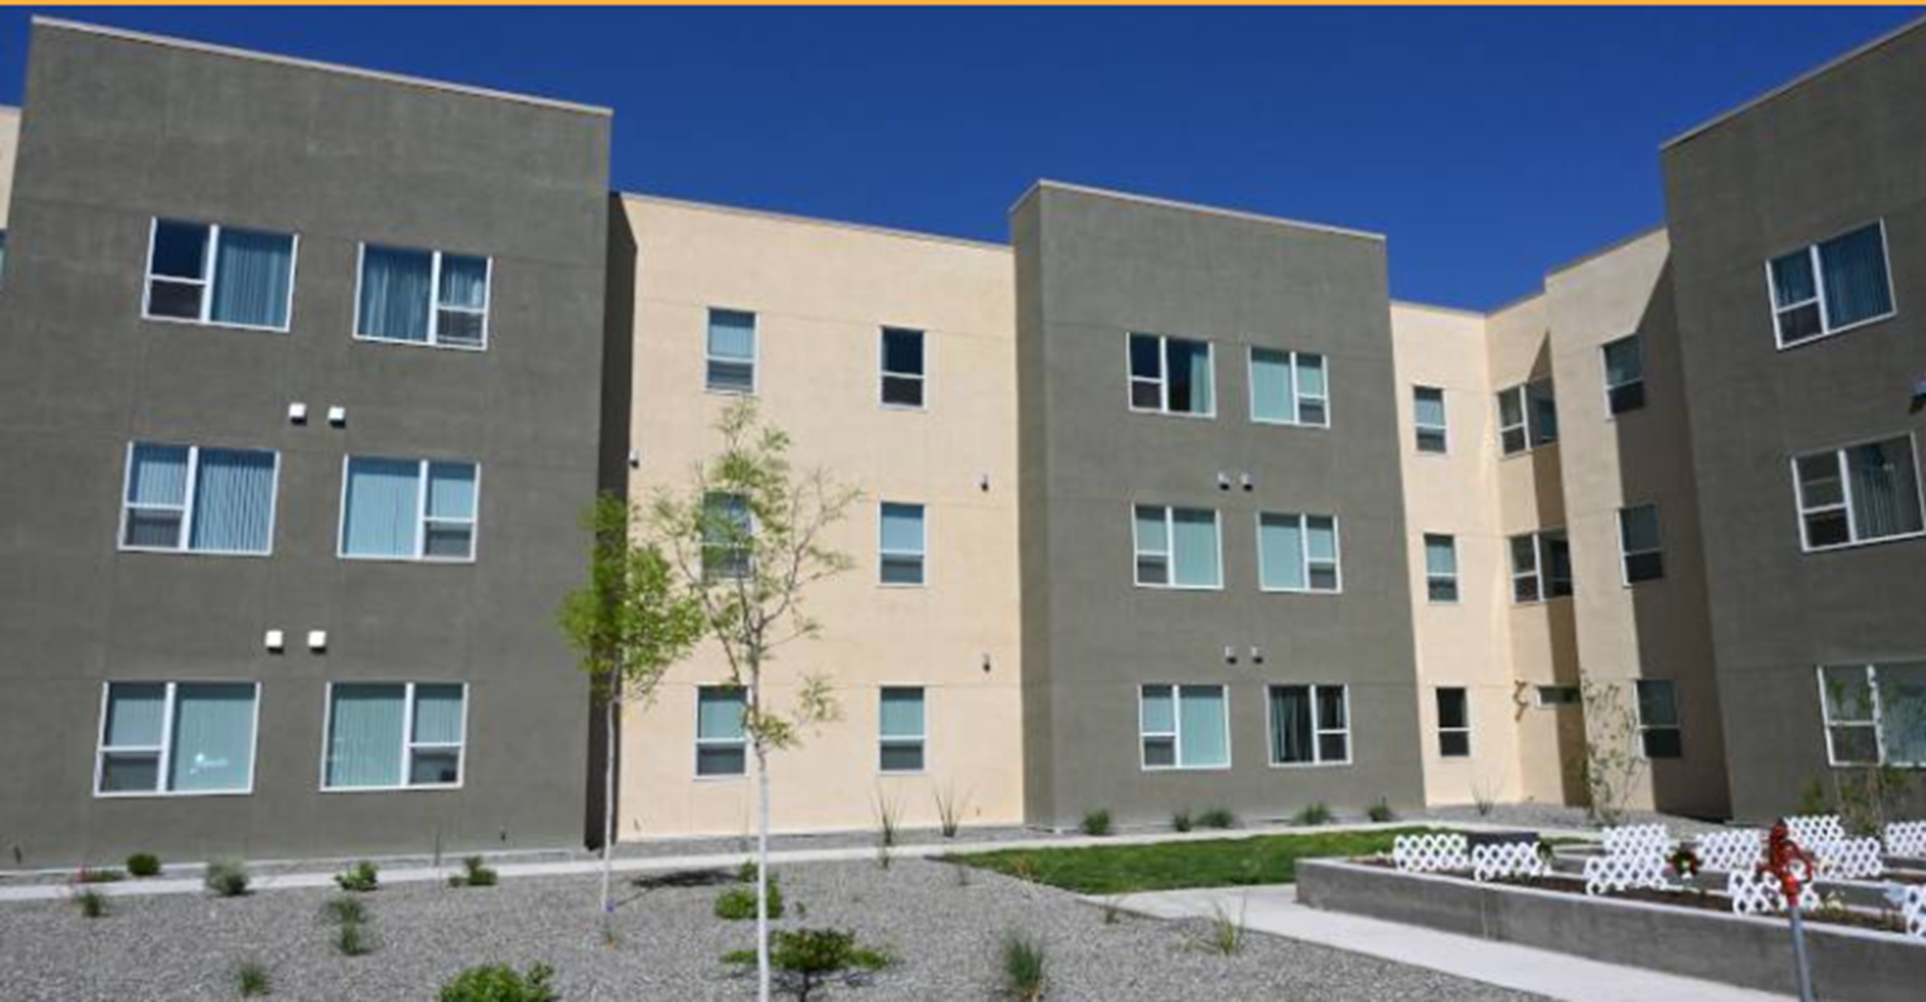
2025 Qualified Allocation Plan
1
4% Threshold Requirements
2
Rehabilitation
3
2025 QAP Review
4
2025 Application Process
5
Other Housing New Mexico Financing
6
Environmental Review Process
7
Tax Credit Compliance & Monitoring

Slide 3
Qualified Allocation Plan*
The QAP is the State of NM’s plan for allocating its tax credits.
It is prepared annually, consistent with IRC §42(m).
Approval Process – Approved by Governor.
https://housingnm.org/developers/lihtc/current-and-prior-tax-credit-rounds
Don’t forget about the FAQs as these are incorporated into the 2025 QAP by reference.
https://housingnm.org/developers/lihtc/lihtc-applications-faq-2025
*This information provides a summary and is not inclusive of all requirements in the 2025 QAP.

Slide 4

Tax-Exempt Bond Issuance
Mechanisms:
Private Activity Bond Volume Cap (PAB)
  most common because they come with 4% LIHTC
Refunding outstanding bond issues
Issuing new 501(c)3 bonds
Conduit issuer – loans from other sources
Process for PAB:
Apply for 4% LIHTC
Once approved, draft 42(m) letter provided
Inducement Resolution issued
Applicant prepares State Board of Finance (SBOF) application for Housing New Mexico to submit to SBOF for approval
TEFRA hearing
Bond Resolution to Housing New Mexico Board for approval
Closing

Slide 5
New in 2025
4% LIHTC Projects:
  15 minutes from Grocery Store in Master Plan
  Readiness preference when volume cap constrained at year end
  Limit on bond volume cap is 60% of aggregate basis
  Rent Comparability Study for HUD Post-Rehab Rents
  Simplified compliance affidavit
  ¼ mile distance between Projects by same Principal or Affiliate
Notes:
The Low-income housing tax credit program was started in 1986 by the IRS.
Housing Credit Agencies were designated by each state to manage the allocation of credits.
There are two types of credits available, 4% credits are “as of right” with the use of tax exempt bonds, and only cover around 30% of development costs and 9% credits, which cover around 70% of the development costs for a project, are highly competitive.
The 9%s are allocated to states based on population, and NM received about 6 million in 2024.

Slide 6
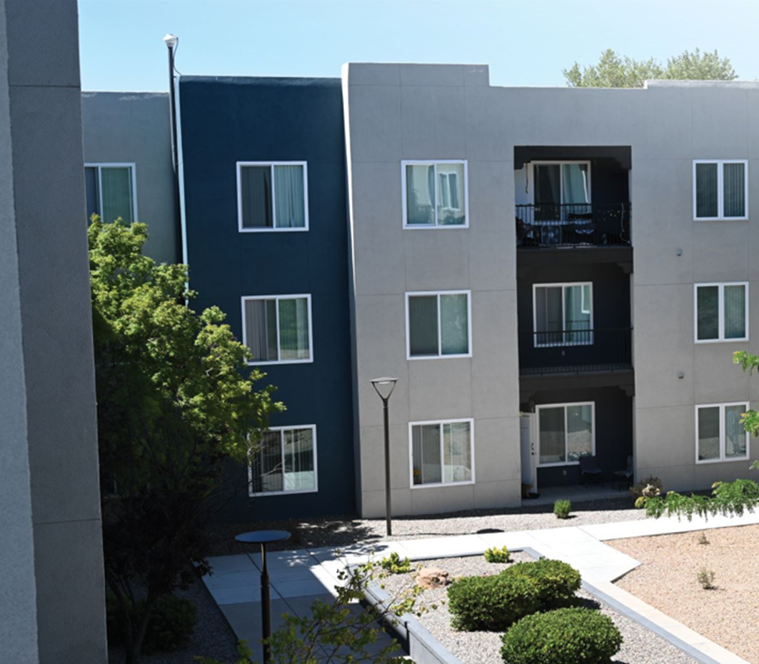
Threshold Requirements – Pre-Application
“Intent to Submit a Tax Credit Application and Development Synopsis” required for both:
  4% Applicants – 30 days prior to submittal
All Applicants are encouraged to meet with staff prior to submission.
Must receive a Draft 42(m) before applying for volume cap.

Slide 7
Threshold Requirements – Fees
All fees owed to MFA for all tax credit projects in which principal(s) participate must be current.
2025 Fees
Application fee $750 or $1,500
Design Review fee $12,000
Processing fee* of 8.5%
$50/unit monitoring fee, due annually
Income Averaging projects may be subject to increased monitoring fee
*Applicable if a reservation or final determination is received
Notes:
All principals for the project must be current on all MFA fees.
Application fee - $750 application fee for nonprofit or governmental entity Applicant and $1500 for a for-profit applicant
Due at initial application
Deposit for design review base fee
Due at initial application
Differences will be billed or refunded (due within 20 calendar days of MFA request)
Processing Fee
For 9%, due at execution of reservation contract
For 4%, due prior to delivery of letter of determination or construction start, whichever comes first
Monitoring Fee
Due annually by January 31st (or may be paid lump sum for the Compliance Period at the final allocation application)
$50/set aside unit/year
AI projects may be subject to an increase

Slide 8
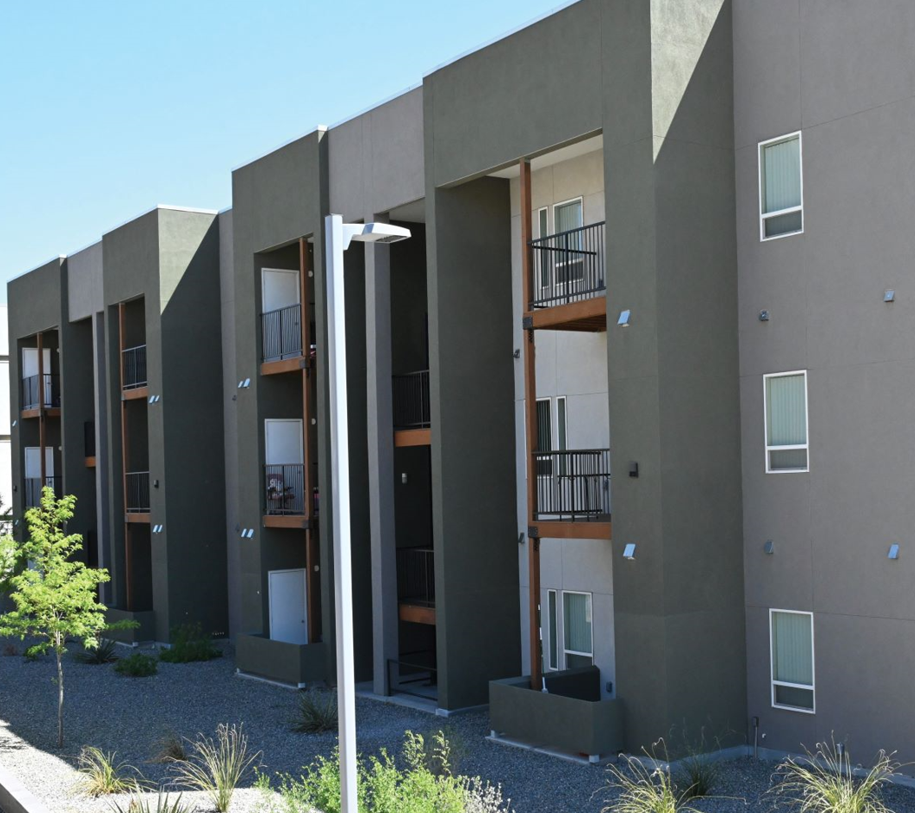
Threshold Items for Application
Site control
  legally enforceable purchase contract or purchase option, or
  written governmental commitment to transfer or convey the property to applicant by deed or lease (“transfer commitment”), or
  Recorded deed or recorded lease
Zoning
Fees
Market Study
Applicant eligibility
Financial Feasibility
Pre-Application Requirements (Intent/QAP Training)

Slide 9
Specific 4% Threshold Items
Serve a targeted population (Households with Special Housing Needs, Households with Children, or Projects Reserved for Seniors) and meet the applicable threshold requirements OR meet the requirements for the Underserved Populations set-aside, as described in Section III.D.
Achieve a Smoke-Free at Home Certification of Platinum or Gold;
Meet all of 2025 Mandatory Design Standards for Multifamily Housing (including HERS ratings), unless granted a waiver;
Must be located within a 15-minute drive (as demonstrated through Google Maps) to a facility in which fresh produce is available (or demonstrate that a full-scale supermarket within a 15-minute drive is part of an approved master plan to be developed);
Market Study must indicate a vacancy rate in the Primary Market Area of less than 10%;
Must market to local Public Housing Authorities;
Include a preference for Veterans in the Tenant Selection Criteria.
The level of rehabilitation (as applicable) must be at least a Moderate Rehabilitation as defined in the Glossary (Section XI of this QAP.)
Project must meet all Housing New Mexico/MFA underwriting standards in this QAP and the current Housing New Mexico/MFA Underwriting Supplement for Multifamily
Complete Application with De Minimis Errors
Notes:
Criterion 17
Projects that include the demolition of blighted building(s) or the remediation and reuse of a Brownfield site are eligible for points under this criterion.
Blighted building(s) must account for at least 10 percent of the project’s gross square feet.
To prove a building is blighted, applicants must submit a letter from the municipality that the building meets the QAP definition of “blighted building”. If that letter is not available, need third party report and other evidence the building is blighted, such as violations of local code, recorded covenants, conditions and restrictions or a condemnation notice from the public record. Also include photos of the blighted structure, neighborhood or area for MFA’s consideration whether the building is blighted.
Include a demolition budget
Brownfield – include Phase II Environmental Site Assessment, remediation budget and plan detailing the proposed work – Key question to remember is how are you mitigating health hazards to residents?

Slide 10
Threshold Requirements – Site Control
Three types of site control:
Fully executed purchase contract or option
Written governmental commitment to transfer property by deed or lease
Recorded deed or long-term lease
Transfer Commitment must:
Be binding on seller through initial term; and
Have names, legal description, and acquisition cost that match application.
Notes:
One of the major issues with underwriting is that we don’t see documentation that the earnest fees were paid.
If you are also applying for federal financing such as HOME, you may want to have a longer initial term, or rights to extend the purchase option or contract to provide time for the required environmental review prior to purchase, since that is a choice limiting action.

Slide 11
Site Control
Missing evidence of earnest deposit
  Copy of check or
  Receipt from Title Company
Names on purchase contract don’t match names on title report
Missing amendments to purchase and sale contract
  Need all amendments
Stale – in name of a previous owner (not owner listed in purchase contract)
Notes:
This section commits the project to be affordable for a certain number of years. Where is the applicant not reading the requirements?
Click – arrow for LIHTC compliance period
This applicant only includes the first 15 years in the compliance period.
Click – So the 15 years listed is incorrect.
Click - All applications need to include at least 30 years. The 15 year compliance period plus the 15 year extended use period. If points are requested for additional years of affordability, at least 35 years must be inserted here.
What else?
Click – The period of affordability for the National Housing Trust Fund is longer
Click – the minimum period of affordability is 30 years.

Slide 12
Threshold Requirements – Applicant Eligibility
All members of the development team of the proposed project must be in good standing with MFA and all other state and federal affordable housing agencies; and
Related party affidavits must disclose relationships (if any) between:
  Developer,
  Project Owner,
  General Partner,
  Contractor,
  Management company*,
  Consultant(s), and
  Architect
*Management company review deferred until construction
Notes:
All members of the development team of the proposed project must be in good standing with MFA and all other state and federal affordable housing agencies
Must also sign an affidavit affirming no related party relationships (See tab 1h of application).

Slide 13
Threshold Requirements – Financial Feasibility
Applications must demonstrate the project’s financial feasibility based on Housing New Mexico’s standards:
QAP Section IV.C.2, Section IV.D, and Section IV.E. summarize MFA’s financial feasibility considerations.
Additional Underwriting Details in the 2025 MFA Universal Initial Underwriting Supplement.
Must include 50 bps to interest on LOI for First Mortgage
Must pay off deferred developer fee by Year 15
Notes:
Applications must demonstrate, in MFA’s reasonable judgment, the project’s financial feasibility.
Section C.2 – Per Unit Cost Limits – will discuss on subsequent slide
Section D - Development costs
Compare development cost compared to average costs of competing projects and for rehab to your CNA
Section D – Fees
6%/2%/6% of construction costs for builder profit, overhead and general requirements
May be lowered in the case of identity of interest
Any amount of fee that exceeds the lesser of the limits established at Initial Application or the percentage limitations will be excluded from the Project’s Eligible Basis when calculating the tax credit allocation
Developer Fee – will go over in a future slide
Architect and Engineer Fees – capped at 3.3% of TDC
May be reduced further if previous design used
Exceptions may be granted in the MFA’s sole discretion
Section D - Reserves
Development budget must have an operating reserve equal to a minimum of six months of projected operating expenses, debt service payments and replacement reserve payments.
Replacement reserves must be shown in the operating budget at least $250/year for new construction senior housing and $300/year for all others.
Section D - DSC
Aggregate minimum debt service ratio of 1.20
Section D - Unit Distributions
All unit types must be distributed proportionately among each of the multiple tiers.
Section E – Tax Credit Proceeds
Will use more conservative of the equity pricing factor in your LOI or the equity pricing factor in the underwriting supplement
Need to see proof of financing (especially for grants or contributions)

Slide 14
Threshold Requirements – Financial Feasibility
Cost Limits
Based on average per unit and per square footage cost of new construction and adaptive re-use projects submitted in the round.
Purchase price attributed to land, costs related to commercial space, reserves and bond costs of issuance are excluded.
Tax Credits are awarded at 8609.
Notes:
Section C.2 - Cost Limits
Based on the per unit and square footage costs of new construction/adaptive reuse projects submitted in the round (NOTE – TDC excludes land, developer fees, consultant fees, commercial space costs and reserves AND units include manager and employee units, which really are considered common space)
As a reminder, the average TDC per unit for new construction was $289,529 at application in 2023.
And as an aside here- include any proposed manager or employee units as low-income units in the application. After the project is placed in service you may request managers or employee units through Asset Management. This way the management unit is not locked in and can float as needed for the property.
New construction and adaptive reuse projects – TDC per unit and square foot cannot exceed 130% of weighted average TDC cost per unit and square foot for new construction/adaptive reuse projects submitted in the round
Acq/rehabilitation – TDC per unit and square foot cannot exceed 100% of weighted average TDC cost per unit and square foot for new construction/adaptive reuse projects submitted in the round
Combined rehab/new construction/adaptive reuse projects – TDC per unit and square foot costs will be evaluated separately by category

Slide 15
4% Threshold Requirements – Market Study
Applications must contain a market study that meets the following criteria:
Was completed by a vendor meeting the requirements agreed upon in the Market Study Professional Certification document
Follows the methodologies identified in the Market Study Parameters
Issued no earlier than 180 days prior to the Application submission
The rent burden (rent plus utility allowance, if any) may not exceed 30% of gross income at each income strata proposed
The overall Vacancy Rate for a Project must not exceed 10%
Notes:
The required market study submitted at application must meet certain criteria. [go over criteria]. More information in QAP. All application materials have been posted.

Slide 16
Threshold Requirements for Fresh Produce
Notes:
Criterion 2
Proximity is services is 2 points and must include access to fresh produce (if in a rural or tribal category you need to submit evidence of how you qualify)
Access to public transportation is 2 points and based on walking distance to a commuter bus or rail stop.
Alternative forms may be acceptable (projects on tribal land with established “on call” transportation programs are eligible)
Access to frequent transportation is eligible for 4 points. Public transportation must be established and provided on a fixed route with frequent scheduled service (defined as: any series of three or more single direction stops more frequent than every 1 hour, Monday - Friday).

Slide 17
2025 Qualified Allocation Plan
1
4% Threshold Requirements
2
2025 QAP Review
3
2025 Application Process
4
Other Housing New Mexico Financing
5
Environmental Review Process
6
Tax Credit Compliance & Monitoring

Slide 18
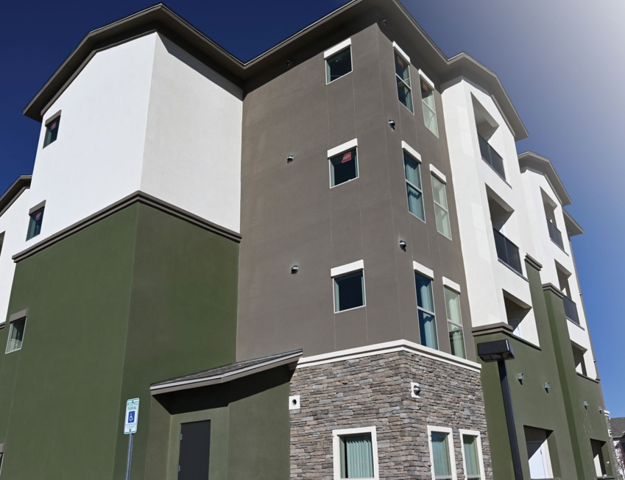
Rehabilitation Criteria
Rehabilitation Projects
Scope of work required at Application
Cost thresholds for moderate/substantial rehab
Detailed narrative + prelim relocation plan due
Information on existing debt for feasibility analysis
Capital Needs Assessment
Notes:
Criterion 3
To be eligible for points, more than 21 - 29 years must have elapsed since: 1) issuance of certificates of occupancy; or 2) the units were Placed in Service and/or 3) since the Project’s prior rehabilitation utilizing tax credits as a source of funding was finished and those units were Placed in Service.
Points are given based on how much you exceed this minimum requirement.
At initial application, you must submit a 1) Scope of work, 3) detailed narrative, 4) preliminary relocation plan, and 5) information about any existing debt on the property or Project that will be assumed or paid with LIHTC equity or an MFA-administered funding source.
Projects must incur average rehabilitation construction costs of $25,000 per unit or more for moderate rehabilitation or $45,000 per unit or more for substantial rehabilitation.
Non-scoring requirements, such as Capital Needs Assessment are listed in Section II.J on pages 9-11 of the redlined QAP.. Projects that don’t qualify for points because they are financed with private activity bonds or were placed in service less than 20 years ago need to submit the capital needs assessment with the application.

Slide 19
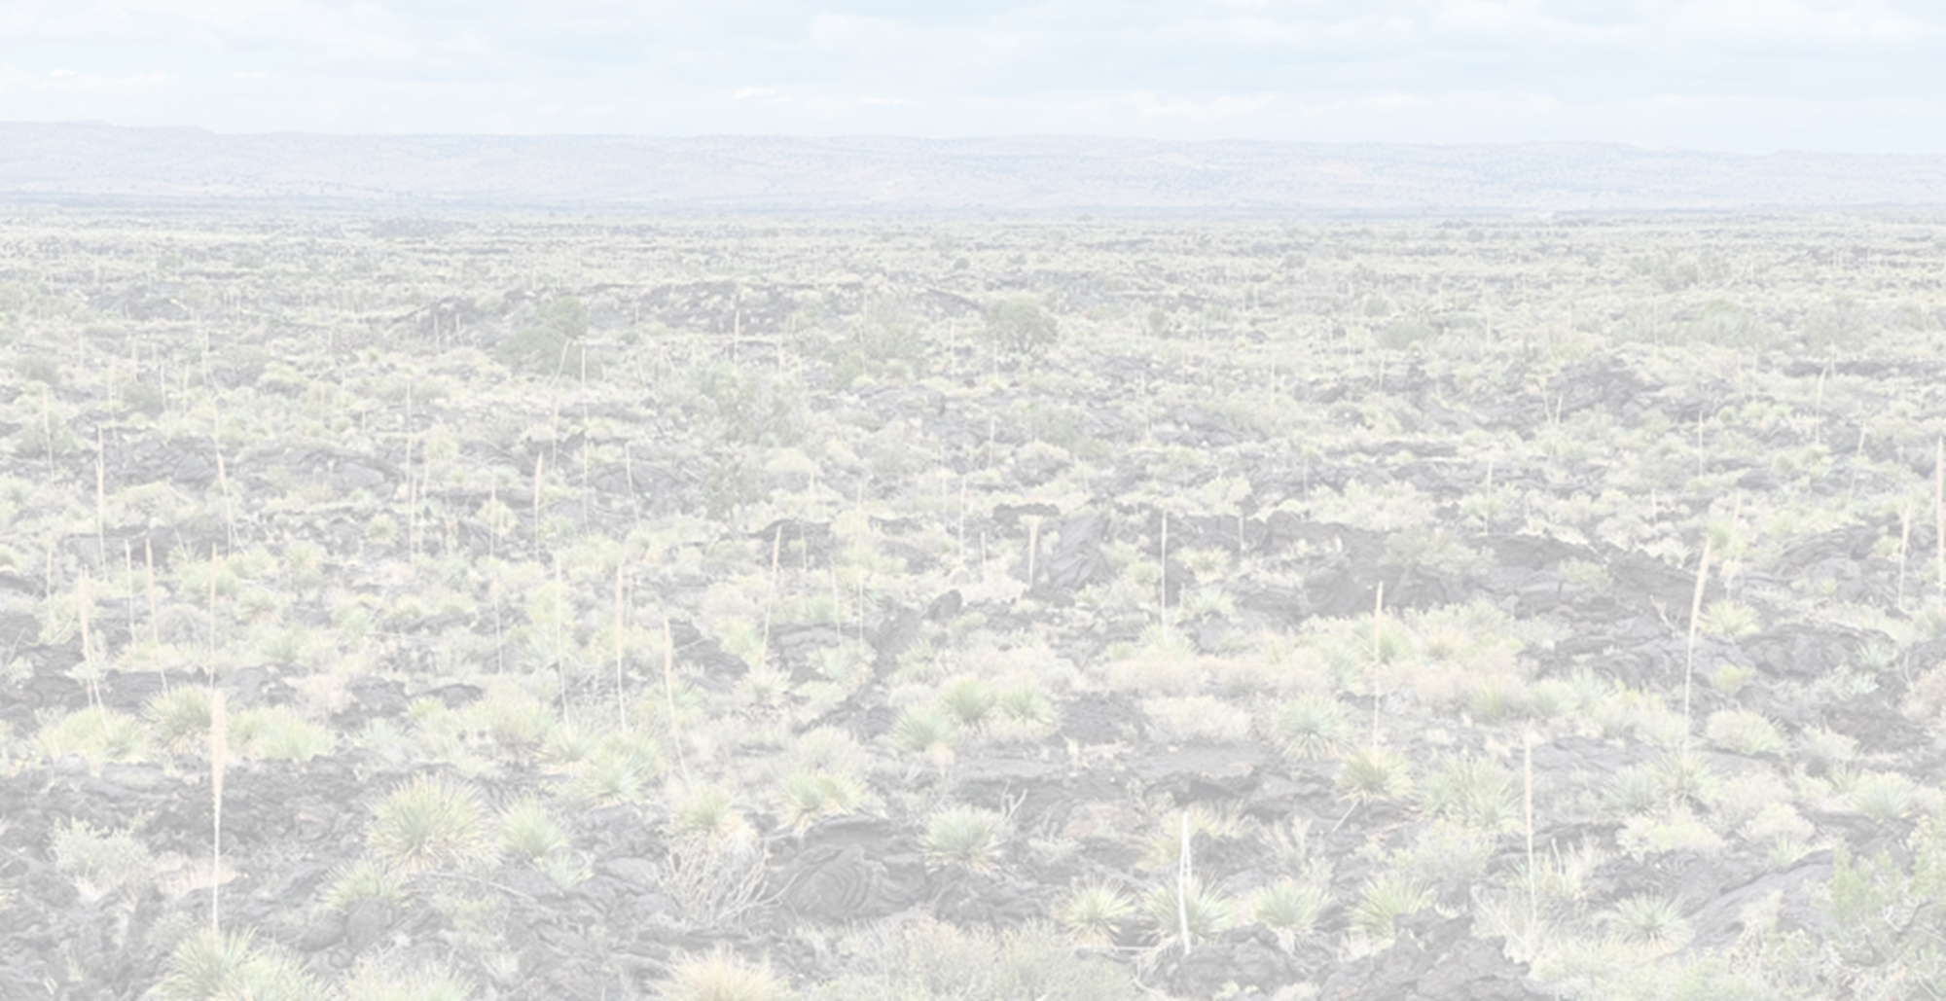
Rehabilitation Eligibility Worksheet
Notes:
- The application workbook includes a checklist – this is not all inclusive – please read the QAP
Changes are shown in red font this year
Phase I Environmental Review is not included in the LIHTC application, but may be required for MFA gap financing

Slide 20
Rehabilitation – Project Based Voucher Rents
Documents Utilized for PBV Rents
Underwrite HUD Post-Rehab Rents:
Rent Comparability Study
those utilizing a conversion of existing federal rental assistance (e.g., RAD)
HUD Comfort Letter
Underwrite Current HUD Rents:
Provide documentation of current OCAF-based rents, or
Published payment standard

Slide 21
Income & Rent Set Asides
Choose one set aside:
20/50 – At least 20% of the residential units in this development are rent-restricted and to be occupied by households with incomes at 50% or less of area median income; OR
40/60 - At least 40% of the residential units in this development are rent-restricted and to be occupied by households with incomes at 60% or less of area median income; OR
For Average Income (AI)* - At least 40% of the residential units in this development are rent and income restricted and the average income limit for all tax credit units in the Project is at 60% or less of area median income;
Market Units are not allowed when choosing the Average Income set aside.
*Average Income projects must have at least 5% of the low-income units above 60% AMI
Notes:
Average Income projects must have at least 5% of the low-income units above 60% AMI to qualify for this scoring criterion.

Slide 22
Market Rate Units
Market Rate Units
Minimum 15% of the total units.
If Average Income election under §42(g)(1)(C) cannot include Market Rate units.
Market Rate/Unrestricted Units should not include management units. Employee/Exempt Units are approved by Asset Management after PIS/8609, NOT AT APPLICATION. they may be included as revenue or non-revenue restricted Units.

Slide 23
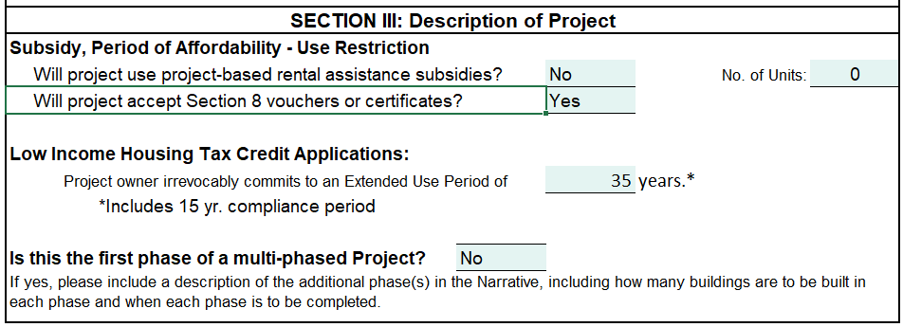
Affordability Period
Extended Use Period includes 15 Year Compliance Period:
30-year Extended Use Period
35-year Extended Use Period
Permanent Affordability
Indicate on Page 1 of Tab 2 (Application form)
Notes:
Criterion 7
15 year initial Compliance Period and a 20 year Extended Use Period for a total of 35 years.

Slide 24
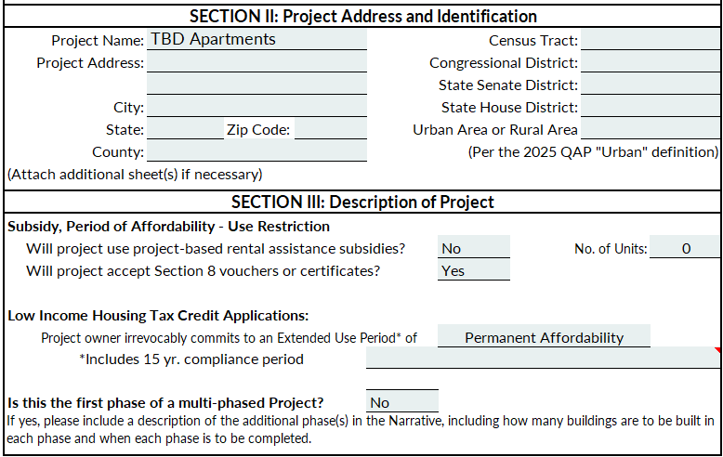
Permanent Affordability & Multi-phase QCT
Select Dropdown Here
Explain “other” here
Important for QCT if multi-phase
Notes:
- The application workbook includes a checklist – this is not all inclusive – please read the QAP
Changes are shown in red font this year
Phase I Environmental Review is not included in the LIHTC application, but may be required for MFA gap financing

Slide 25
Special Housing Needs Requirements
Special Housing Needs
20% of the units reserved for special housing needs households and services provided (to be eligible at least 10% of units restricted at 30% AMI or permanent rental subsidy support)
Threshold: Service Coordination Certification plus at least 2 services + proposed budget
MOU – who and how services delivered; update
Additional Services are not required
Related party service provider – expertise narrative
Notes:
Must meet minimum set aside requirements in terms of unit mix and provide some baseline services (must provide a service coordination certification and proposed budget).
If you select this criterion you can get up to 8 points for providing additional services outlined in the QAP
Can get points for other types of services but must be approved by the MFA in writing one month before the application due date.
Services begin immediately when first resident moves in – this is because it is assumed that residents need supportive services to maintain their housing
- Participation in the Underserved Populations set-aside for providing permanent supportive housing does not automatically mean points in this scoring criterion. Services must be selected and all requirements met for points to be obtainable.

Slide 26
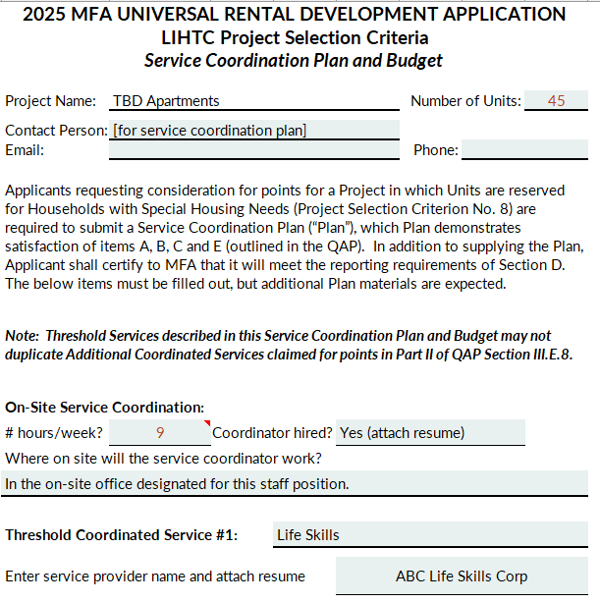
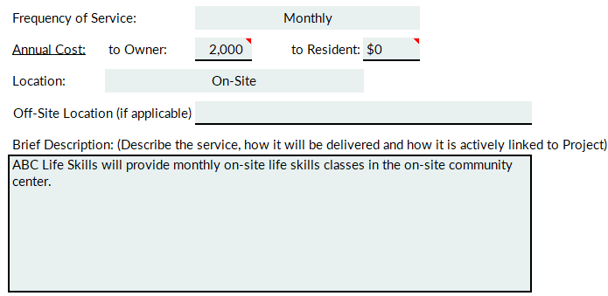
Special Housing Needs Service Coordination
Include MOU between Owner and Third-Party Service Provider OR Narrative detailing experience and planned services from affiliated service provider
Marketing Narrative explains how units will be marketed to targeted population
Notes:
- The application workbook includes a checklist – this is not all inclusive – please read the QAP
Changes are shown in red font this year
Phase I Environmental Review is not included in the LIHTC application, but may be required for MFA gap financing

Slide 27
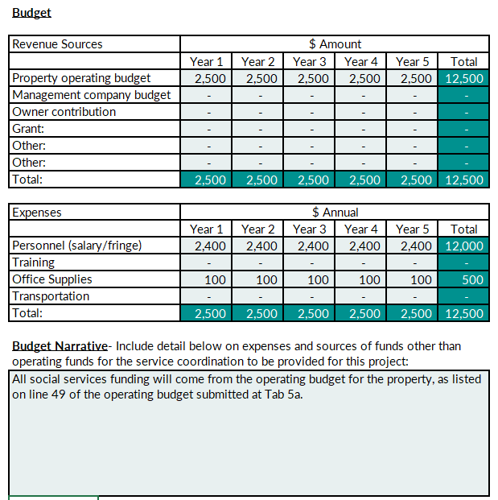
Special Housing Needs Budget
Budget for Supportive Services must balance
Must include Personnel expenses
Explain sources other than operating budget.
Notes:
- The application workbook includes a checklist – this is not all inclusive – please read the QAP
Changes are shown in red font this year
Phase I Environmental Review is not included in the LIHTC application, but may be required for MFA gap financing

Slide 28
Senior Households
Senior Housing
80% @ 55+ or 100% @ 62+ of total units reserved for Senior Housing.
The project must meet the requirements on page 38 and provide a description of the Project’s specific design elements that service the needs of Seniors (Tab 20a)
The Project must qualify for an exemption from familial status discrimination under the Fair Housing Act, submit a Fair Housing Act Certification for Senior Housing Facilities (Tab 20b) and meet Housing NM/MFA’s Mandatory Design Standards as described on page 38 .
The project must comply with Fair Housing Requirements as described at the bottom of page 38 and on page 40.
Supportive services are not required. If the applicant elects to provide non-required services, the project must conform to the requirements stipulated on pages 40-41 regarding any fees and other documentation regarding the elective services.
Notes:
Review first two bullets for set aside
If you meet unit reservation requirement along with the design requirements for this category, you are eligible to receive points though the selection of services.
you must have a service coordinator (who is in addition to the property manager) that is on site for a minimum of two days a week.
The social services that would receive additional points are listed in the QAP and in the project application.
Can get points for other types of services but must be approved by the MFA one month before the application due date.
The project must have an annual operating budget that includes at least $2,500 for the provision of social services.
If you are opting for the senior housing priority, you must fill out the senior housing certification form in the application packet.
Services must begin within 90 days of construction completion.

Slide 29
Households with Children
Households with Children
At least 25% of the total units reserved for Households with Children.
The project must meet the requirements in the Design Standards and on page 42 of the QAP. Provide the description of the Project’s specific design elements that serve the needs of Households with Children.
Supportive services are not required. If the applicant elects to provide non-required services, the project must conform to the requirements stipulated on pages 43-45 regarding any fees and other documentation regarding the elective services.
Notes:
Review first two bullets for set aside
If you meet unit reservation requirement along with the design requirements for this category, you are eligible to receive points through the selection of services.
you must have a service coordinator (who is in addition to the property manager) that is on site for a minimum of two days a week.
The social services that would receive additional points are listed in the QAP and in the project application.
Can get points for other types of services but must be approved by the MFA one month before the application due date.
The project must have an annual operating budget that includes at least $2,500 for the provision of social services.
Services must begin within 90 days of construction completion.

Slide 30
Market Units to PHA or Tribal Entity
Commitment to marketing units to public housing authority waiting lists
Include letter to PHA or Tribally Designated Housing Entity committing to market units to their waitlist
Notes:
Criterion 13
Need a letter to the Housing Authority or Indian Agency committing to market units to their waitlist.

Slide 31
QCT or DDA
QCT or DDA Requirements for 130% Boost
Evidence required at initial application and PIS/8609 submission
Must be in a QCT/DDA for the QAP application year
State Designated Boost not applicable
Acquisition costs not eligible for the boost
Multi-phase projects must be detailed in Phase I application

Slide 32
Non-Smoking Threshold Requirement
Non-Smoking Properties
Smoke Free at Home program:
  Platinum certification = New Construction
  Gold certification = Rehabilitation or Adaptive Reuse
Notes:
PLATINUM New property that does not allow smoking anywhere on the property.
GOLD Rehab or Adaptive Reuse that does not allow smoking anywhere on property
SILVER No smoking in units, common areas, or within 25 feet of any entrance or window.
Whole process to get certified Visit smokefreeathomenm.org for more information. Certification required at 8609 request.
Be careful when you check the box to make sure your project qualifies – don’t check a box for rehabilitation if a new construction project

Slide 33
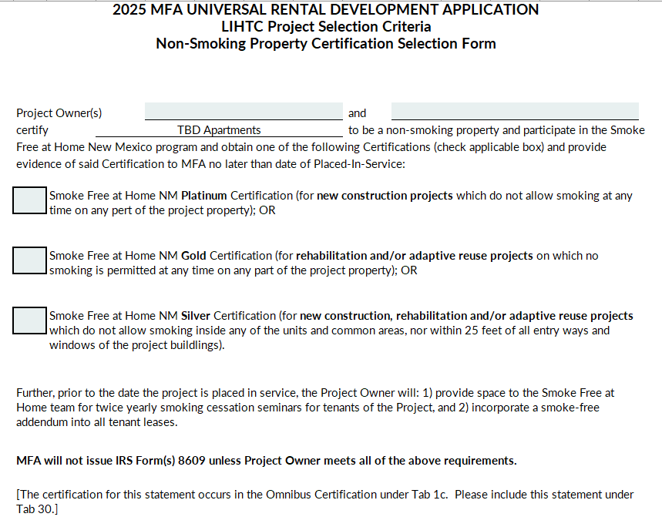
Non-Smoking Certification
Notes:
- The application workbook includes a checklist – this is not all inclusive – please read the QAP
Changes are shown in red font this year
Phase I Environmental Review is not included in the LIHTC application, but may be required for MFA gap financing

Slide 34
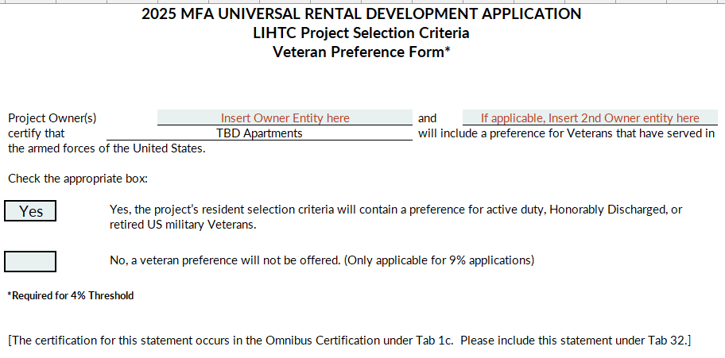
Veteran’s Preference
Other materials in Application must be consistent with this selection.
This form required for threshold for 4% LIHTC Projects
and for 9% LIHTC Points
Notes:
- The application workbook includes a checklist – this is not all inclusive – please read the QAP
Changes are shown in red font this year
Phase I Environmental Review is not included in the LIHTC application, but may be required for MFA gap financing

Slide 35
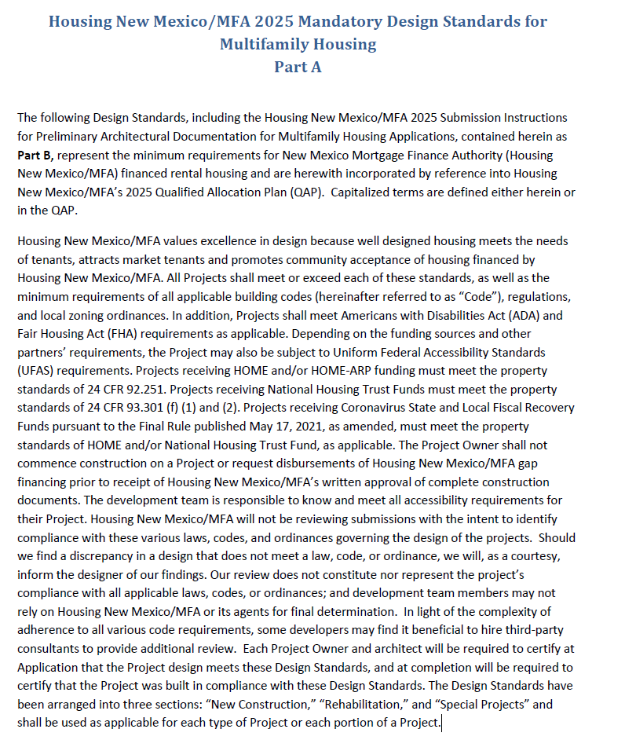
Mandatory Design Standards
Conceptual Plans reviewed with Application
Permit-Ready Plans reviewed before construction
Must receive Housing New Mexico written approval before beginning construction and before receiving 8609s
Notes:
A very important document to review and make sure your application is addressing is the Mandatory Design Standards for Multifamily Housing. There are two parts to this document. The first part discusses the requirements for any design receiving MFA funding. The second part goes through the documentation required for application and what will be required going forward through construction.

Slide 36
Mandatory Design Standards
Separate sections for new construction, rehab and special projects (i.e., single room occupancy and adaptive reuse).
Sub-sections on general design, site design and development, building design and construction, unit design.
Updated yearly and posted on Housing NM’s website.
Housing New Mexico:
  Reviews and approves plans, and
  Inspects the Project for compliance

Slide 37
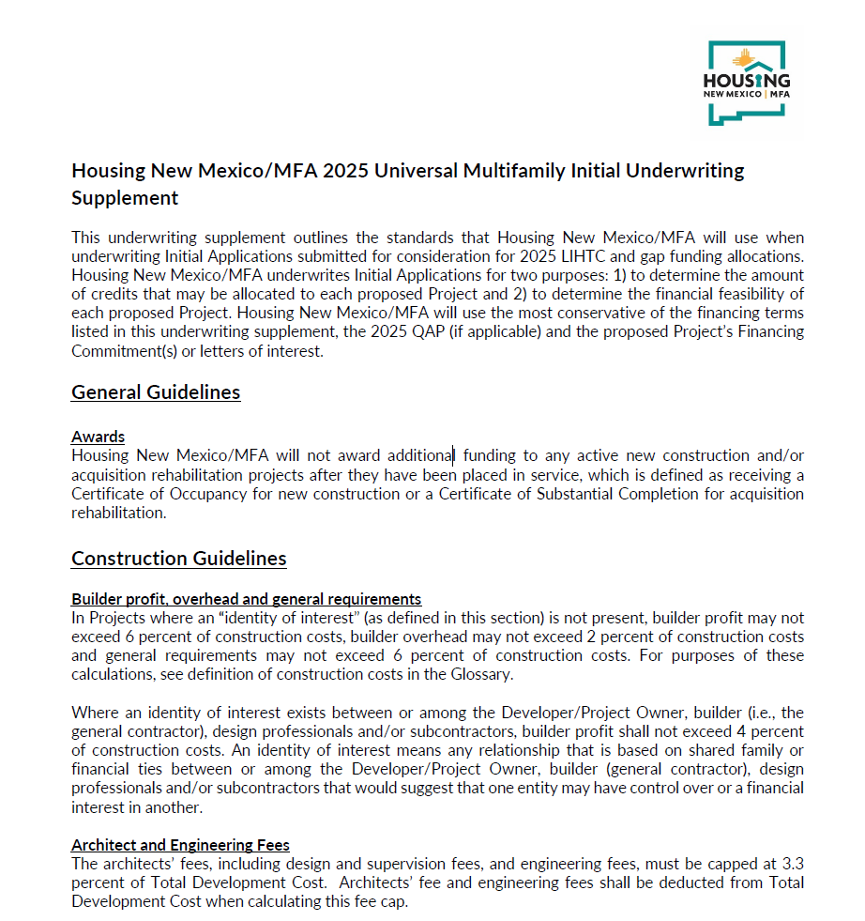
Underwriting Supplement
All Applications must meet Underwriting Supplement Standards
Specifics for gap financing included
Financial Feasibility can’t be corrected with a Deficiency Correction – read this document carefully alongside the QAP
Notes:
There document incorporates and clarifies requirements for underwriting at initial application for LIHTC and gap sources. This document should be reviewed meticulously before submitting an application.
I’ll go through some of the highlights that, but please make sure to examine this document before submitting an application. It is on the website under all the relevant funding sources, along with the universal rental development application.

Slide 38
2025 Qualified Allocation Plan
1
4% Threshold Requirements
2
2025 QAP Review
3
2025 Application Process
4
Other Housing New Mexico Financing
5
Environmental Review Process
6
Tax Credit Compliance & Monitoring

Slide 39
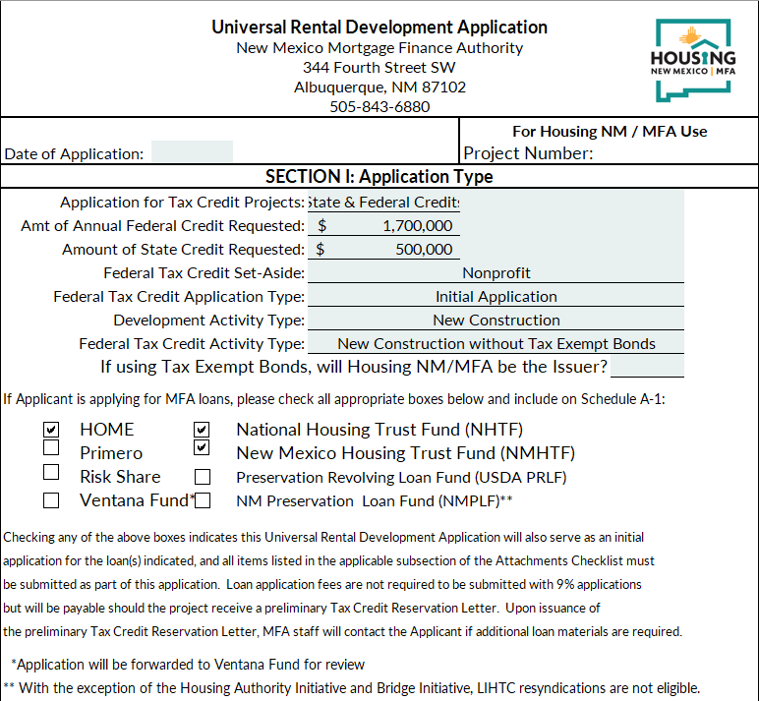
Application Review
Universal Rental Development Application
LIHTC
HOME
NHTF
NMHTF
Risk Share
NM State Tax Credits
Primero
Ventana Fund*
*Ventana Fund - not Housing New Mexico/MFA funds
Notes:
There document incorporates and clarifies requirements for underwriting at initial application for LIHTC and gap sources. This document should be reviewed meticulously before submitting an application.
I’ll go through some of the highlights that, but please make sure to examine this document before submitting an application. It is on the website under all the relevant funding sources, along with the universal rental development application.

Slide 40

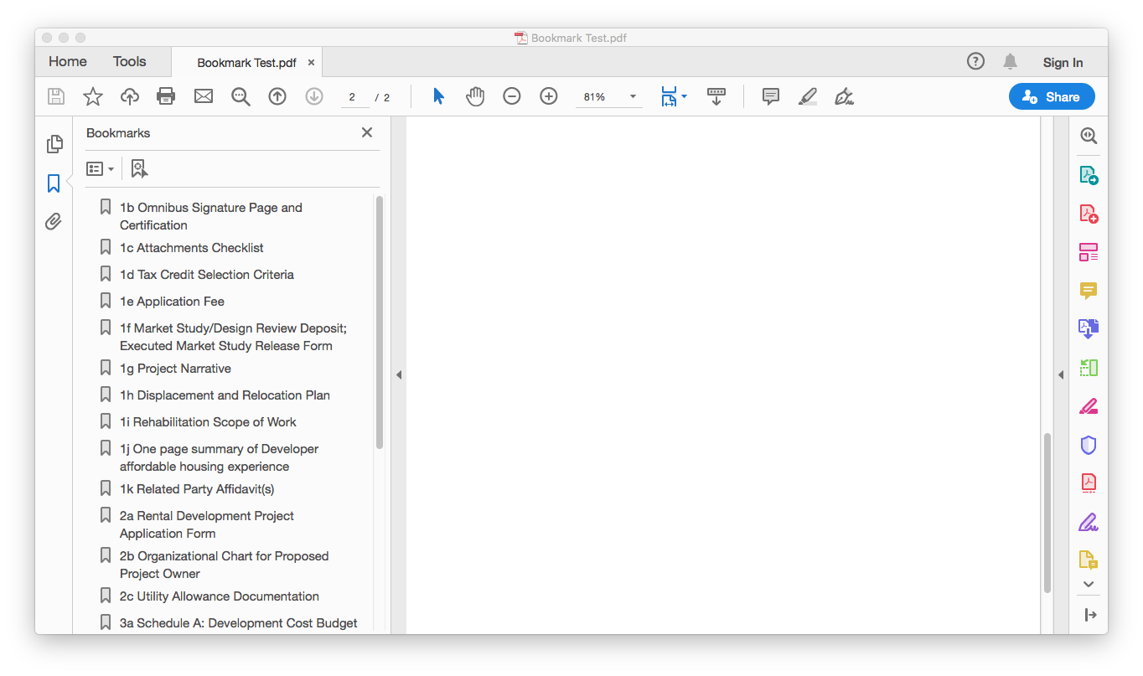
Application Form of Submission
“one fully tabbed PDF file bookmarked with each applicable tab and named to match the Attachments Checklist” and Excel Worksheets

Slide 41
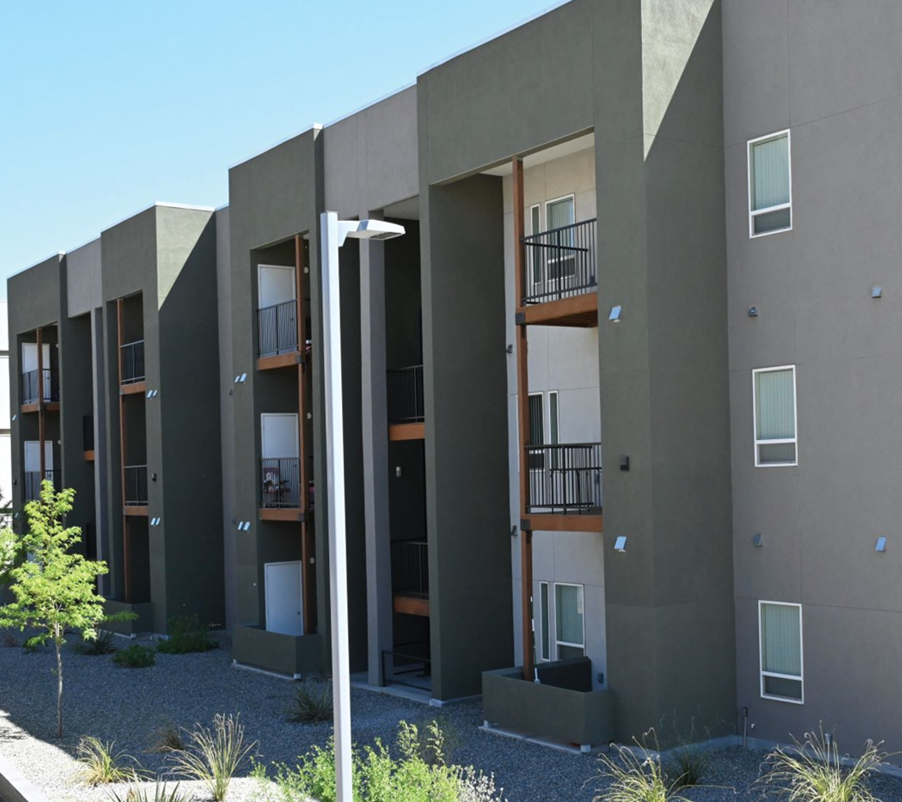
Application Form of Submission
The following documents are to be uploaded as separate files:
Market Study
Appraisal
Capital Needs Assessment
Architectural Plans and Specifications
Upload all to Secure File Transfer:
https://mfa.internal.housingnm.org/SFT_HD/

Slide 42
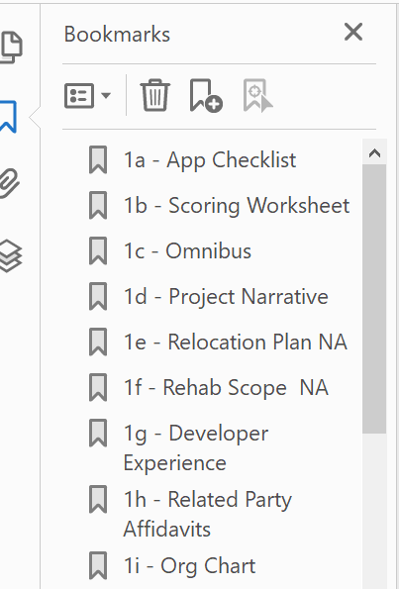
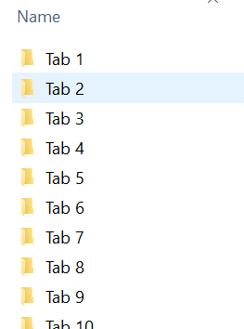
✓
Make sure that you have the Excel File, the Market Study, Architectural plans, CNA and the PDF uploaded
Notes:
The QAP requests one PDF file that is bookmarked with each applicable tab and named to match the Attachments Checklist. Can someone tell me which of these is done correctly?
Answer from audience.
Click
The one on the right is separate files – not all one pdf
Click
The one on the left is done correctly – it is one pdf; it is bookmarked by tab in the application

Slide 43
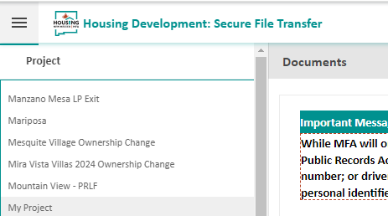
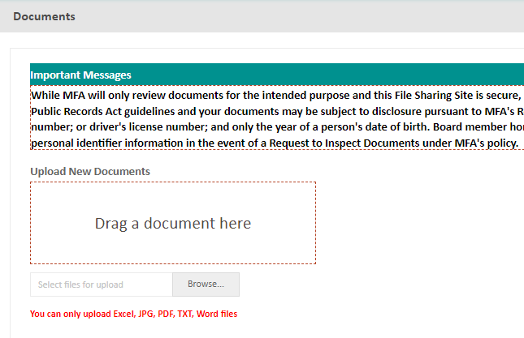
Low-Income Housing Tax Credits
Register for account – your project assigned to your account
https://mfa.internal.housingnm.org/SFT_HD/
Notes:
Select the correct project – don’t upload to another project that you are working on
Contact us if you have issues.

Slide 44
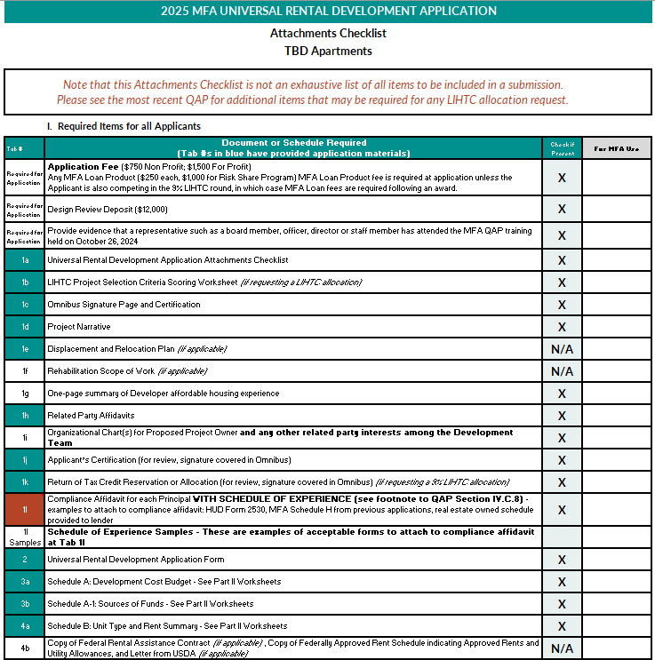
Application Checklist
Notes:
- The application workbook includes a checklist – this is not all inclusive – please read the QAP
Changes are shown in red font this year
Phase I Environmental Review is not included in the LIHTC application, but may be required for MFA gap financing

Slide 45
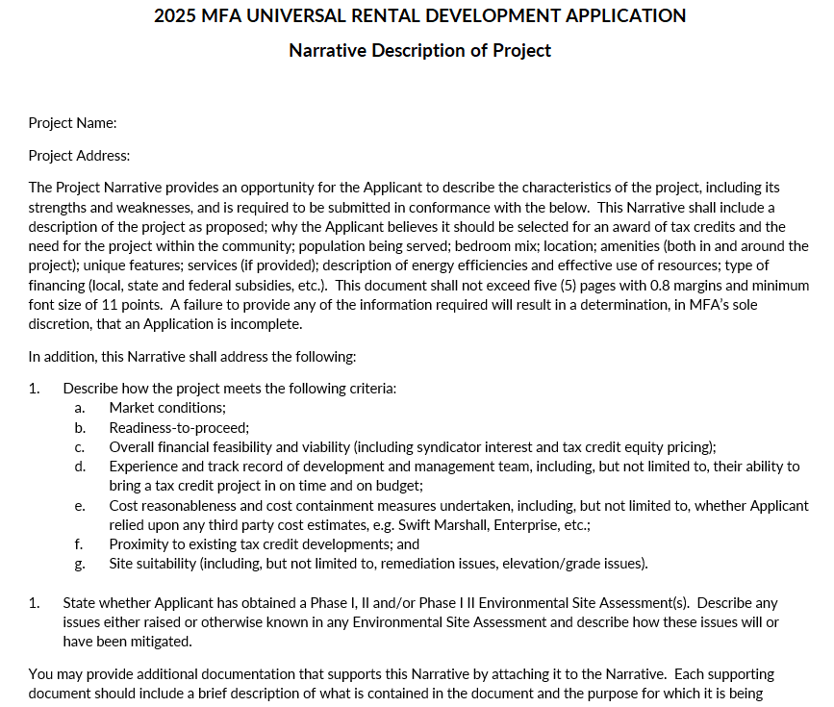
Project Narrative
Include all information requested
Place on letterhead and scan
Notes:
- The application workbook includes a checklist – this is not all inclusive – please read the QAP
Changes are shown in red font this year
Phase I Environmental Review is not included in the LIHTC application, but may be required for MFA gap financing

Slide 46
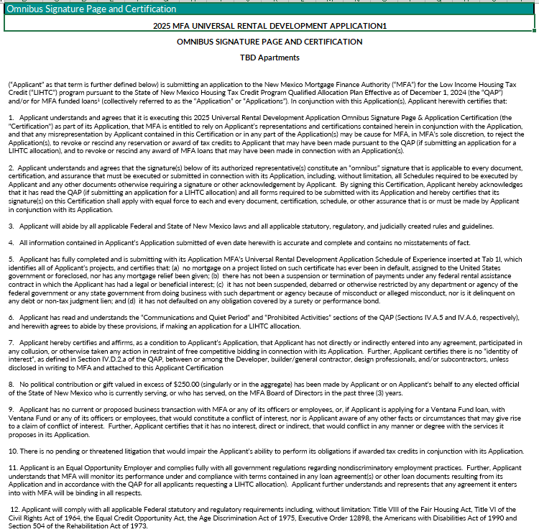
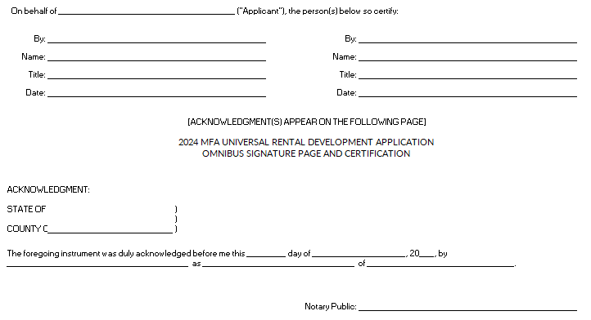
Omnibus Signature Page and Certification
Must be signed by principal of each entity that is part of Owner entity
Not syndicator
Blue ink and scan
Must be notarized
Notes:
- The application workbook includes a checklist – this is not all inclusive – please read the QAP
Changes are shown in red font this year
Phase I Environmental Review is not included in the LIHTC application, but may be required for MFA gap financing

Slide 47
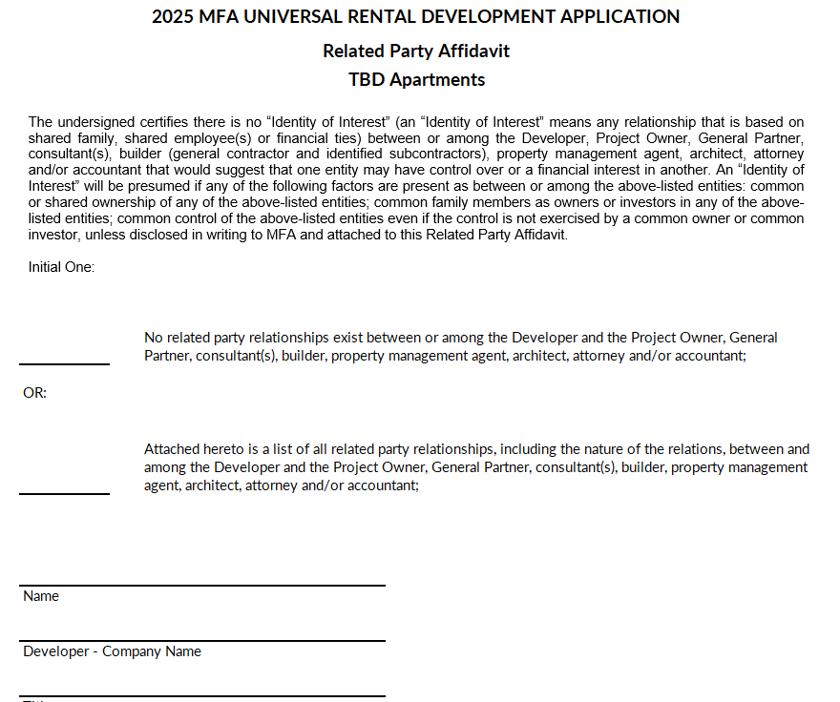
Related Party Affidavit
The following members of the development team (see bottom of page 21 of QAP for list) are required to complete the applicable form:
  Developer
  Project Owner(if formed)
  General Contractor
  Consultant(s)
  Architect
Show Related Parties with Visual Diagram, if applicable
Notes:
- The application workbook includes a checklist – this is not all inclusive – please read the QAP
Changes are shown in red font this year
Phase I Environmental Review is not included in the LIHTC application, but may be required for MFA gap financing

Slide 48
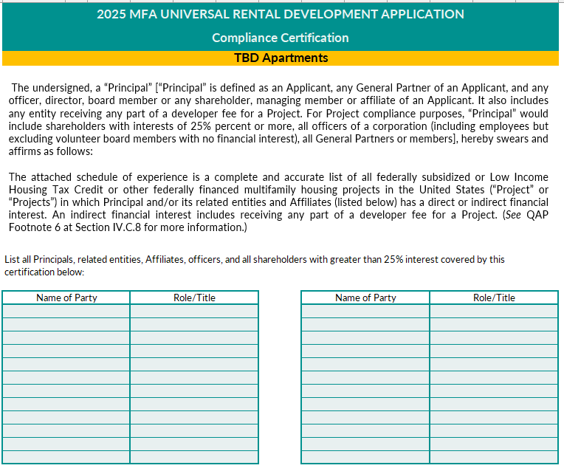
Compliance Certification
Form simplified this year
Insert at Tab 1l
Insert Schedule of Experience behind Compliance Affidavit
If one of the Principals, related entities, Affiliates, officers, or shareholders have a different schedule of experience, they must fill out a separate compliance certification and insert their schedule of experience behind it
Notes:
- The application workbook includes a checklist – this is not all inclusive – please read the QAP
Changes are shown in red font this year
Phase I Environmental Review is not included in the LIHTC application, but may be required for MFA gap financing

Slide 49
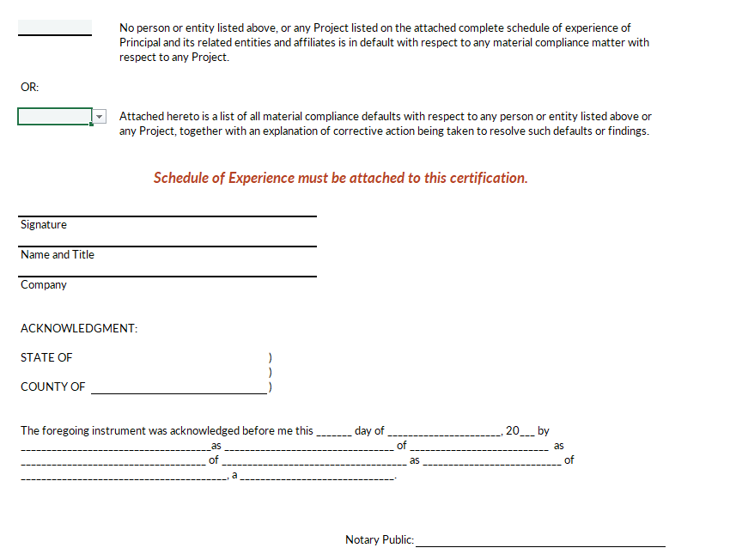
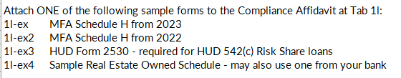
Compliance Certification
Notes:
- The application workbook includes a checklist – this is not all inclusive – please read the QAP
Changes are shown in red font this year
Phase I Environmental Review is not included in the LIHTC application, but may be required for MFA gap financing

Slide 50
Organization Chart
Owner Entity
Developer
51% GP
49% GP
LP
Insert behind Related Party Affidavits at tab 1i
Proposed Owner Entity and
Any other related party interests among Development Team
Notes:
- The application workbook includes a checklist – this is not all inclusive – please read the QAP
Changes are shown in red font this year
Phase I Environmental Review is not included in the LIHTC application, but may be required for MFA gap financing

Slide 51
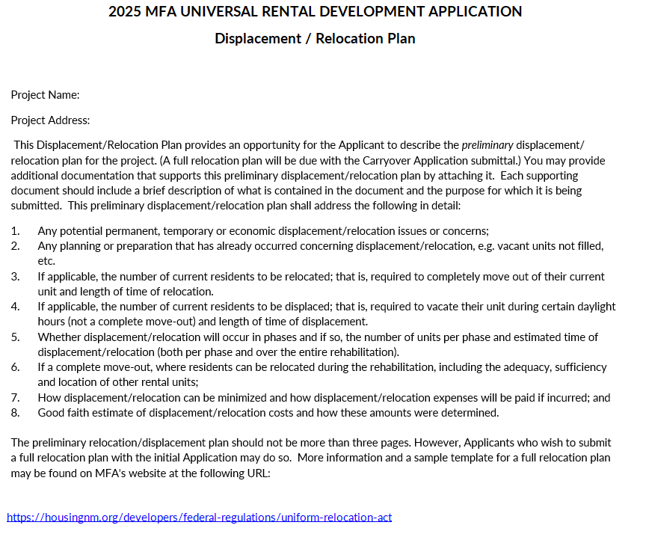
Displacement/Relocation Plan
Include all information requested
Place on letterhead and scan
4% Applications –
  Final Plan Required with Initial Application
Notes:
- The application workbook includes a checklist – this is not all inclusive – please read the QAP
Changes are shown in red font this year
Phase I Environmental Review is not included in the LIHTC application, but may be required for MFA gap financing

Slide 52
Financial Feasibility
Credit cannot exceed amount MFA determines is necessary for financial feasibility and long-term viability as low-income housing.
MFA must consider:
  All sources and uses of funds;
  Equity from Credits; and
  Reasonableness of development and operating costs.
Evaluation occurs two times (application and completion/8609’s).
Underwriting supplement updated and posted- there are limits on developer and builder fees, operating expense projections, reserve requirements

Slide 53

General Contractor’s Cost Certification
Not required for Stipulated Sum Contracts
Not required for Maximum Guaranteed Price Contracts
Actual costs incurred by the GC
Fully completed
  Vendor names
  Relationship between parties
  Invoices
  Payroll Details
  Cancelled Checks
  Lien Release Waivers
Notes:
MFA also requires a general contractor’s cost certification that rolls up into the Form A cost certification whenever the construction contract is not for a stipulated sum or maximum guaranteed price. The cost certification needs to include the actual costs incurred by the general contractor, which should also be reflected in the invoices presented to the developer. Again, consistency is paramount. Finally, it needs to be complete – include vendor names, whether the subcontractor has an arm’s length relationship with the contractor or any member of the development team. Detailed invoices, payroll, cancelled checks and lien waivers should all tie together.

Slide 54
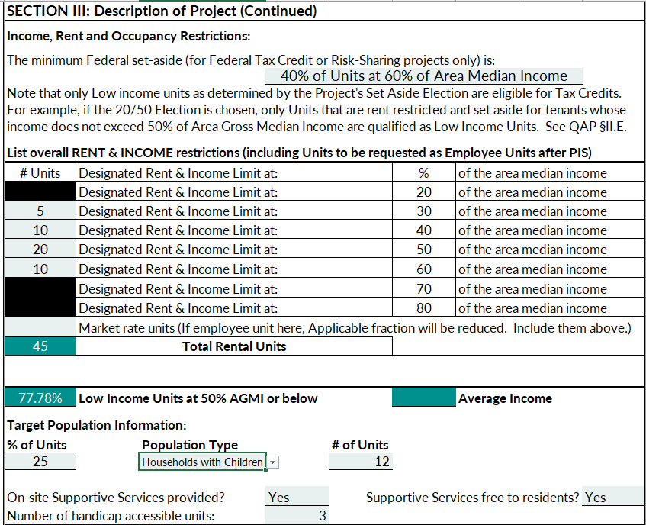
Tab 2 – Page 2
Select federal set-aside
Employee Units are not Market Rate Units
LI Units at 50% AMGI affects Scoring Criterion 5 Income Levels of Tenants
Target Population only needs to be amount required, but can be greater – it will be in LURA
To get points, services must be free and on-site
Accessible Unit must be at least federal minimum (5%)
Notes:
- The application workbook includes a checklist – this is not all inclusive – please read the QAP
Changes are shown in red font this year
Phase I Environmental Review is not included in the LIHTC application, but may be required for MFA gap financing

Slide 55
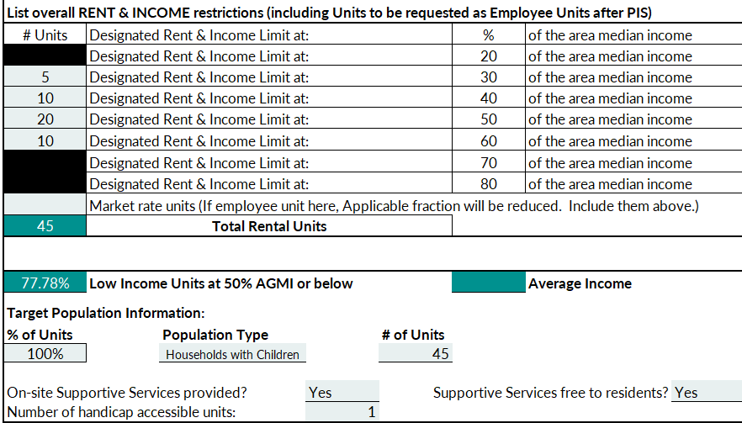
Application Form rs
3 handicapped accessible units
Notes:
Only list 25% of the units rather than 100%.
At least 5% of the units must be Type A accessible units and an additional 2% need to be designed for people with hearing impairments. The three required Type A units need to be shown here.

Slide 56
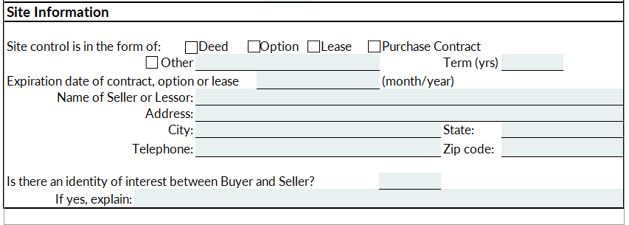
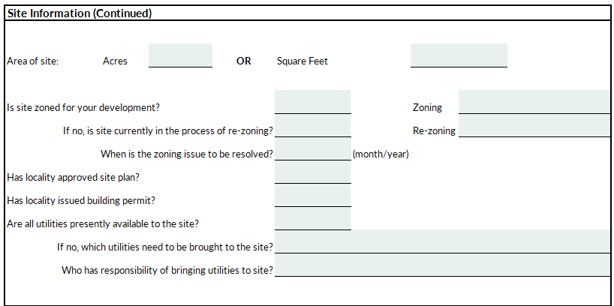
Site Information
Notes:
- The application workbook includes a checklist – this is not all inclusive – please read the QAP
Changes are shown in red font this year
Phase I Environmental Review is not included in the LIHTC application, but may be required for MFA gap financing

Slide 57
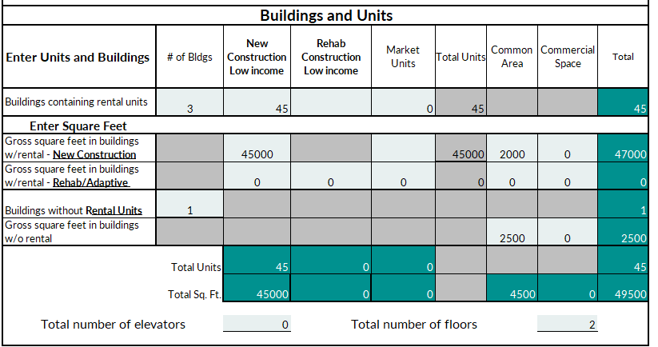
Buildings and Units
Notes:
- The application workbook includes a checklist – this is not all inclusive – please read the QAP
Changes are shown in red font this year
Phase I Environmental Review is not included in the LIHTC application, but may be required for MFA gap financing

Slide 58
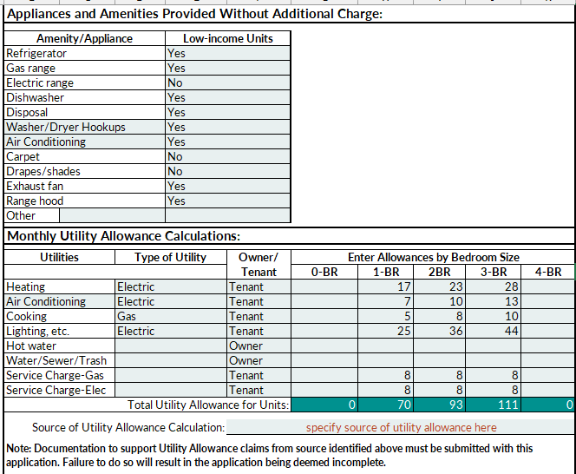
Amenities and Utility Allowance
Notes:
- The application workbook includes a checklist – this is not all inclusive – please read the QAP
Changes are shown in red font this year
Phase I Environmental Review is not included in the LIHTC application, but may be required for MFA gap financing

Slide 59
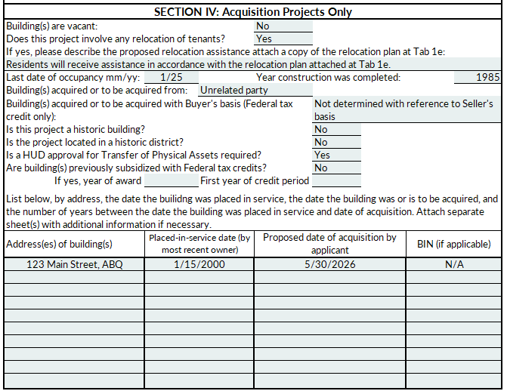
Building Acquisition Information
Notes:
- The application workbook includes a checklist – this is not all inclusive – please read the QAP
Changes are shown in red font this year
Phase I Environmental Review is not included in the LIHTC application, but may be required for MFA gap financing

Slide 60
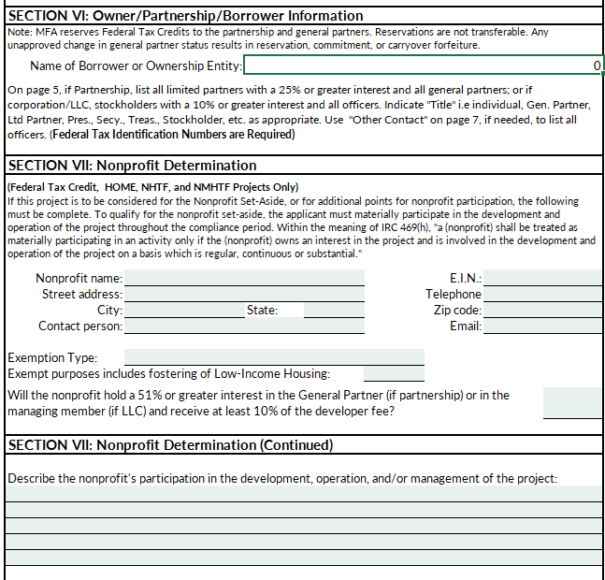
Borrower/Owner Entity & Nonprofit Determination
Notes:
- The application workbook includes a checklist – this is not all inclusive – please read the QAP
Changes are shown in red font this year
Phase I Environmental Review is not included in the LIHTC application, but may be required for MFA gap financing

Slide 61
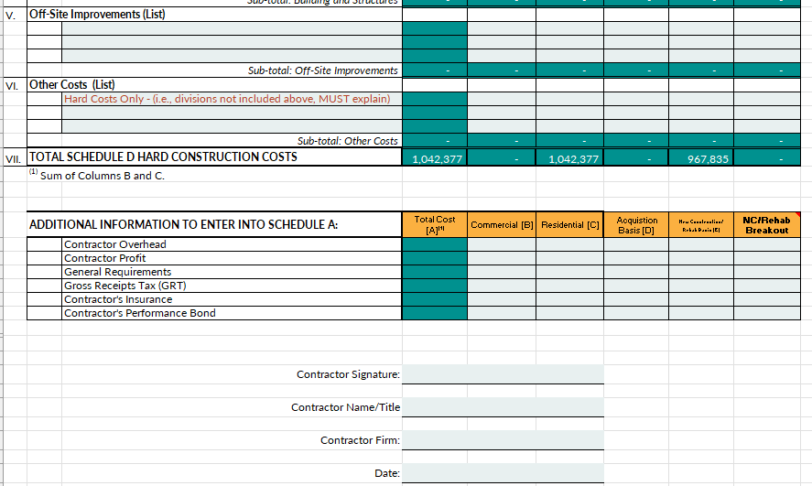
Schedule D – Contractor’s Cost Breakdown
Information transfers to Schedule A
Contractor must sign
Notes:
- The application workbook includes a checklist – this is not all inclusive – please read the QAP
Changes are shown in red font this year
Phase I Environmental Review is not included in the LIHTC application, but may be required for MFA gap financing

Slide 62
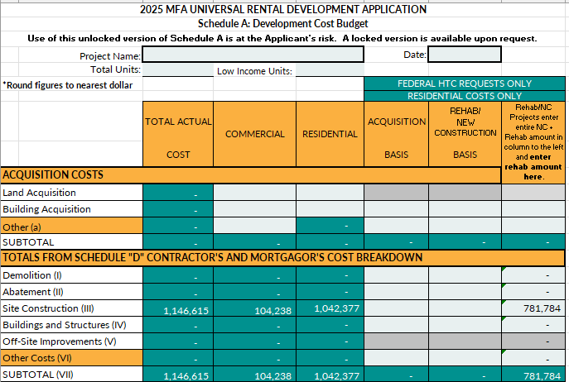
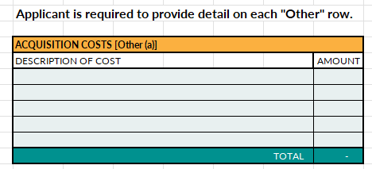
Schedule A – Development Cost Budget
Notes:
- The application workbook includes a checklist – this is not all inclusive – please read the QAP
Changes are shown in red font this year
Phase I Environmental Review is not included in the LIHTC application, but may be required for MFA gap financing

Slide 63
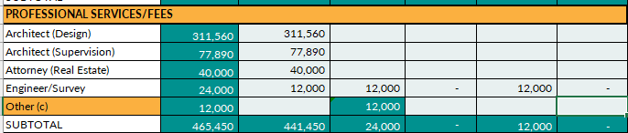
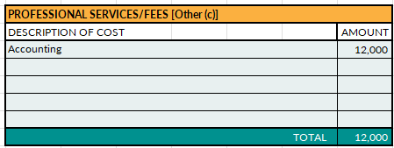
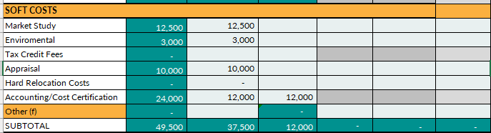
Schedule A – Development Cost Budget
Enter costs where there is a line for them.
Notes:
- The application workbook includes a checklist – this is not all inclusive – please read the QAP
Changes are shown in red font this year
Phase I Environmental Review is not included in the LIHTC application, but may be required for MFA gap financing

Slide 64
Schedule A – Construction Contingency Example
New Construction
$11,094,892 Construction Costs before GRT, GR, Overhead & Profit
5% Minimum Owner Contingency Percentage
$ 554,745 Minimum Owner Contingency Dollar
$ 650,000 Application Contingency
$ (95,255) (Excess)/under minimum
Contingency included in construction contract will be included as a hard construction cost and will not count toward required owner construction contingency.
Notes:
- The application workbook includes a checklist – this is not all inclusive – please read the QAP
Changes are shown in red font this year
Phase I Environmental Review is not included in the LIHTC application, but may be required for MFA gap financing

Slide 65
Schedule A/D – Builder’s Fees Example
$11,094,892 Construction Costs before GRT, GR, Overhead & Profit
6% Allowed percentage for Profit
$665,694 Maximum for Profit (if no identity of interest)
$665,694 Application Profit
$0 (Excess)/under used
Same formula as above for General Requirements
$11,094,892 Construction Costs before GRT, GR, Overhead & Profit
2% Allowed percentage for Overhead
$221,898 Maximum for Overhead
$221,898 Application Overhead
$0 (Excess)/under used
Notes:
- The application workbook includes a checklist – this is not all inclusive – please read the QAP
Changes are shown in red font this year
Phase I Environmental Review is not included in the LIHTC application, but may be required for MFA gap financing

Slide 66
Schedule A – 4% Developer Fee Calculation
14% TDC** Excludes:
Donated Land
Waived Fees
Developer Fees (which includes consultant fees)
Reserves
Acquisition cost (Non-arms length purchase)
Notes:
- The application workbook includes a checklist – this is not all inclusive – please read the QAP
Changes are shown in red font this year
Phase I Environmental Review is not included in the LIHTC application, but may be required for MFA gap financing

Slide 67
Schedule A – 4% Developer Fee Calculation
$16,388,500 Total Development Costs – affordable units (before reserves and developer fees)
x 14% Maximum Fee Percentage
$2,294,390 Developer Fee final calculation at 8609
If an identity of interest, acquisition costs will not be included in calculation.
Notes:
- The application workbook includes a checklist – this is not all inclusive – please read the QAP
Changes are shown in red font this year
Phase I Environmental Review is not included in the LIHTC application, but may be required for MFA gap financing

Slide 68
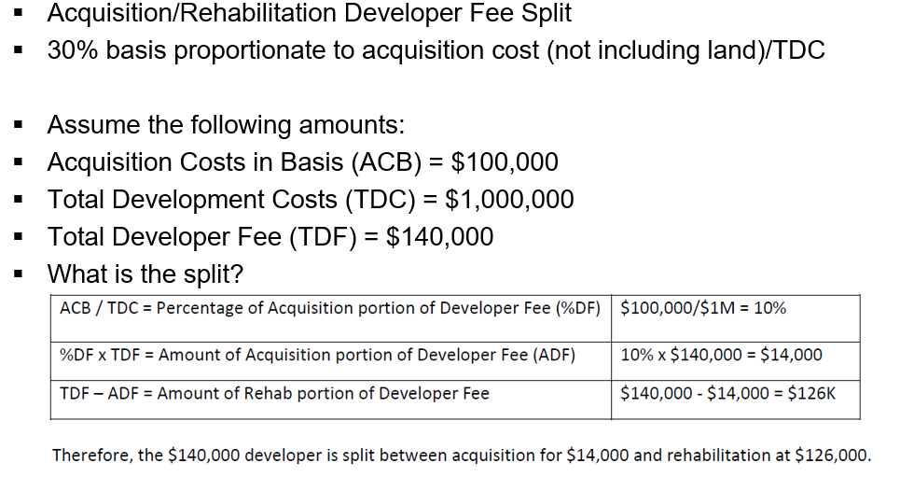
Schedule A – Developer Fee Calculation
Notes:
- The application workbook includes a checklist – this is not all inclusive – please read the QAP
Changes are shown in red font this year
Phase I Environmental Review is not included in the LIHTC application, but may be required for MFA gap financing

Slide 69
Schedule A – Reserves and Expenses
Operating Expenses = Project operating expenses (excluding reserves and resident social services expenses); $4,300 to $5,800/unit;
Replacement Reserve = $250/unit/year for Senior housing (new construction only) and $300/unit/year for all other project types;
Operating Reserve = minimum of six months operating expenses (including replacement reserves and social services expenses) and all must-pay debt service.
Notes:
- The application workbook includes a checklist – this is not all inclusive – please read the QAP
Changes are shown in red font this year
Phase I Environmental Review is not included in the LIHTC application, but may be required for MFA gap financing

Slide 70

A Development Cost Budget
Cost Caps by Line Item
6%/2%/6%=14%
of Construction Costs
Fee per LI Unit
Not To Exceed $2.5M & 14% TDC
3.3% of TDC
Contractor OH/
Profit/GR
Architect
Fees
Developer
Fees
Notes:
Some costs in the development budget are capped. What are the limits for Contractor Overhead, Profit and General Requirements?
Click – these costs are limited to a total of 14% but broken down by the type of cost. They are calculated based on the hard construction costs on Schedule D. Any amounts over the caps are reduced from eligible basis.
What about architecture and engineering fees?
Click – they are limited to 3.3% of Total Development Cost as defined in the Glossary. Again, any amount over this will be reduced from eligible basis.
What about Developer Fees?
Click – Developer fees in the 9% round are limited per unit - Click

Slide 71
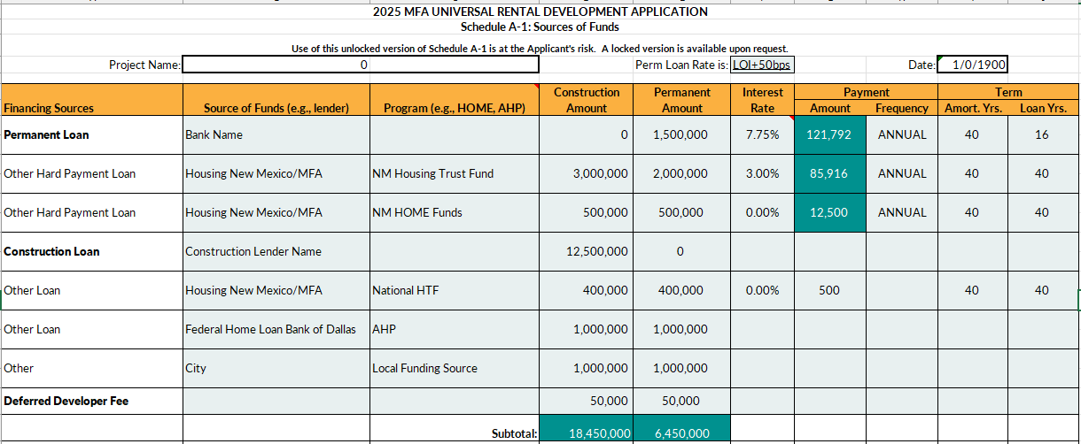
Schedule A-1 – Sources of Funds
Notes:
- The application workbook includes a checklist – this is not all inclusive – please read the QAP
Changes are shown in red font this year
Phase I Environmental Review is not included in the LIHTC application, but may be required for MFA gap financing

Slide 72
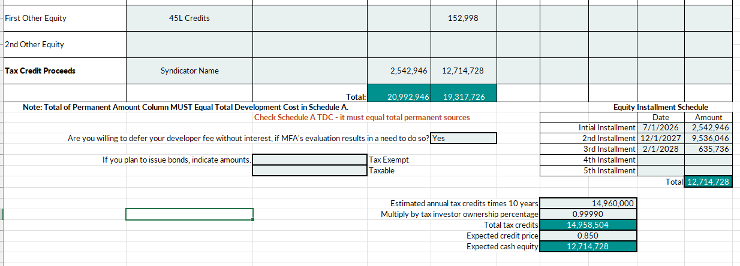
Schedule A-1 – Sources of Funds (continued)
Notes:
- The application workbook includes a checklist – this is not all inclusive – please read the QAP
Changes are shown in red font this year
Phase I Environmental Review is not included in the LIHTC application, but may be required for MFA gap financing

Slide 73
Schedule A-1
Interest Rate
Always add 50 bps
  7.25% Amount in LOI + 50 bps = 7.75%
  7.25% Amount in LOI
LOI:
Projected Loan Rate: 7.25% PLUS 50 Basis Points = 7.75%
Notes:
Another issue we see frequently is the failure to place the correct interest rate in Schedule A-1. Which interest rate should be included based on the information on the slide?
Click
4.25% is correct. It matches the letter of interest from the lender. If there is no letter of interest, MFA will assume a 6.5% rate. In addition, although you are to enter 4.25% to match the lender’s LOI, MFA will add 50 basis points to that amount when we underwrite the project. If the project does not properly cash flow with the 50 basis points the project may be deemed to be infeasible.

Slide 74
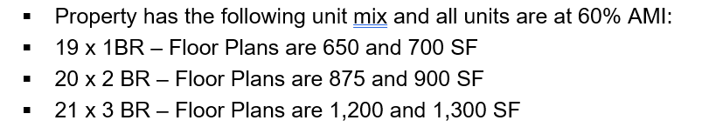
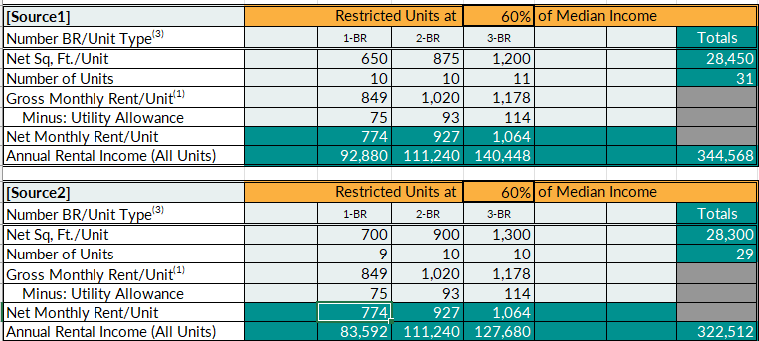
Schedule B – Rent Schedule
Notes:
- The application workbook includes a checklist – this is not all inclusive – please read the QAP
Changes are shown in red font this year
Phase I Environmental Review is not included in the LIHTC application, but may be required for MFA gap financing

Slide 75
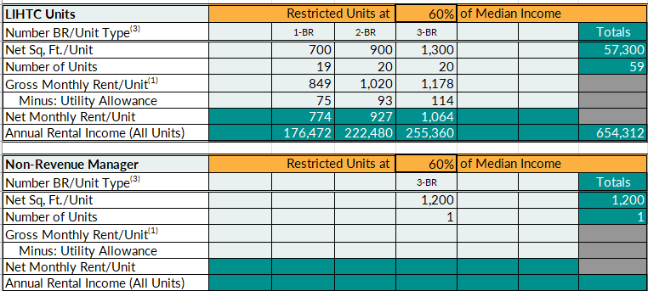
Schedule B – Rent Schedule
Include all units on Schedule B. Employee/Exempt Units are approved by Asset Management after PIS.
Notes:
- The application workbook includes a checklist – this is not all inclusive – please read the QAP
Changes are shown in red font this year
Phase I Environmental Review is not included in the LIHTC application, but may be required for MFA gap financing

Slide 76

Schedule B – Rent Schedule
Land Use Restriction Unit Count: 60 Units
Obtain a letter from Asset Management for approval of management units after PIS.
All units will be considered “LIHTC units” on LURA; “management units” are considered “common area”, not residential units. This allows for flexibility if the property requires additional units in the future or management household size changes.
Notes:
- The application workbook includes a checklist – this is not all inclusive – please read the QAP
Changes are shown in red font this year
Phase I Environmental Review is not included in the LIHTC application, but may be required for MFA gap financing

Slide 77

Schedule B
Manager’s Unit
Project Narrative States:
  The Project will include 59 newly constructed LIHTC units. One additional unit will be a non-revenue management unit.
Include all units on Schedule B. Employee/Exempt Units are approved by Asset Management after PIS.
Notes:
Employee units continue to be incorrectly documented in the application. In this example, the project narrative indicates that there will be 59 low-income units plus a non-revenue management unit. Schedule B includes 59 units. Click. This is incorrect. Click Include the 60th unit as a 60% AMI unit. Click Management units are approved after the project is placed in service.

Slide 78


Insert Rents and UA from HAP Contract
Into Schedule B
No rent overhang on Schedule C
Notes:
When you have a project with rental assistance, the rent comes from the HUD or USDA rent schedule. Click1
Click2 find the gross rents in column 6 in the HUD schedule and Click3 enter them into Schedule B
Click 4/5 Include the gross rents on Schedule B. Don’t include the tax credit rents with an overhang on Schedule C

Slide 79
Schedule C – Operating Expense Budget (Tab 5a)
Schedule C – Operating Expense Budget (Tab 5a)
7% vacancy / 5% (Seniors, PSH, PBV)
Maximum 6% management fee (calculated on gross income)
Replacement Reserves – we will underwrite to at least MFA minimums
No HAP Contract “Overhang” – include full rent on Schedule B
Annual Compliance Fee is $50 per Low Income Unit
Don’t forget Prior Year Operating Expenses if Rehabilitation Project
Notes:
- The application workbook includes a checklist – this is not all inclusive – please read the QAP
Changes are shown in red font this year
Phase I Environmental Review is not included in the LIHTC application, but may be required for MFA gap financing

Slide 80

Schedule C – Operating Expense Budget (Tab 5a)
Explain other income
Notes:
- The application workbook includes a checklist – this is not all inclusive – please read the QAP
Changes are shown in red font this year
Phase I Environmental Review is not included in the LIHTC application, but may be required for MFA gap financing

Slide 81


Schedule C – Operating Expense Budget (Tab 5a)
Must show reduction in eligible basis if including parking income in budget.
Notes:
- The application workbook includes a checklist – this is not all inclusive – please read the QAP
Changes are shown in red font this year
Phase I Environmental Review is not included in the LIHTC application, but may be required for MFA gap financing

Slide 82

What in this pro-forma is unacceptable?
Notes:
What about this pro-forma’s debt coverage ratio? Click
Yes, it’s too low – All in aggregate debt service coverage should not be below 1.20:1. The lowest acceptable DSCR is 1.15.

Slide 83

Architect Certification
Fill in information at top
Sign bottom with architect’s seal
Notes:
- The application workbook includes a checklist – this is not all inclusive – please read the QAP
Changes are shown in red font this year
Phase I Environmental Review is not included in the LIHTC application, but may be required for MFA gap financing

Slide 84


Waiver Requests
No waivers approved in advance of Application
Submit with Initial Application, or if later, with $500 change fee after award
Notes:
- The application workbook includes a checklist – this is not all inclusive – please read the QAP
Changes are shown in red font this year
Phase I Environmental Review is not included in the LIHTC application, but may be required for MFA gap financing

Slide 85

Capital Needs Assessment Certification
Complete and insert into front of capital needs assessment.
Notes:
- The application workbook includes a checklist – this is not all inclusive – please read the QAP
Changes are shown in red font this year
Phase I Environmental Review is not included in the LIHTC application, but may be required for MFA gap financing

Slide 86

Energy Credits Calculations
Complete and insert at Tab 14b, if applicable.
Note link to data base for more programs
Notes:
- The application workbook includes a checklist – this is not all inclusive – please read the QAP
Changes are shown in red font this year
Phase I Environmental Review is not included in the LIHTC application, but may be required for MFA gap financing

Slide 87

Hybrid Projects
Private Activity Bond Volume Cap Information Form required for Hybrid 4%/9% Projects
Notes:
- The application workbook includes a checklist – this is not all inclusive – please read the QAP
Changes are shown in red font this year
Phase I Environmental Review is not included in the LIHTC application, but may be required for MFA gap financing

Slide 88
2025 Qualified Allocation Plan
1
4% Threshold Requirements
2
2025 QAP Review
3
2025 Application Process
4
Other Housing New Mexico Financing
5
Environmental Review Process
6
Tax Credit Compliance & Monitoring

Slide 89
Housing New Mexico Financing Sources
Housing New Mexico offers:
HOME Investment Partnerships (federal)
National Housing Trust Fund (federal)
Ventana Fund
Primero Investment Fund
New Mexico Housing Trust Fund
542(c) FHA-Insured Multifamily (Risk Share)
State Tax Credit (Donation based)
Universal Rental Development Application for most sources; apply for all Housing New Mexico financing concurrently

Slide 90
HOME Investment Partnership
Loan Terms:
Maximum award with 9% LIHTC is lowest of:
  Per Project - $500K ($1.25M for CHDO)
Maximum award if no 9% LIHTC is lowest of:
  Per Project - $1M ($1.25M for CHDO)
  80% of approved total development cost
Hard Debt – Principal only
Interest - 0% - 3%
Term – 2 Years Construction + 40 Year Perm
Environmental review process required
Davis Bacon wages may apply

Slide 91

National Housing Trust Fund
Loan Terms:
Extremely Low-Income Households
  30% AMI or federal poverty line
Maximum award with 9% LIHTC - $400K /Project
Maximum award if no 9% LIHTC – $1.5M/Project
Maximum per Unit subsidy – See NOFA
Cash Flow Payment
  Or $500 per annum
Interest - 0%
Term – Minimum 30 Years
Eligible Costs: Development Hard Costs, Refinancing, Acquisition, Related Soft Costs, and Rehabilitation
Environmental Review

Slide 92

Ventana Fund Construction Loan
Eligible Costs: New construction or acquisition/ rehabilitation with firm take-out financing
Income Restrictions: at or below 80% AMI
Term: 12-24 months
Maximum Loan: $1M
LTV: 80%; may consider subordinate lien position
Interest: below market rate (check their website) www.ventanafund.org
Payment: monthly interest only

Slide 93

Primero Loan Fund
Funded through Housing Opportunity Fund
Funding high-risk projects and priority is given to MFA’s Primero Selection Preference:
Tribal Housing, Colonias Housing, Housing Rehabilitation, and Manufactured Housing Assistance
Eligible Costs:
Predevelopment – third party reports such as: environmental assessments, appraisals, title search/insurance, architecture/ engineering fees, market studies
Development – multifamily rental acquisition, construction, conversion or rehabilitation
Interest – Typically 3%/annum; 1% loan fee at closing
Loan Fee at Closing – 1%
Term – Up to 5 years for pre-development
Maximum loan - $3M per Project or funds available

Slide 94

New Mexico Housing Trust Fund
Eligible Costs: Infrastructure, construction, acquisition & rehabilitation for single-family or rental housing as outlined in NOFA
Interest – Rural, Senior, Tribal, PSH, underserved areas may be eligible for discount from the base rate:
  9% LIHTC – 3% base rate
  4% LIHTC – 2% base rate
  Non-LIHTC – 1% base rate
Income Limits: Households at or below 60% AMI
Maximum loan during construction: $3M
Maximum long-term permanent loan: $2M
Hard Payment – fully amortizing over 40 years
Loan Term – 2-year construction period and up to a 40-year term

Slide 95

542(c) FHA-Insured Multifamily (Risk Share)
Eligible Projects: New Construction, substantial rehabilitation, refinancing or acquisition
Maximum Loan – Up to $2M (LTV restrictions apply)
Term: up to 35 years (existing) and 40 years (new const) plus up to 24 months for construction
Interest: (10 Year Treasury Rate + current HUD-approved total MIP + 25 bps MFA Servicing Fee + 2.00%)
Fully amortizing after interest only during construction
First Lien Position
Prepayment prohibited for minimum 10 years of amortization period (longer if required for bond transactions)

Slide 96
NM State Tax Credit Program
  Program Basics:
    Used to fund affordable housing for low to moderate income occupants
    Provides tax credits to eligible individuals and businesses that provide donations to MFA-approved affordable housing projects approved by MFA, or to the charitable trust administered by MFA
    Credits on income taxes, gross receipts taxes (GRT) and compensating taxes (excluding local option GRT imposed by a municipality or county, or the government GRT)
    Donations can include land, buildings, cash or services
    Credit is equal to up to 50% of the value of the donation (i.e. $2,000 donation = $1,000 tax credit)
    Minimum accepted donation is $200; maximum is $2,000,000

Slide 97
NM State Tax Credit Program
  How much is available?
    Amount equal to a base rate of $1.85, adjusted annually for inflation, multiplied by the state population
  How does it work?
    Once an award is approved, eligible project applicants solicit donations for the development of an eligible affordable housing project
      includes non-profit or for-profit developers and governmental or tribal instrumentalities
    Qualified affordable housing activities include land or building acquisition, new construction, rehabilitation, weatherization, etc. for an eligible affordable housing project
    Eligible projects include single family or multifamily housing
      Project must remain affordable for a minimum of 5 years (single family) or 10 years (multifamily)

Slide 98
Questions?
Jacobo Martinez
Assistant Director
Housing Development Department
Tel: 505-767-2285
Email: jmartinez1@housingnm.org
Tim Martinez
Assistant Director
Housing Development Department
Tel: 505-767-2258
Email: tmartinez@housingnm.org
We Are Housing New Mexico
7425 Jefferson St. NE, Albuquerque, NM 87109
Tel: 505-843-6880
www.housingnm.org

Slide 99
2025 Qualified Allocation Plan
1
4% Threshold Requirements
2
2025 QAP Review
3
2025 Application Process
4
Other Housing New Mexico Financing
5
Environmental Review Process
6
Tax Credit Compliance & Monitoring

Slide 100
Environmental Review
An environmental review is the process of reviewing a project and its potential environmental impacts to determine whether it meets federal, state, and local environmental standards. The environmental review process is required for all HUD-assisted projects to ensure that the proposed project does not negatively impact the surrounding environment and that the property site itself will not have an adverse environmental or health effect on end users. Not every project is subject to a full environmental review but every project must be in compliance with the National Environmental Policy Act (NEPA), and other related Federal and state environmental laws.
HOME, NHTF, Risk Share, and any other federal fund source must complete environmental review before site control or execution of loan documents to avoid a choice limiting action.
Projects with NHTF funding only must complete Environmental Provisions process before construction completion.
Keep in mind the timing of the environmental review process. You can complete review before submission of loan application. On average a review can take up to 4 months to complete.
  You will receive environmental review packets after Loan Award Letter is sent out.
Training can be provided upon request by MFA. HUD Exchange website has training modules.

Slide 101
Questions?
Michelle Wherley
Regulatory Compliance Specialist II
Policy & Planning Department
Tel: 505-308-4230
Email: mwherley@housingnm.org
We Are Housing New Mexico
7425 Jefferson St. NE, Albuquerque, NM 87109
Tel: 505-843-6880
www.housingnm.org

Slide 102
2025 Qualified Allocation Plan
1
4% Threshold Requirements
2
2025 QAP Review
3
2025 Application Process
4
Other Housing New Mexico Financing
5
Environmental Review Process
6
Tax Credit Compliance & Monitoring

Slide 103
Compliance Monitoring
MFA’s asset management department is responsible for compliance audits and physical site inspections for more than 300 properties totaling over 18,000 units throughout New Mexico.
The asset management department is committed to working with and providing training to property owners, management agents and property managers, to ensure the successful operation of properties.
18,643 units
264 properties
2,163 units
3 properties.
88 units
14 properties
60 units
1 property.
41 units
3 properties
LIHTC
S-8
542C
HOME
HTF
NSP
538
RTC
811
5,140 units
85 properties
773 units
122 properties.
16 units
1 property
370 units
15 properties.

Slide 104
Monitoring Schedule
LIHTC/TCAP
ON SITE: within one year of date of last building placed in service, then once every three years.
If non-compliance issues are severe then visits could be every year until non-compliance is corrected.
HOME/HTF
ON SITE: The on-site inspections must occur within 12 months after project completion and at least once every 3 years thereafter during the period of affordability.
The participating jurisdiction may adopt a more frequent inspection schedule for noncompliant properties.
542(c) Risk Sharing
ON SITE: within one year of the loan closing, then Annually.
REAC: frequency of re-inspection based upon score. From every three years to annually.
TCEP/RTC/ USDA 538/NSP
ON SITE: Annually.

Slide 105
Utility Allowance Methods
Properties with tenant paid utilities must evaluate utility allowances schedules annually using an acceptable method chosen by the owner/agent.
Acceptable methods to calculate utility allowances:
HUD UTILITY SCHEDULE MODEL
MULTIFAMILY HOUSING
UTILITY COMPANY ESTIMATE
ENERGY CONSUMPTION MODEL
*PUBLIC HOUSING AUTHORITY SCHEDULE*
*Properties with HOME/HTF funds cannot use this method*

Slide 106
Part III: Financing
Low Income Housing Tax Credit (LIHTC) (Continued)
Compliance Monitoring
On-site compliance review
At least 20 percent of the tenant files will be selected by MFA at random. The tenant file review will cover an evaluation of utility allowance schedules and respective implementation deadlines; comparison of rents charged and allowable set aside maximums; and evaluation of household income and the applicable set aside income limit.
On-site physical inspection
At least 20 percent of the units will be selected by MFA at random. Compliance monitoring regulations published January 14, 2000, require housing credit agencies to conduct physical inspections consistent with standards governed by HUD’s Uniform Physical Conditions Standards
Annual reporting requirements
The project owner shall provide MFA with a Certification of Continuing Program Compliance annually on or before March 31st.
The project owner must submit to MFA annual audited property financial statements, within 120 days of fiscal year end, through MFA's compliance online system, WCMS.
Electronic data via Next Gen: On a monthly basis, the project owner must provide TICs and property vacancy data.
Annual vacancy reporting: The project owner must submit to MFA a vacancy report, by month, for the previous year, annually on or before March 31st.
Construction & Closeout
Compliance fees are due in MFA’s office by January 31 of each year. Owners will be notified once, or one time, of past due compliance fees. They will then have 30 days to submit payment. If payment is not submitted, MFA will send a Notice of Noncompliance (IRS Form 8823) to the Internal Revenue Service.
$50 per qualifying tax credit unit

Slide 107
Part III: Financing
Low Income Housing Tax Credit (LIHTC) (Continued)
Compliance Monitoring
Housing Priority Requirements
Housing priorities & enrichment services
Enforced throughout the affordability period
Must not allow for more than a 30-day gap in services
Documentation confirming compliance with the LURA requirements must be maintained throughout the affordability period
Special needs housing priority
Must have a plan or a policy explaining how units will be marketed
Documentation that special needs housing units were not rented by the owner/agent for at least 30 days until the required threshold is met
MOU with any service providers
Enrichment services
Documentation to confirm compliance with enrichment services of the LURA
Date, time and location of event
Newsletters, flyers or brochures advertising scheduled events
Sign in log of attendees
Provider information
Service coordination
Service Coordinator must be in addition to the property manager and property management staff
Annual operating budget must be sufficient to cover costs
Annual survey must be conducted and documented regarding satisfaction or dissatisfaction
Annual certification must be provided by the owner of
  Number of hours on site
  Number of residents served

Slide 108
Additional Functions
Service Enrichment LURA Modifications
In conjunction with the housing development department, asset management will review requests to modify service enrichment changes subsequent to the initial selection at application.
Lease up meeting
In conjunction with the housing development department, a representative will be available at the lease up meeting to answer questions and provide information.
Approval of Employee units
After initial application should a need for an employee unit to be added, written requests from owner/agents can be submitted to the asset management department for Review and approval.
Review of Affirmative Fair Housing Marketing Plans (Risk Share, HOME, NHTF, TCEP. NSP)
LIHTC projects with additional affordable layers may require an approved marketing plan. Plans can be submitted to the asset management department for review, approval and on-going compliance monitoring.
Reserve for Replacement Requests (Risk Share)
Risk Share projects require a reserve held for capital replacement. Requests for eligible expenditures can be submitted to the asset management department for review and approval. The next site inspection will confirm repair and replacement of items paid by the reserve.

Slide 109
Section 811 Project Rental Assistance
In 2020, Housing NM-MFA received a $3.5 million award to participate in HUD’s Section 811 Project Rental Assistance
(PRA) program, which provides project-based rental assistance for extremely low- income persons with disabilities
who are linked with long-term services. The rental assistance covers the difference between the tenant payment
and the property’s contract rent. Housing NM-MFA has HUD approval to accept FMR.
TENANT ELIGIBILITY
Households in which a household member has one or more of the substantial, long-term disabilities listed below, provided that an LLA determines appropriate services related to the type of disability
PROJECT ELIGIBILITY
New construction or rehabilitation projects
Existing multifamily properties excluding units with existing occupancy or use restrictions for persons with disabilities or for persons aged 62 or older or units that have received any form of long-term operating subsidy in the last six months.
$2.5 Million in 811 PRA assistance available
At least one person in the household must be non-elderly (18-61 years of age), have a disability that meets the criteria for Special Needs, and be eligible to receive Medicaid and services/supports.
The household must be extremely low-income (earning 30 percent of AMI or below) as defined by HUD.
No more than 25 percent of the total units in a property may be restricted to persons with disabilities and Section 811 PRA units must be dispersed throughout the property.
FY2019 funding, we have approximately 49 units available with $2,539.841 of funding remaining. The total award per RAC depends on units taken and FMRs

Slide 110
Questions?
Amanda Mottershead-Aragon
Assistant Director
Asset Management Department
Tel: 505-767-2267
Email: aaragon@housingnm.org
We Are Housing New Mexico
7425 Jefferson St. NE, Albuquerque, NM 87109
Tel: 505-843-6880
www.housingnm.org

Slide 111
Helpful Links
Application Materials
https://housingnm.org/developers/lihtc/current-and-prior-tax-credit-rounds
Developer Page (resources, loans, state tax credits, QCTs, etc.)
https://housingnm.org/developers
Submit questions after this workshop in writing – FAQ Process
https://housingnm.org/developers/lihtc/lihtc-applications-faq-2025
Fundamentals Slides and Video are available here:
https://housingnm.org/developers/lihtc/current-and-prior-tax-credit-rounds
Want to meet about your project? (except scoring)
https://housingnm.org/developers/developer-meeting-request-form
Rent and Income Limits:
https://housingnm.org/property-owners-agents-and-managers/tools-resources-1/rent-and-income-limits

Slide 112
More Questions?
Jeanne Redondo
Tax Credit Program Manager II
Finance Department
Tel: 505-767-2210
Email: ssmith@housingnm.org
Christi Wheelock
Tax Credit Program Manager
Housing Development Department
Tel: 505-767-2279
Email: cwheelock@housingnm.org
We Are Housing New Mexico
7425 Jefferson St. NE, Albuquerque, NM 87109
Tel: 505-843-6880
www.housingnm.org

