Slide 1

Housing New Mexico
MFA
Build America, Buy America (BABA) Overview
Tim Martinez
Assistant Director
Housing Development Department
Justin Carmona
Development Loan Manager
Housing Development Department

Slide 2

Build America, Buy America (BABA) Overview
Outline
Definition of BABA
    What Housing New Mexico (HNM) Funds Trigger BABA
Materials Covered by BABA
    Help Identifying Suppliers Compliant with BABA
How HNM Will Implement BABA
BABA Waivers

Slide 3
Definition of BABA
BABA stands for the Build America, Buy America Act
  Passed by Congress as part of the Infrastructure Investment and Jobs Act of 2021 and signed into law by President Biden
BABA requires
  All iron and steel products, manufactured products, and construction materials used for federally funded “infrastructure projects”, inclusive of buildings and real property, that are constructed, altered, maintained, or repaired are produced in the United States
    A product should only be classified as one of the three kinds of products or materials based on its status at the time it is brought to the project’s work site
    If a housing project receives any of our federal funding, all covered materials across the entire project would have to be produced in the United States, not just those costs paid with federal funds

Slide 4
What HNM Funds Trigger BABA
HOME Investment Partnership Funds (HOME)
National Housing Trust Fund (NHTF)
All HOME & NHTF funds obligated to Housing New Mexico on or after August 23, 2024
Going forward, any HOME or NHTF applied for will require the entire project to comply with BABA
If you currently have a project awarded one of these sources that has not closed yet, you are welcome to reach out to us for confirmation on whether BABA applies

Slide 5
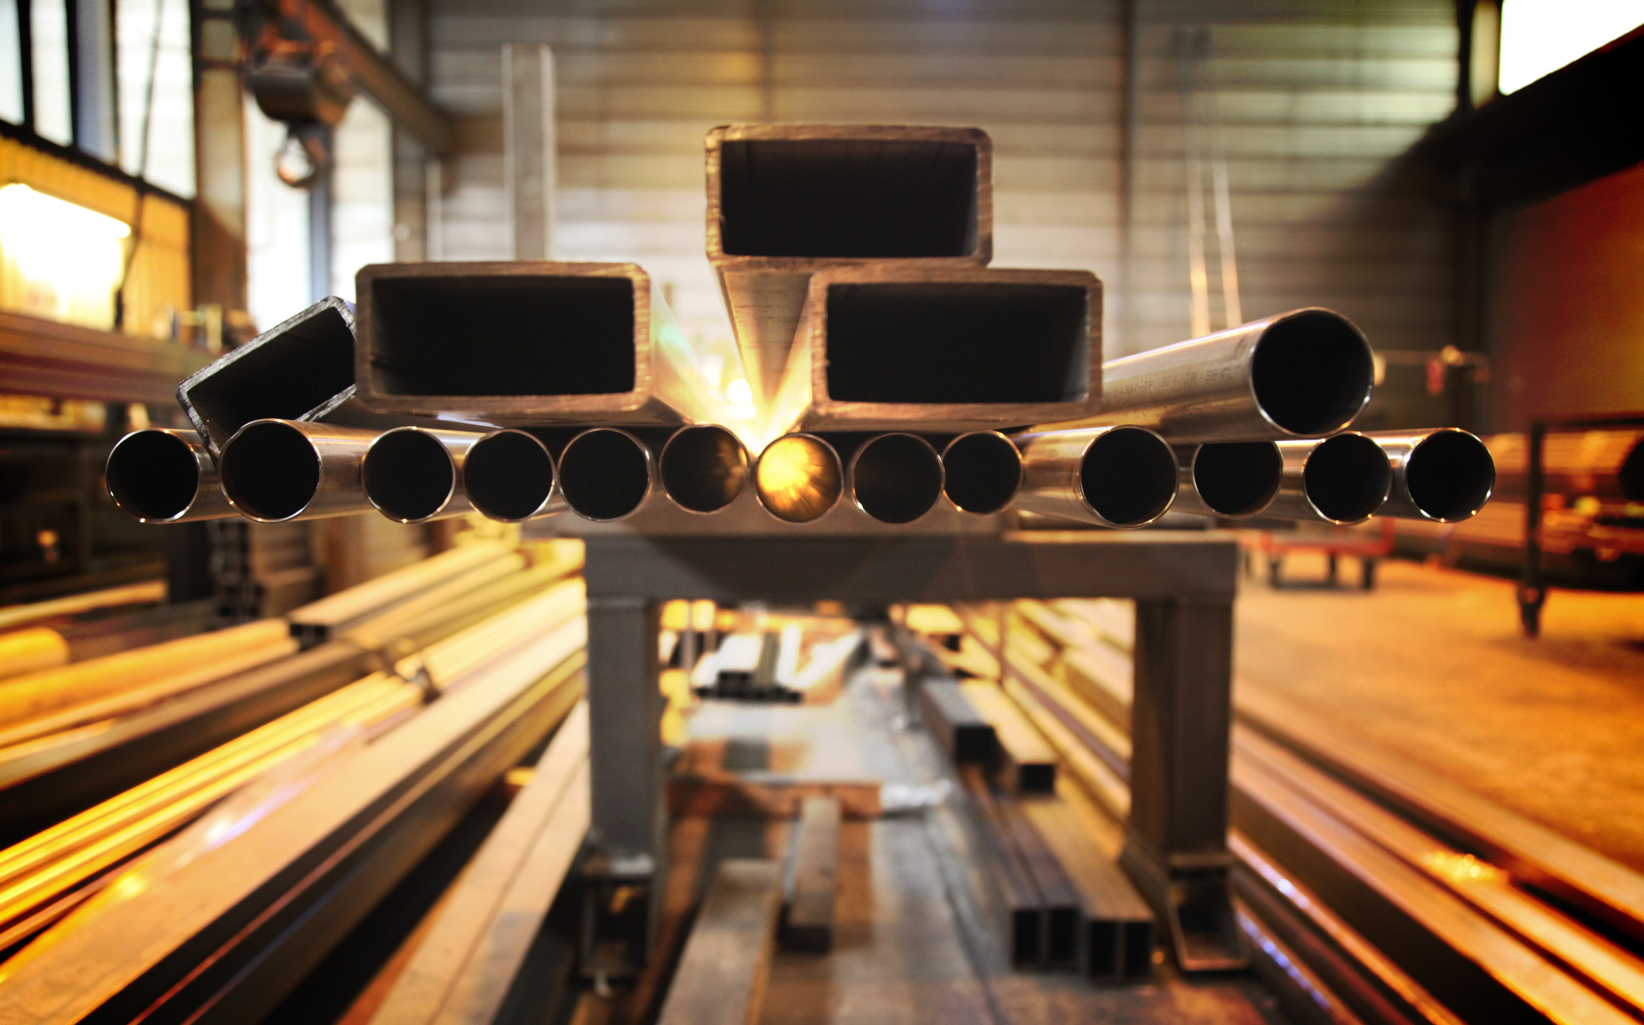
Materials Covered by BABA
Iron and steel products
  Means “articles, materials, or supplies that consist wholly or predominantly of iron or steel or a combination of both” must be “produced in the United States”
    “Predominantly of iron or steel or a combination of both” means that the cost of iron and steel content in a product exceeds 50% of the total cost of all its components
  “Produced in the United States” means that all manufacturing process, from the initial melting stage through the application of coatings, occurred in the United States

Slide 6
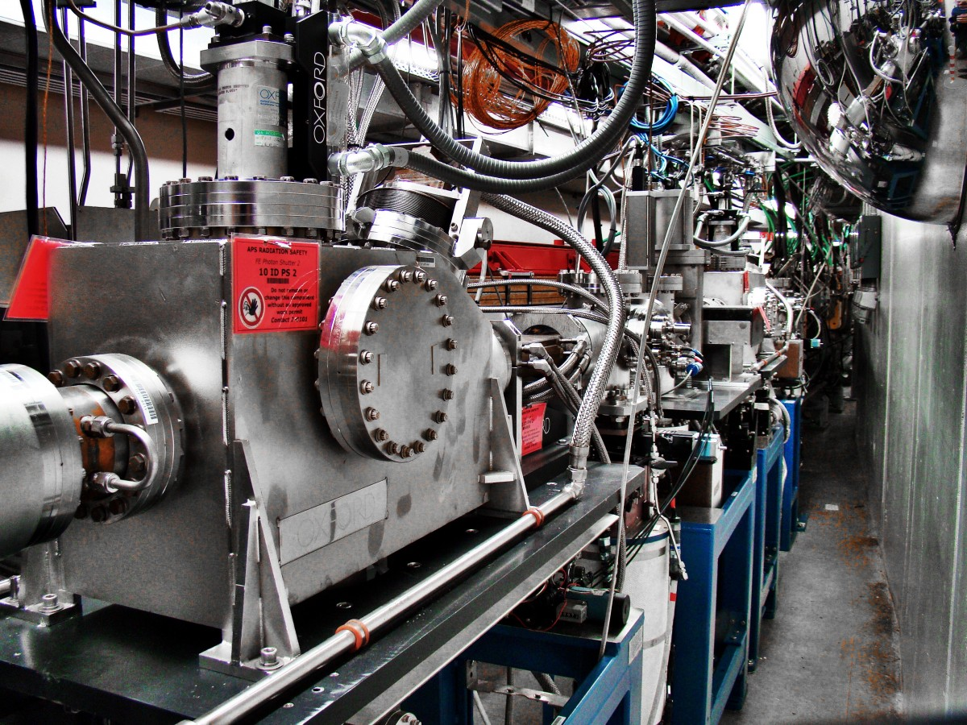
Materials Covered by BABA (Continued)
Manufactured products
  Means “articles, materials, or supplies that have been (i) processed into a specific form and shape or (ii) combined with other articles, materials, or supplies to create a product with different properties than the individual articles, materials, or supplies” must be “manufactured in the United States”
  “Manufactured in the United States” means that the cost of the components of the product that are mined, produced, or manufactured in the United States are greater than 55% of the total cost of all components of the product
  Examples include:
    Windows
    Kitchen appliances
    HVAC units
    Insulation

Slide 7
Materials Covered by BABA (Continued)
Construction materials
  Means articles, materials, or supplies that are listed below must be “produced in the United States”
  Items specifically listed by HUD as construction materials are:
    Non-ferrous metals
    Plastic and polymer-based products (including polyvinylchloride and composite building materials)
    Glass
    Fiber optic cable
    Optical fiber
    Lumber
    Engineered wood
    Drywall
  “Produced in the United States” means that all manufacturing processes for the construction material occurred in the United States

Slide 8
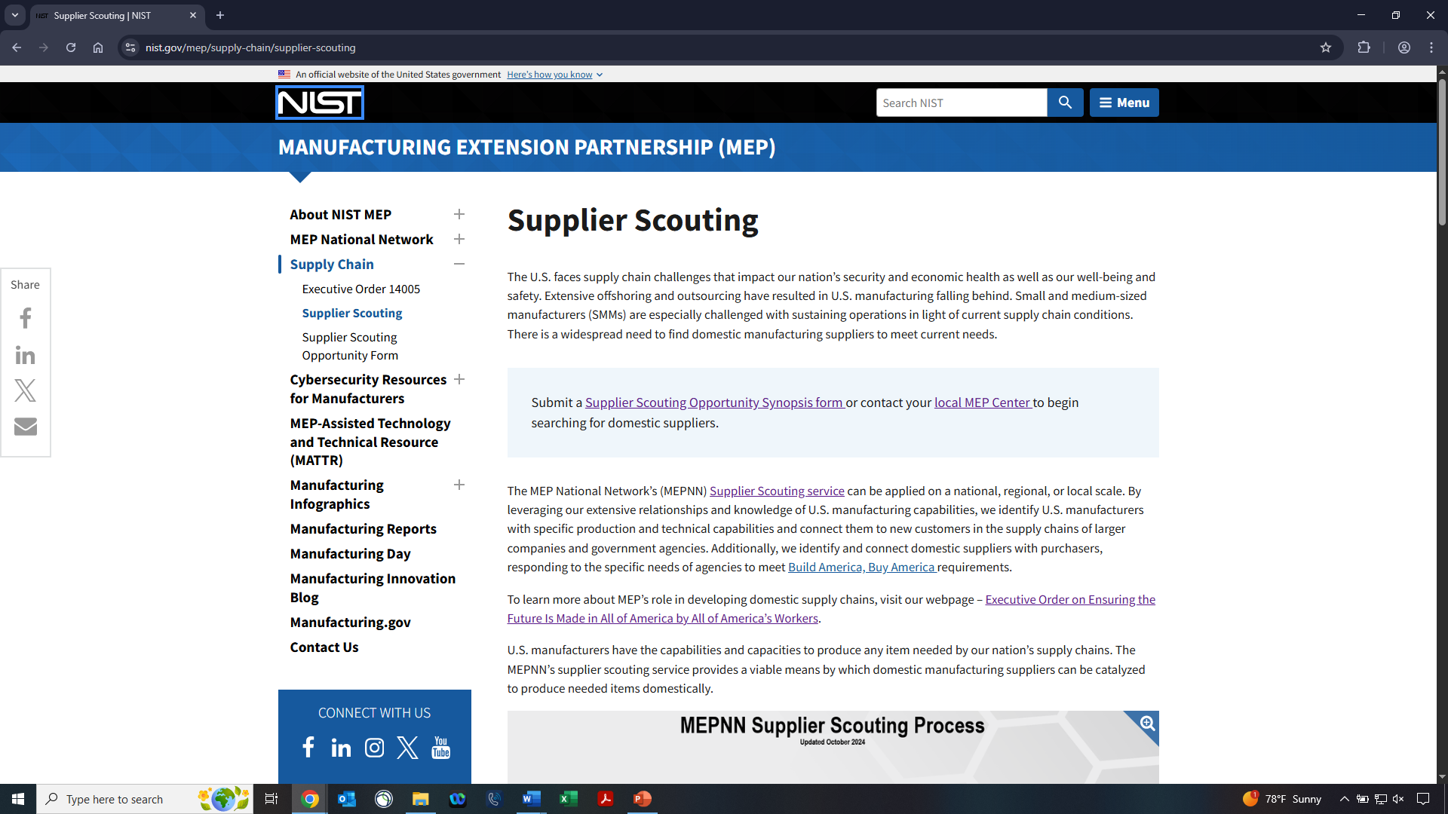
Help Identifying Suppliers Compliant with BABA
The National Institute of Standards and Technology (NIST) offers a “Supplier Scouting” service that can identify manufacturers of specific products that comply with BABA at https://www.nist.gov/mep/supply-chain/supplier-scouting

Slide 9
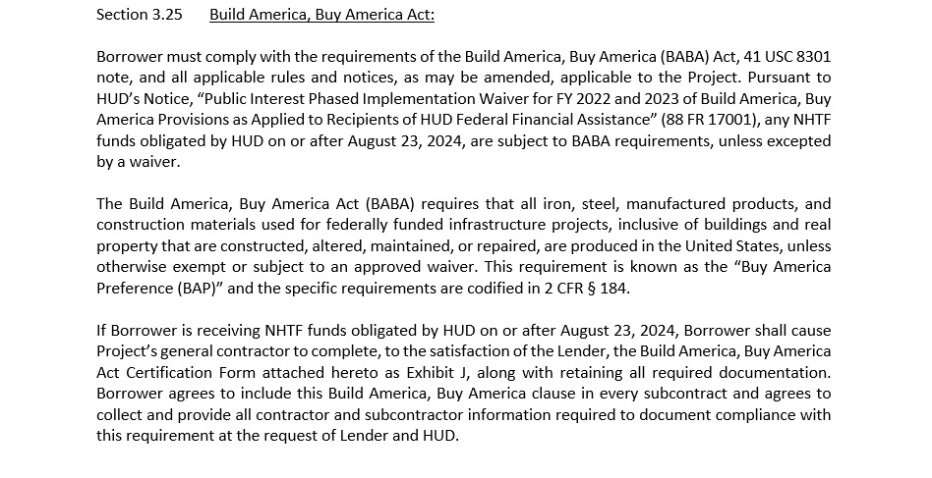
How HNM Will Implement BABA
New Clause in HOME & NHTF Loan Agreements
  The below clause from the Loan Agreement will need to be included in every subcontract

Slide 10
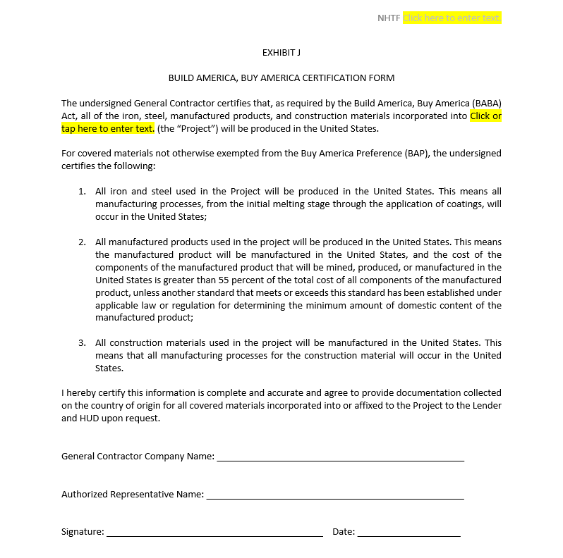
How HNM Will Implement BABA (Continued)
New Exhibit in HOME & NHTF Loan Agreements
  The below exhibit from the Loan Agreement will need to be signed by the General Contractor

Slide 11
How HNM Will Implement BABA (Continued)
New Clause & Exhibit in HOME & NHTF Loan Agreements
  Requires the Borrower & General Contractor to collect and retain documentation showing all materials used in the project complied with BABA
  We recommend that the Borrower & General Contractor retain these documents for at least five years after the project completion date
Housing New Mexico will collect BABA compliance documentation at the 50% construction completion draw and the final draw of HOME and/or NHTF

Slide 12
BABA Waivers
HUD General Waivers - these waivers can be granted at HNM’s discretion without sending a formal request to HUD
  Tribal Recipients Waiver
    Awards of federal funds to tribes of $2.5 million or less
    Expires January 10, 2030
  De Minimis Waiver
    Waive BABA’s applicability to materials whose cost is less than or equal to 5% of the total cost of materials used in a project, up to $1,000,000
    Expires November 23, 2027

Slide 13
BABA Waivers (Continued)
Project Specific Waivers - these waivers must be formally requested from HUD by HNM
  Unreasonable Cost Waiver
    Project’s compliance with BABA would increase the overall cost of the project by more than 25% compared to the project using non-BABA compliant products and materials
  Non-availability Waiver
    Specific product(s) cannot be sourced in the United States

Slide 14
BABA Waivers (Continued)
HUD General Waiver Application Process
Developer submitted HUD General Waiver Request Form to HNM
HNM reviews and approves waiver application
Project Specific Waiver Application Process
Developer submits Project Specific Waiver Request Form to HNM
HNM submits online waiver application to HUD
HUD approves waiver application, submits it to the Office of Management and Budget’s Made in America Office (MIAO)
MIAO makes final decision approving waiver
HUD estimates the Project Specific waiver process will take at least 8 weeks.
Any BABA waiver request must be approved prior to committing federal funds to a project.

Slide 15
Questions?
Tim Martinez
Assistant Director
Housing Development Department
Tel: 505-767-2258
Email: tmartinez@housingnm.org
Justin Carmona
Development Loan Manager
Housing Development Department
Tel: 505-767-2211
Email: jcarmona@housingnm.org
7425 Jefferson St. NE, Albuquerque, NM 87109
Tel: 505-843-6880
www.housingnm.org

