Slide 1


Housing New Mexico
MFA
Single-Family Housing Development Funding Overview
(Infrastructure and Vertical Construction)
Josh Howe
Development Loan Manager II
Housing Development Department

Slide 2


Agenda
Housing New Mexico SFH Development Loan Basics
Affordability
Eligible Applicants & Project Activities
Program Improvements
Additional Developer Feedback
El Toro Community (Roswell, NM)

Slide 3
Housing New Mexico Loan Basics
Programs (Funding Source)
a) ZIHP Single Family Development/Construction (New Mexico Housing Trust Fund)
b) Single Family Development/Construction (New Mexico Housing Trust Fund/Primero Investment Fund)
c) HOME Single Family (HOME Investment Partnership Program)
Maximum Term and Repayment
a) Sixty (60) Months – Draw Down Structure (Infrastructure)
Thirty-Six (36) Months – Revolving Line of Credit (Vertical Construction)
b) Monthly Interest Only / Lot Release Price and/or Sale of Home
Interest Rate
a) Interest Rate Range of 0.00% to 2.50% per Annum Adjusted Upward for Project Specifics and/or Risk Profile
Simplified Loan Application Process
Maximum Loan Amount
a) $3,000,000

Slide 4
Affordability
Income Limits
Land Use Restriction Agreement (LURA)
Household Not to Exceed 150% AMI Income Restriction on Both Primero Investment Fund AND New Mexico Housing Trust Fund (HomeForward)
Qualified Income Certification
Also Referenced as a Deed Restriction
Five (5) Year Master LURA / Deed Restriction
Five (5) Year Individual Homebuyer LURA / Deed Restriction
- Tiered Net Profit Penalty

Slide 5
Eligible Business Entities and Project Activities
Eligible Applicants
- For Profit Entities, Non-Profit Entities, Government Housing Agencies & Regional Housing Authorities, Governmental Entities and Instrumentalities, Tribal Governments and Housing Agencies
Eligible Project Activities
a) Infrastructure - All Expense Items Must be Related to ON-SITE (IE Street Improvements, Sidewalks, Utilities, Etc. that will be Located within the Confines of the Designated Plat)
b) Stick-Built / Manufactured Housing on Permanent Foundation/ Modular
- Minimum Mandatory Design Standard Requirement
Eligibility Requirements
a) Minimum Project Size of 5+ Units
b) Applicable Builder Experience / Financial Feasibility
Construction Lending = High Risk Enterprise…Housing NM Providing a SERVICE

Slide 6
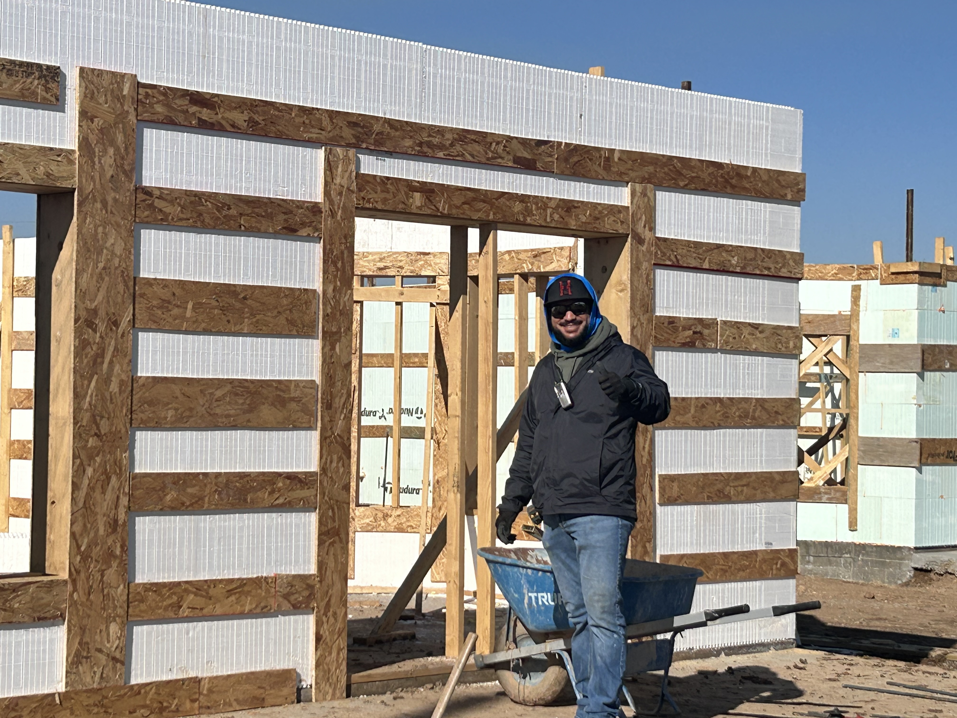
Program Improvements
Qualifying Income Definitions and Housing NM Department Program Alignment
Removal of Contractor Profit Restrictions
Inspection Fees and Draw Process
Zero Interest Homebuilder Program
Application and Reduced Design Review Fees

Slide 7

Developer Feedback
Limited Buyer Pool
Shrinking Profit Margins
Income Restrictions
Development Exit Plan

Slide 8
El Toro Community
El Toro Community (Roswell, NM)
First Single-Family Housing Development Utilizing Housing NM/MFA’s Current Funding Structure
Location: Roswell, NM
Twenty-Nine (29) Affordable Housing Units
Vertical Construction
Insulated Concrete Forms

Slide 9
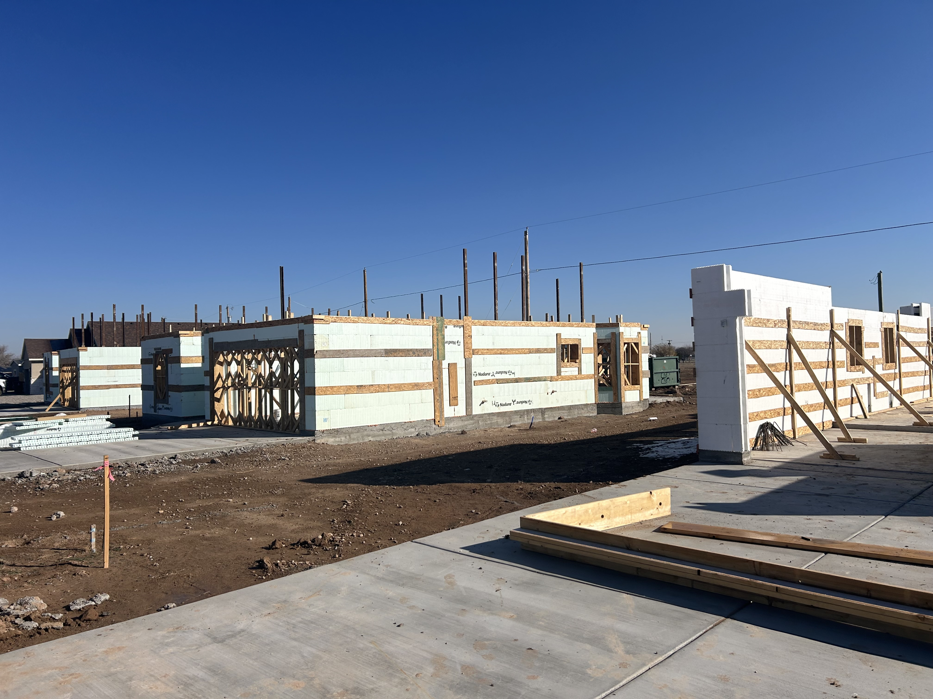
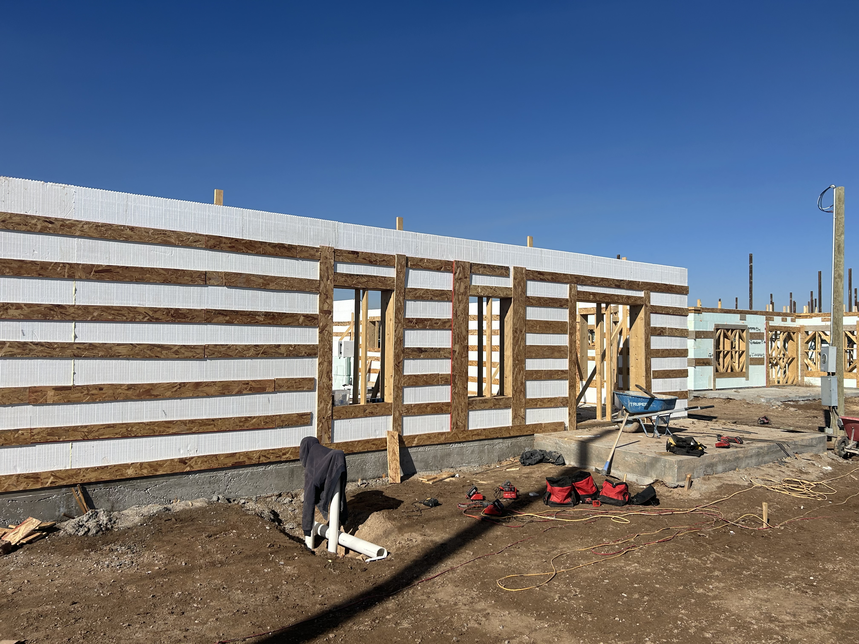
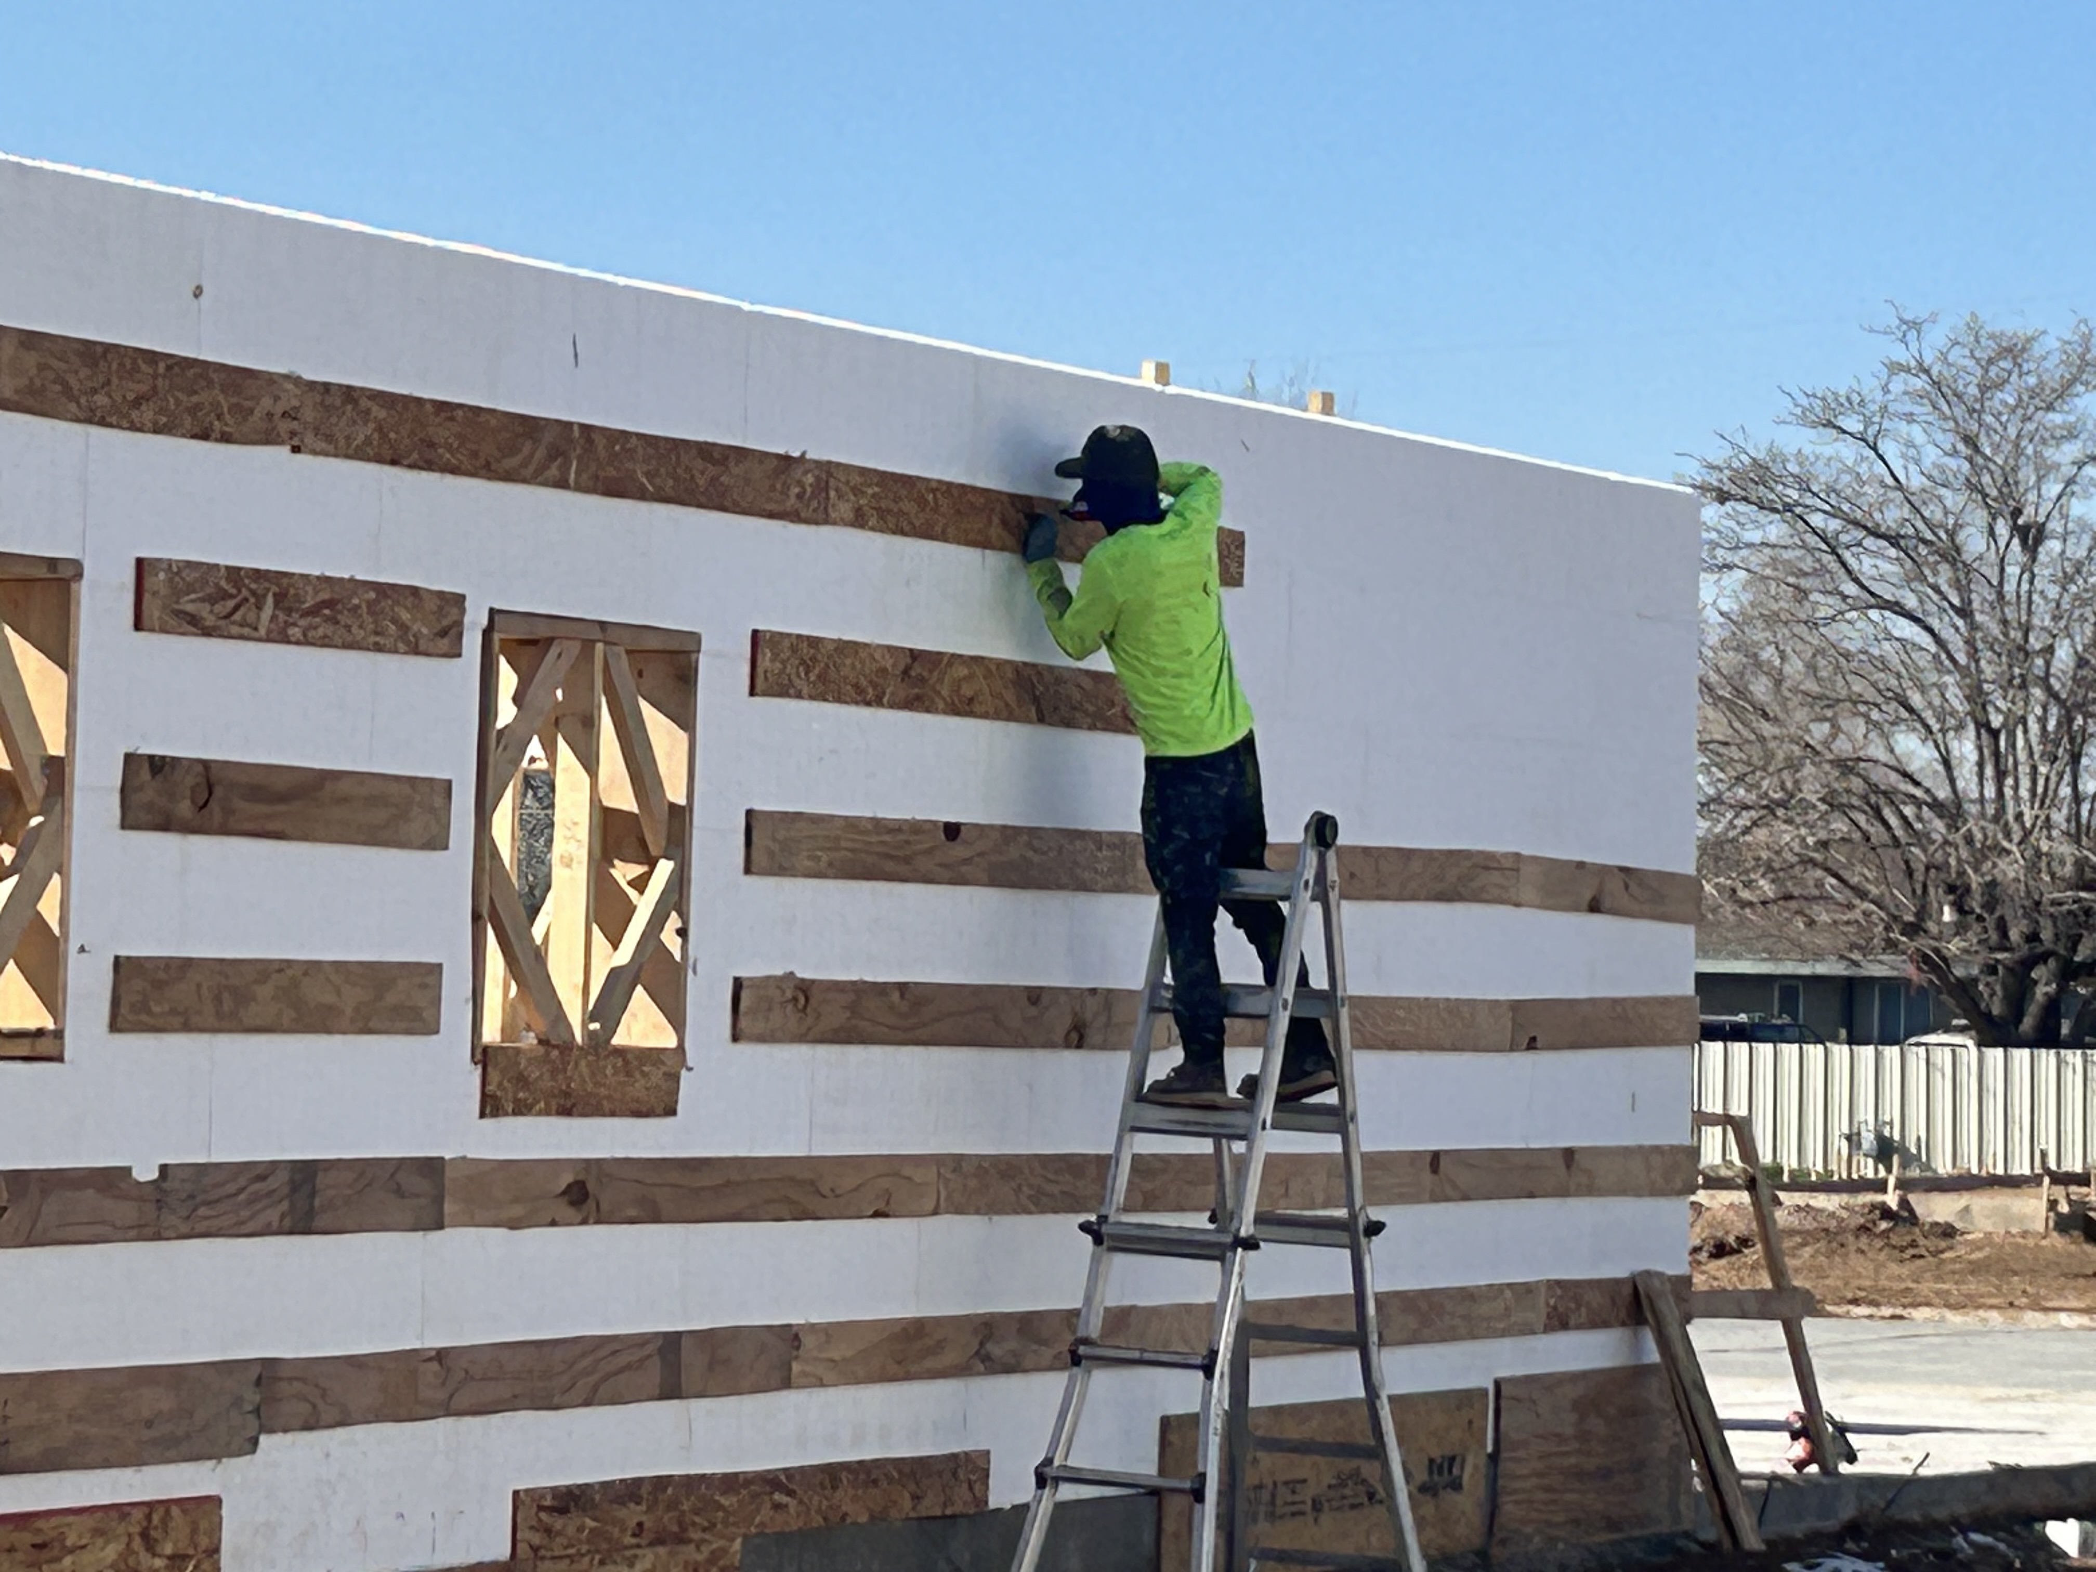
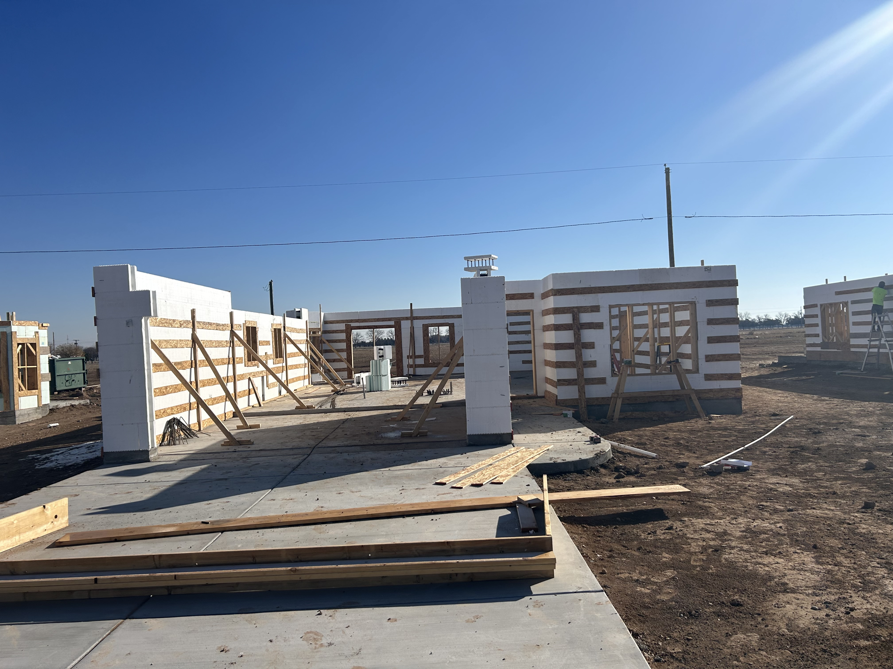
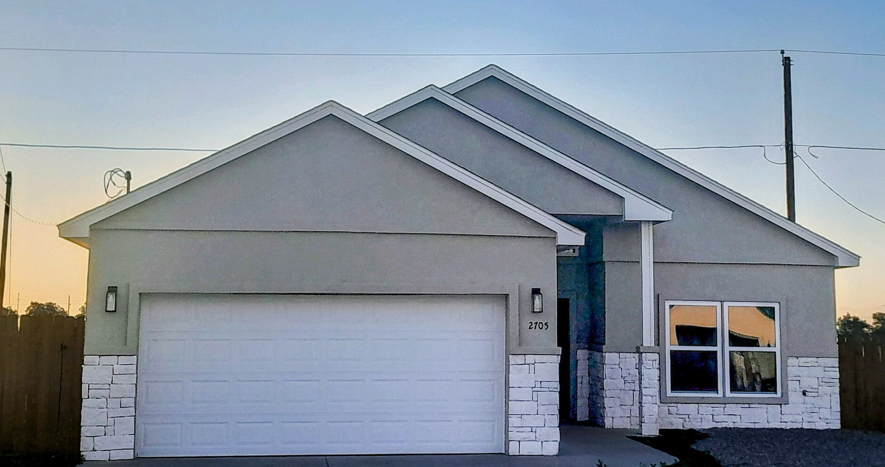
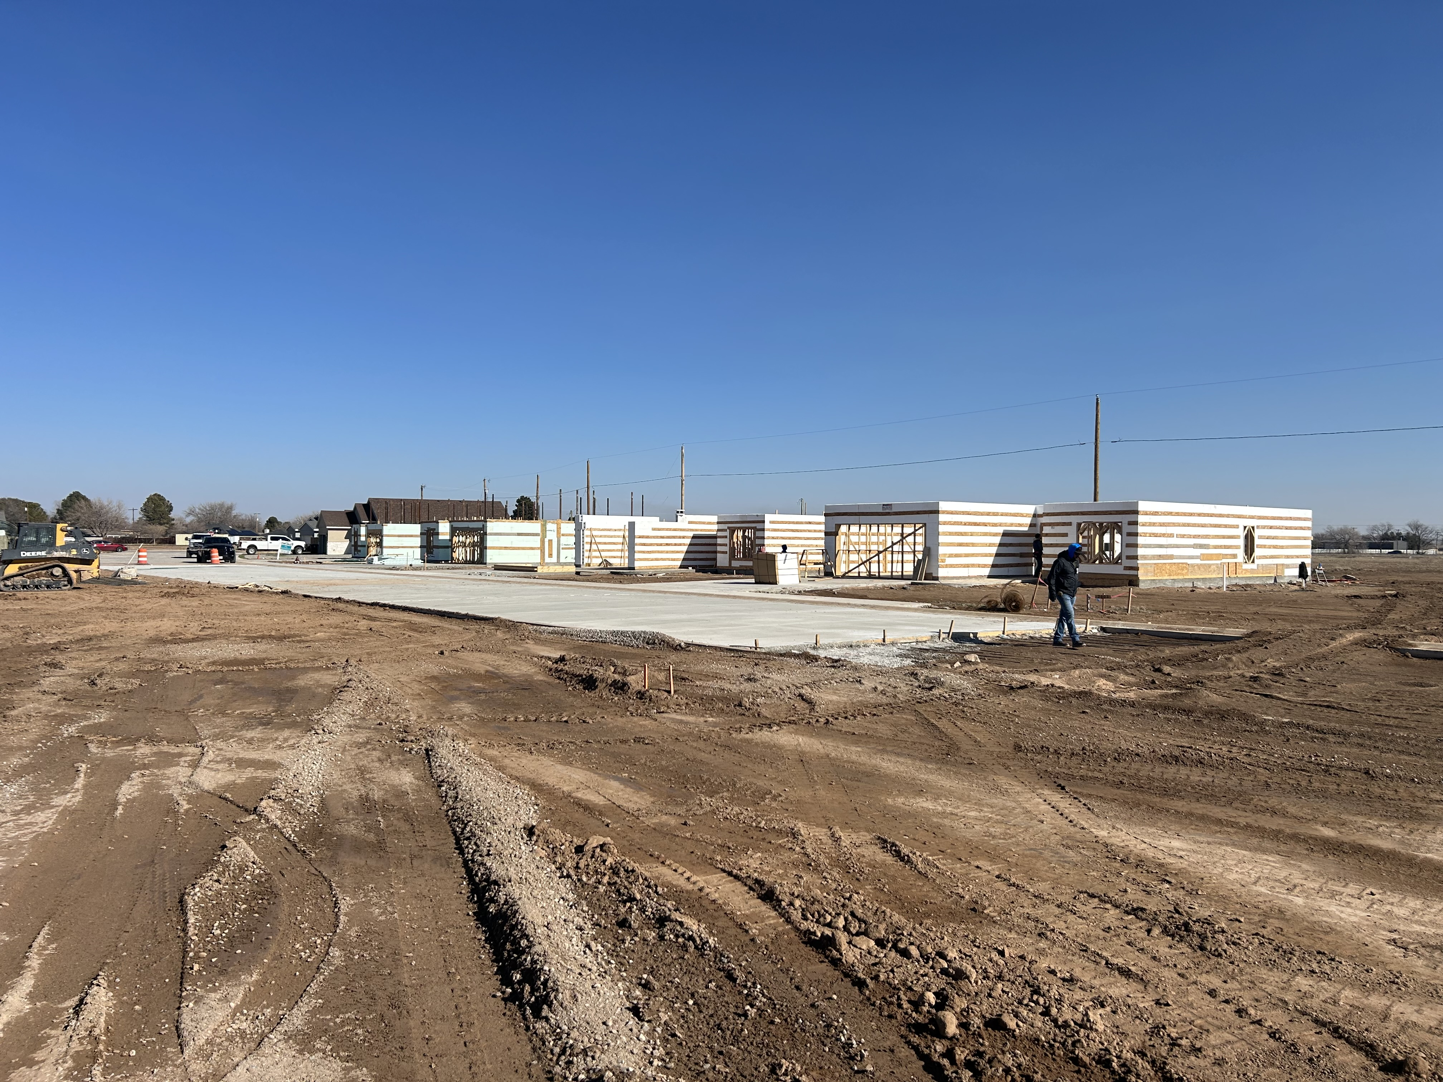
El Toro Community (Roswell, NM)

Slide 10

QUESTIONS/FEEDBACK

Slide 11
Questions?
Josh Howe
Development Loan Manager II
Tel: 505-308-4223
Email: jhowe@housingnm.org
7425 Jefferson St. NE, Albuquerque, NM 87109
Tel: 505-843-6880
www.housingnm.org
We Are Housing New Mexico

