Slide 1

Development 101
George Maestas
Director of Housing Development
Tim Martinez
Development Loan Manager
2022 New Mexico Housing Summit - 09/14/2022

Slide 2

Development 101
Outline
  Due Diligence
  Design and Feasibility
  Financing
  Construction
2022 New Mexico Housing Summit - 09/14/2022

Slide 3
Development 101
Intro
  It takes a village to build a village…
  Make a list of the skills needed
  Assess your internal capacity
  Partner, venture, hire, and manage other team members to fill the gaps in your capacity
Energy Consultant
CPA
Attorneys
Service Provider
Property Manager
Tenant
Asset Managers
Compliance Monitors
Developer
Owner
Syndicator
Investor
Lenders
Contractor
Architect/Engineer
Market Analyst
Environmental Professionals
2022 New Mexico Housing Summit - 09/14/2022
Notes:
Housing development is chaotic, non-linear
So, you need a way to help structure, define the work and reduce risk
Each stage includes tasks, deliverables, and decisions related to the market, site, financing, and your team
Starts with relationships and the team you build
Project takes a LONG time (3-5yrs)…100s if not 1000 pages for MFA. Creating a simple example of putting a project together.

Slide 4
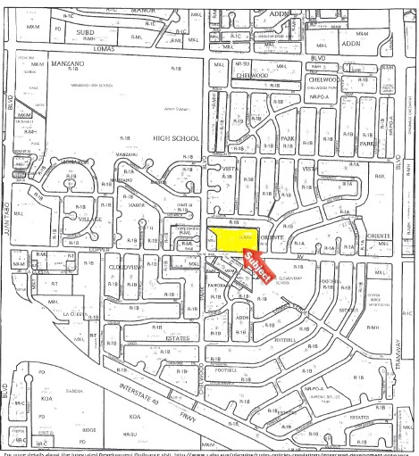
Part I: Due Diligence
Program planning & concept
  Establish population served
      Assess housing needs & market
      What housing problems are you trying to solve?
      Locational and design implications
  Build a basic site criteria
      Access to utilities, public transportation & employment
      Services, health care, schools
      Residential community
      Building type
      Number of units
2022 New Mexico Housing Summit - 09/14/2022
Notes:
Check with local planning/community development department
Local housing needs assessment, master plan housing goals, housing production plans
access to utilities, public sewer, and water
proximity to an established residential area

Slide 5
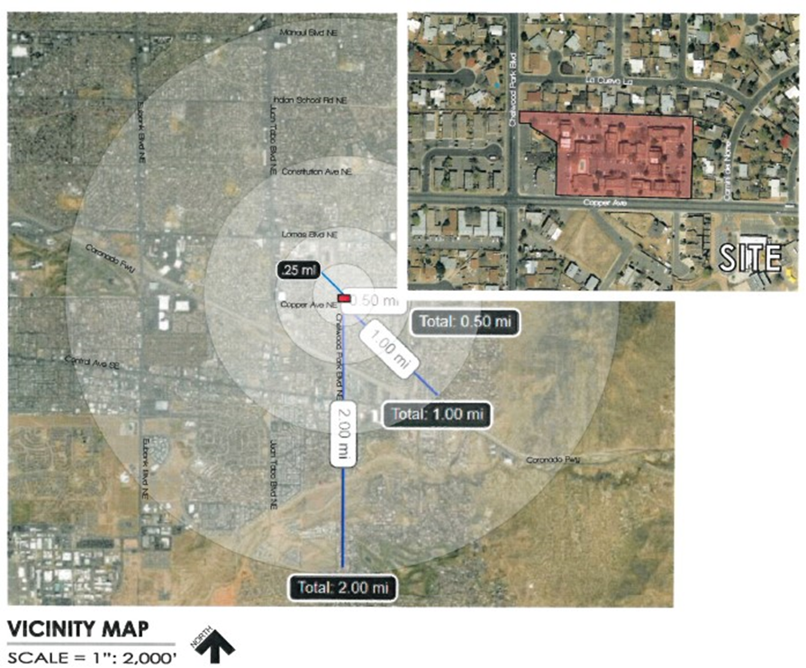
Part I: Due Diligence
Site Selection
  Identify a site
      Land availability and cost are significant challenges to affordable housing development
      Establish relationship with municipality early in your search
      Research sites with planning department, local housing authority, and/or assessor’s office
      Look for municipal land and land-banking opportunities including RFPs for parcels
2022 New Mexico Housing Summit - 09/14/2022
Notes:
You are competing with market rate developers who can afford prime real estate, since they are ultimately able to generate better cash-flow. Inexpensive or challenging land is often where affordable housing projects begin.
Tax title land owned by public entity
Public entities, such as a municipality or a housing authority, often choose to dispose of properties to private developers. Provides opportunities for favorable pricing, or a long-term ground lease.
requests for proposals for disposition of a parcel by a federal, state, or municipal agency
tax title land owned by the public entity

Slide 6
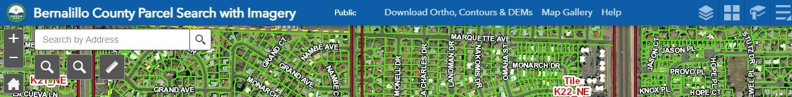
Part I: Due Diligence
Site Selection
  Identify a site - continued
      Find lenders with real estate owned (REO properties)
      Work with a broker with local knowledge
      Find recent sales of similar properties
      Consider hiring a consultant with technical experience, local knowledge, and existing relationships
2022 New Mexico Housing Summit - 09/14/2022
Notes:
May explore these options if there is no municipally owned land.
Especially if new to either the area or affordable housing development in general, approach consultant with local knowledge, understanding of federal/state financing. Consultant may have deep knowledge of local housing priorities and existing relationships.
Extremely important to hire consultant early on if new

Slide 7
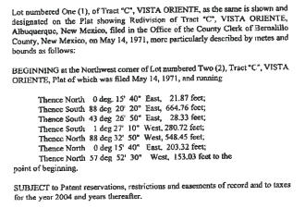
Part I: Due Diligence
Site Evaluation
  Entitlements and Access
    Confirm seller and clear title
    Accuracy of legal description
    Recent surveying/plat maps
    Free of tax liens, judgments, encumbrances
    Covenants, conditions, restrictions, reservations, and easements
    Access to utilities
2022 New Mexico Housing Summit - 09/14/2022
Notes:
You as the buyer are responsible for confirming that property conditions match the descriptions on the title and survey before the sale. They will also need to confirm that the owner of the property is the sole property owner. Most municipalities will be able to perform a title search.
Properties that have existing access roads may not be accessible to public water and sewer without significant infrastructural work.
The difference between available on-site utilities and “nearby” utilities can cost a developer hundreds of thousands of dollars in work and delays, even when the connecting distance is only a few dozen meters.

Slide 8
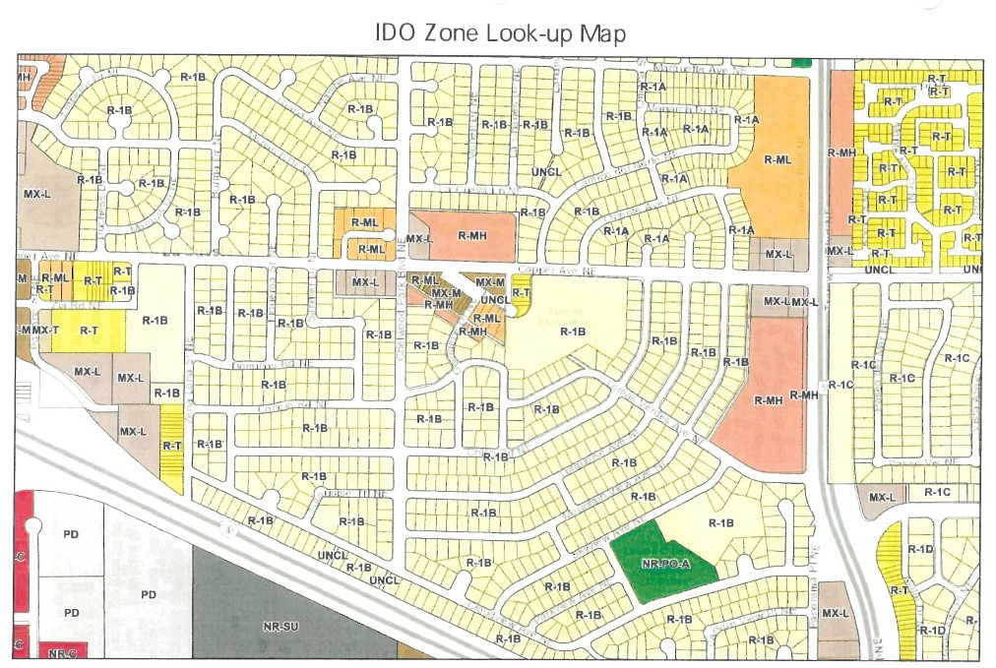
Part I: Due Diligence
Site Evaluation
  Land Use & Zoning
    Find zoning maps and contact planning department
    Residential code
    Permissible density
    Floor area ratio (FAR) and setbacks
    Assess adjacent uses
    Parking requirements
    Right of way and road access
2022 New Mexico Housing Summit - 09/14/2022
Notes:
Failing to do proper checks on zoning guidelines could result in costly plan revisions, perhaps even a long and drawn out petitioning process that could slow your development by months or years.

Slide 9
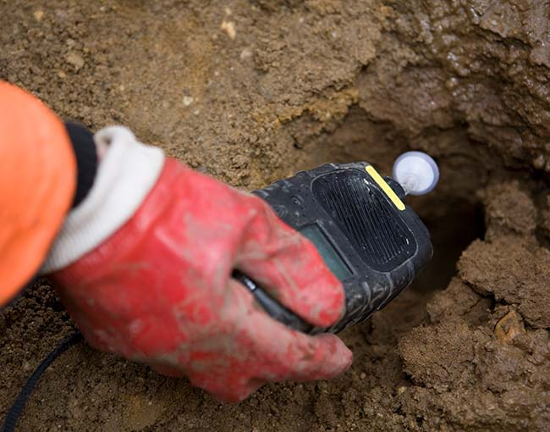

Part I: Due Diligence
Site Evaluation
  Environmental Due Diligence
    Historical structures and materials
    Adjacent properties and uses
    Wetlands and sensitive habitats
    FEMA Flood Map
    Phase I Environmental Site Assessment or other recent reports
Environmental issues may pose serious challenges but may also present a unique opportunity…
2022 New Mexico Housing Summit - 09/14/2022
Notes:
Not building enough time into the project plan for environmental due diligence is probably the biggest driver of unexpected setbacks.
Land with environmental issues may be less desirable to market rate developers, but may be a point of leverage for an affordable housing developer. May be in municipality’s best interest to assist in remediation, or they may be grants involved in remediation.

Slide 10
Part II: Design and Feasibility
Preliminary site feasibility
Now that you’ve selected a site that meets your basic criteria and have established site control…
      Determine number of units
      Determine unit mix and size
      Approximate space needed for community rooms and amenities
      Approximate outdoor and landscaping space
      Assess market need/demand for your initial concept (market study)
      Develop community support for your project early on
2022 New Mexico Housing Summit - 09/14/2022
Notes:
Building the outline of your development concept. What is feasible for the site? Realistic capacity? Preliminary rent schedule.
Community support/input will ultimately affect decisions.

Slide 11
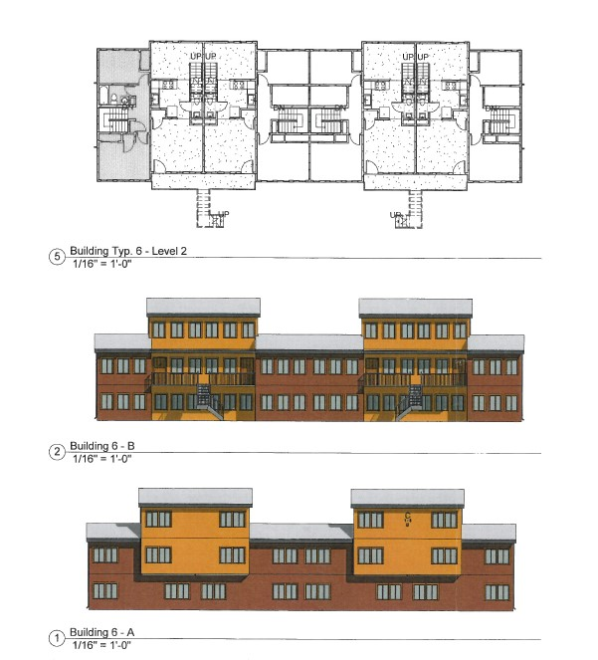
Part II: Design and Feasibility
Preliminary Site & Building Design
  Site and Building Design
    Select an architecture firm with experience on similar projects
    Architect produces preliminary building design and floor plan (emphasis on preliminary!)
    Likely will work through several iterations throughout development lifecycle
    Ensure compliance with MFA Mandatory Design Standards
2022 New Mexico Housing Summit - 09/14/2022
Notes:
Optimum scheme can start to be identified. This is preliminary, as the final determination will be based on factors such as the proposed site’s physical capacity, market conditions, the availability of financing, and the character of the neighborhood and surroundings. The development concept will change throughout the pre-development process.

Slide 12
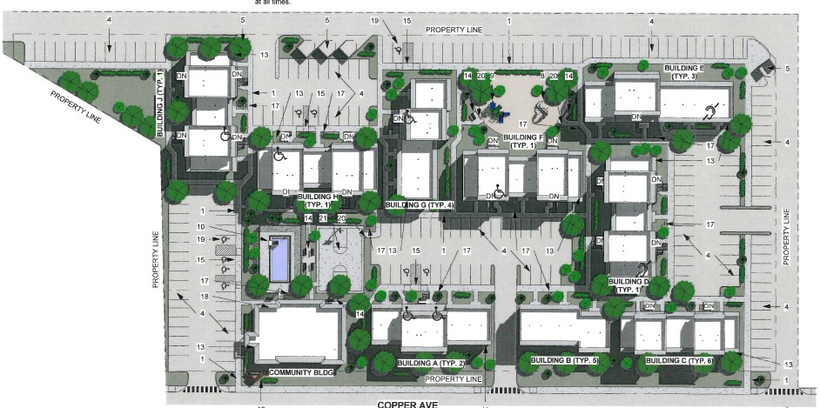
Part II: Design and Feasibility
Preliminary Site & Building Design
2022 New Mexico Housing Summit - 09/14/2022
Notes:
Site plan. Building configuration. Orientation. Part of application for funding.

Slide 13
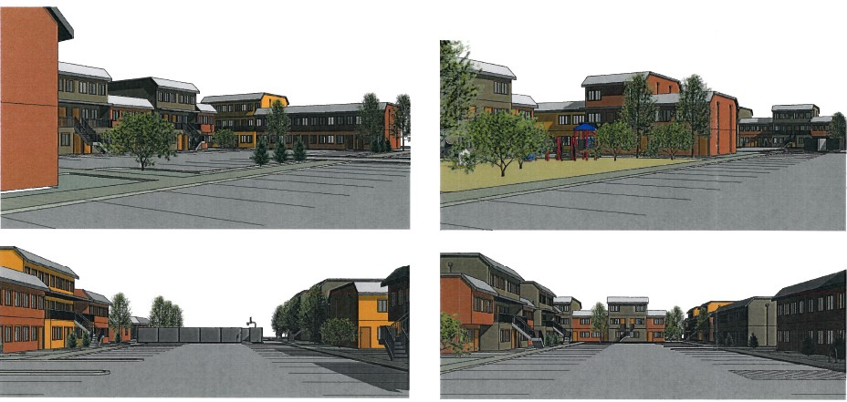
Part II: Design and Feasibility
Preliminary Site & Building Design
2022 New Mexico Housing Summit - 09/14/2022

Slide 14
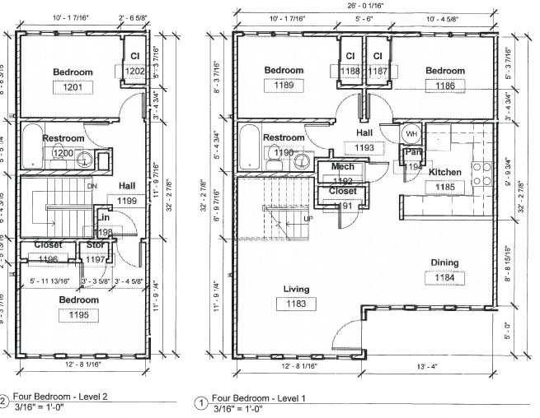
Part II: Design and Feasibility
Preliminary Site & Building Design
2022 New Mexico Housing Summit - 09/14/2022

Slide 15
Part III: Financing
Development Budget
  Develop a budget
    Discuss materials and level of finishes with architect
    Architect completes preliminary site and building design
    Establish relationship with general contractor(s) for a preliminary cost estimate
    Utilize historical data from previous projects
    Consultant may be essential to developing more complete budget
    First step in building a basic financial snapshot
2022 New Mexico Housing Summit - 09/14/2022
Notes:
Consultant with extensive land planning and real estate development experience may also be a good resource in your effort to quantify costs.
Development budgets need to be continually refined as a project progresses and new information about a site is uncovered. Especially in today’s environment, costs will change frequently.

Slide 16
Part III: Financing
Project NOI
  Determine project revenue
    Calculate total annual income from rents
    Area Media Income (AMI)
    Current HUD Rent and Income Limits (released annually, available on MFA’s website)
    AMI restrictions from funding sources
2022 New Mexico Housing Summit - 09/14/2022

Slide 17






Part III: Financing
Project NOI
100 units serving 60%, 50%, 30% AMI Households (+6 market rate units)
Total income from rents: $1,054,260
2022 New Mexico Housing Summit - 09/14/2022
Notes:
For this example, we have a project that has plans on building 100 units. Determined that project will serve households at or below 60, 50, and 30% of the Area Median Income, with 6 market rate units

Slide 18
Part III: Financing
Project NOI
  Build an operating budget
    Calculate annual revenues from rents and other income (laundry, parking, etc.)
    Factor in vacancy to calculate Effective Gross Income (EGI)
    Expenses: management fee, other admin, utilities, supportive services
    Effective Gross Income – Total expenses = Net Operating Income (NOI)
    NOI is key metric for determining loan size
2022 New Mexico Housing Summit - 09/14/2022

Slide 19

Part III: Financing
Project NOI
Rental income + Laundry income = $1,061,760
Less Vacancy @ 7% = ($74,323)
Effective Gross Income = $987,437
Total Expenses = $574,847
NOI = $412,590
2022 New Mexico Housing Summit - 09/14/2022

Slide 20
Part III: Financing
Capital Stack
  Secure funding
    Conventional first mortgage (almost always largest loan source)
    Construction vs permanent funding
    Permanent first mortgage critical to securing other funding
    Lenders require NOI to cover annual debt service with significant income left over
    How much debt can the project handle?
2022 New Mexico Housing Summit - 09/14/2022

Slide 21
Part III: Financing
Capital Stack
  First Mortgage Loan Sizing
    NOI/Debt Service = Debt Service Coverage Ratio (DSCR)
      NOI/DSCR = Debt Service
    Banks commonly want at least 1.15 DSCR (on first mortgage only)
      NOI/1.15 = Annual $ available to service debt
    Interest rate and terms produce a loan constant
      Loan constant = annual debt service / loan amount
      Annual available cash / constant = maximum loan size
    Loan sizing also contingent on bank’s loan-to-value (LTV) and/or loan-to-cost (LTC) maximum limit policy
2022 New Mexico Housing Summit - 09/14/2022

Slide 22
Part III: Financing
Low Income Housing Tax Credits (LIHTC)
  Low Income Housing Tax Credits (LIHTC)
    IRS Program created in Tax Reform Act of 1986
    In New Mexico, LIHTC Program is administered by New Mexico Mortgage Finance Agency (MFA)
    Purpose → To stimulate private investment in affordable housing
    Mechanism → Investors fund project and, in exchange, they can claim dollar for dollar credit against their tax liability for 10 years
    Scale → $2.60 per capita to each state (2022)
        NM: 2,115,877 x $2.60 = $5,501,280
    Credit amount is based on the cost of acquiring, constructing or rehabilitating housing developments (known as “Eligible Basis”)
2022 New Mexico Housing Summit - 09/14/2022
Notes:
12:45pm Thursday – LIHTC financing

Slide 23
Part III: Financing
Low Income Housing Tax Credits (LIHTC)
  9% and 4% Tax Credits
    Both 9% and 4% credits available
    9% credits are competitive
    For 9% LIHTC, states receive a finite allocation of tax credits each year, allocated on a per capita basis (approx. $5-6M per year in NM)
    9% LIHTC provides the deepest federal subsidy, funding roughly 70% of total development cost
    4% credits are non-competitive and are “as of right” with the use of tax-exempt bonds
    4% credits attract less equity, funding roughly 30% of total development cost
2022 New Mexico Housing Summit - 09/14/2022
Notes:
12:45pm – LIHTC financing

Slide 24
Part III: Financing
Low Income Housing Tax Credits (LIHTC)
  Tax Credit Affordable Use
    Minimum set asides:
      20% of units for tenants earning no more than 50% AMI, or
      40% of units for tenants earning no more than 60% AMI (by far the most common option), or
      Average Income: can serve households up to 80% AMI if at least 40% of total units are restricted at an average of 60% AMI or below
    Use restriction for a minimum of 30 years required (income and rent limits)
2022 New Mexico Housing Summit - 09/14/2022

Slide 25
Part III: Financing
Low Income Housing Tax Credits (LIHTC)
  Partnership Structure
General partner controls and operates the project, provides guarantees
Passive limited partner invests equity in return for 99.99% ownership
Limited partner gets its return almost exclusively from the tax credits and tax losses from project
Equity from the sale of credits reduces debt & other financing needs, resulting in lower rents
General Partnership (LLLP/LLP) or LLC
General Partner or Managing Member (0.01%)
Limited Partner Investor or Investor Member (99.99%)
2022 New Mexico Housing Summit - 09/14/2022

Slide 26
Part III: Financing
Low Income Housing Tax Credits (LIHTC)
9% Low-Income Housing Tax Credit Process
Allocation
Tax credits are allocated to the designated Allocation Agency on a per-capita basis
$5.5 million allocated to NM in 2022
Awards
9% credits are awarded to proposed development projects through a competitive process, outlined by the Qualified Allocation Plan.
Ex. Project A: $1,000,000 in credits awarded.
Equity Produced
Projects “sell” 10-years worth of credits to investor looking to off-set tax liability (around 88 cents per dollar of credit), producing around 70% of the total development costs.
Ex. Project A:
$1,000,000 x 10 years =
$10,000,000 in total credits
$10,000,000 x $0.88 =
$8,800,000 in equity produced
Compliance
While the investor takes credits annually for only the first 10 years, credits can be recaptured if the project is not in compliance for 15 years. Additionally, extended compliance periods range from 15-20 more years, following the initial 15 years.
2022 New Mexico Housing Summit - 09/14/2022

Slide 27
Part III: Financing
Low Income Housing Tax Credits (LIHTC)
9% LIHTC Funding Example
Credit by Basis
Eligible Basis | $10,000,000
App Fraction | 100%
Adjusted Basis | $10,000,000
QCT/DDA Boost | 130%
Qualified Basis | $13,000,000
Applicable % | 9.00%
Annual Credit | $1,170,000
x 10 years | $11,700,000
Investor Portion | 99.99%
 | $11,698,830
Price per Credit | $0.88
Credit Proceeds | $10,294,970
2022 New Mexico Housing Summit - 09/14/2022

Slide 28
Part III: Financing
Gap Financing
  Fill the gap
    Almost all projects will have a gap due to lower rents
    Determine gap left over after first mortgage and tax credits
    Five or more funding sources is common
    Understand eligibility and constraints of funding programs
    Adjust preliminary rents / NOI accordingly in projections
    Apply for gap funding with full proforma (projected capital stack, rents, operating expenses, and cash flow)
2022 New Mexico Housing Summit - 09/14/2022

Slide 29
Part III: Financing
Gap Financing
  Gap Financing – Loan Program Examples
    HOME – Federal funding (HUD)
    National Housing Trust Fund (NHTF) – Federal funding (HUD)
    New Mexico Housing Trust Fund (NMHTF) – State funding
2022 New Mexico Housing Summit - 09/14/2022
Notes:
Discuss basic terms, loan limits. Example uses two of three

Slide 30
Part III: Financing
Gap Financing
  Other Gap Financing Examples
    Deferred developer fee
    Developer or contractor contributions
    City or County contributions (HOME, CDBG)
    Other Tax Credits (Solar, Historic)
    FHLB Affordable Housing Program grants
2022 New Mexico Housing Summit - 09/14/2022

Slide 31
Part III: Financing
Project NOI
Capital Stack
Financing Sources
Lender/Program
Contact Person Name/Telephone #
Construction
Interest
Payment
Term
Amount
Permanent Amount
Amount
Frequency
Amort. Yrs.
Loan Yrs.
First Mortgage
First National Bank/ American Natl Bank
John Smith 555-1234/Bob Jones 555-9876
$
12,400,000
$
5,000,000
5.00%
$
302,813
Annual
35
16
Second Mortgage
MFA HOME
Tim Martinez 505-767-2258
$
900,000
$
1,000,000
$
12,500
Annual
80
40
Third Mortgage
MFA NM Housing Trust Fund
Tim Martinez 505-767-2258
$
1,000,000
$
500,000
3.00%
$
25,296
Annual
30
30
Other:
Other:
Other:
Grant
Deferred Developer Fee
Best Development Co.
$
639,406
$
131,355
Subtotal:
$
14,939,406
$
6,631,355
Other Equity
Other Equity
Tax Credit Proceeds
Big Tax Credit Investor
Bill Johnson 800-555-5553
$
3,560,594
$
11,868,645
Total:
$
18,500,000
$
18,500,000
2022 New Mexico Housing Summit - 09/14/2022
Notes:
Have development budget/discussed with contractor, soft costs etc. Budget number = 18,500,000
Construction vs permanent,
Go through all sources. Const first lender / perm first lender (won’t necessary be the same)
Perm pays off construction lender.
Perm – MFA adds 50bps (boost is a stress test)
Annual debt service/loan terms
Deferred developer fee, paid off during cash-flow

Slide 32
Part III: Financing
Project NOI
15-Year Proforma
2022 New Mexico Housing Summit - 09/14/2022
Notes:
Escalators – industry standards
Deferred developer fee paid off

Slide 33

Part III: Financing
Closing the deal
  Project closing
    All conventional and MFA financing secured/approved
    Closing generally takes two months to coordinate between all parties
    Closing calls begin between all lenders, the developer, tax credit investor, attorneys, title, etc.
    Lenders draft loan documents and language is negotiated between developer, lenders, tax credit investor, and attorneys
    Fulfill MFA Closing Checklist and other parties’ requirements
    Documents fully executed and all encumbering documents recorded at closing
    Initial draws disbursed to the partnership
2022 New Mexico Housing Summit - 09/14/2022

Slide 34
Part IV: Construction
  Construction with MFA financing
      MFA typically allows for a 24-month period for construction
      MFA must approve construction documents and contracts ahead of construction start
      Different MFA loan products carry specific drawdown requirements and schedules
      MFA requires proof of expenditure with request for reimbursement
      Federal funding requires Section 3 compliance
      MFA monitors construction progress with on-site inspections at the 33% and 66% points, as well as at completion (may be more frequent depending on funding source)
      MFA requires a meeting with MFA’s Housing Development and Asset Management staff, the developer, and the on-site management staff for the project around the 50% mark of construction
2022 New Mexico Housing Summit - 09/14/2022

Slide 35
Part IV: Construction
  Construction completion
      HUD Final Completion form submitted to MFA (if applicable)
      Final draws made
      Permanent financing pays off construction financing
      Monthly principal and interest payments begin
      Project placed-in-service and LIHTC LURA issued
      MFA issues IRS Form 8609 allowing tax credits to flow to investor
      Project is complete and MFA Housing Development no longer manages
      Project is turned over to MFA Asset Management for long-term compliance monitoring (income/LURA requirements, property inspections, annual compliance reporting, etc.)
2022 New Mexico Housing Summit - 09/14/2022

Slide 36
Thank you!
Have an idea for a project and want to see where MFA might fit in? Fill out our Developer Meeting Request Form at: www.housingnm.org/developers

