Slide 1
Title Deactivation and More: 2025 Update
2025 - New Mexico Housing Summit

Slide 2
ALWAYS REMEMBER:
ONCE A MANUFACTURED HOME, ALWAYS A MANUFACTURED HOME.
SET THE RIGHT EXPECTATIONS FOR YOUR SELLER AND BUYER.

Slide 3
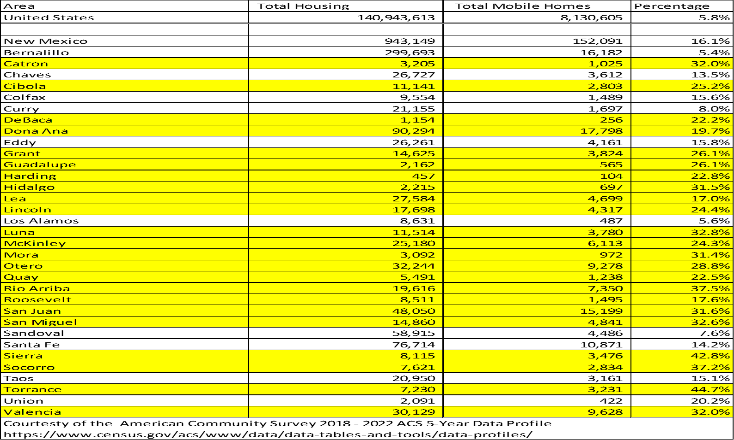

Slide 4

Is the manufactured home titled and deactivated with MVD?
Need Serial Number for the manufactured home (which is registered as the VIN number for MVD purposes)
NOTE: “Location of Manufactured Home Address” must match the current situs address.

Slide 7
Where can we obtain the serial (VIN) Number for the manufactured home
Prior Manufactured Home Title
Data Plate / Compliance Certificate
HUD Verification Label Letter from IBTS (www.ibts.org)
Prior MSO/MCO (Manufacturer’s Statement/Certificate of Origin) Copy

Slide 8
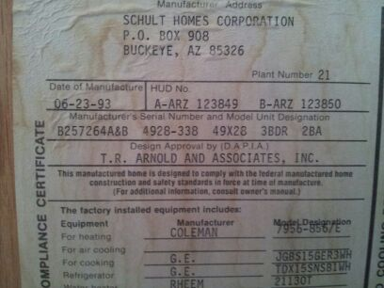
Data Plate / Compliance Certificate

Slide 9
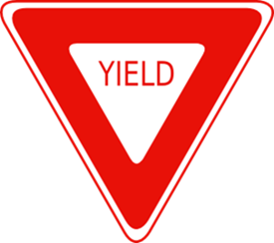
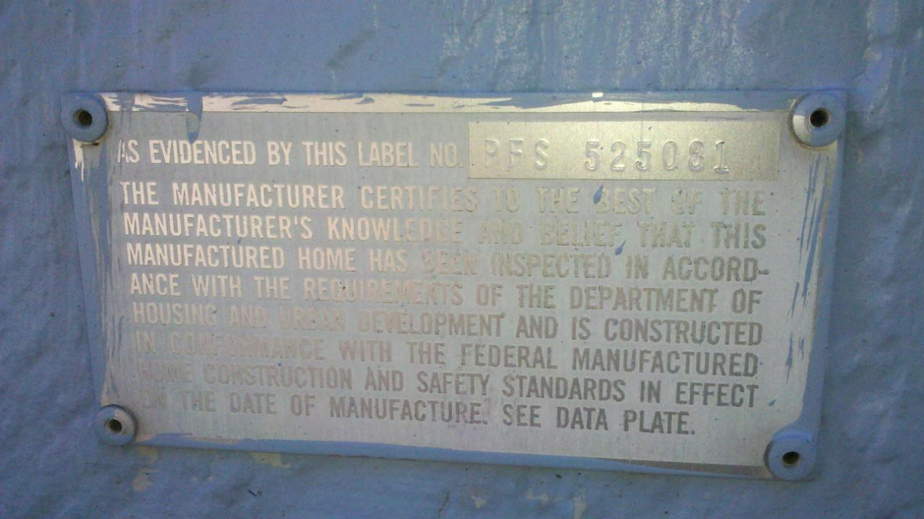
HUD Verification Label Letter
You will need the HUD Certification Label Numbers (aka HUD Tags):

Slide 10
Is the manufactured home taxed as real property by the county assessor’s office?
Best proof is a letter from the county assessor.
Note: Just because a manufactured home is taxed as real property does not guarantee that the manufactured home is on a permanent foundation.

Slide 12
Will a foundation inspection be required?
Even if the title is deactivated, many lenders will require an engineer to certify
home is currently on a permanent
foundation (according to current guidelines)

Slide 13
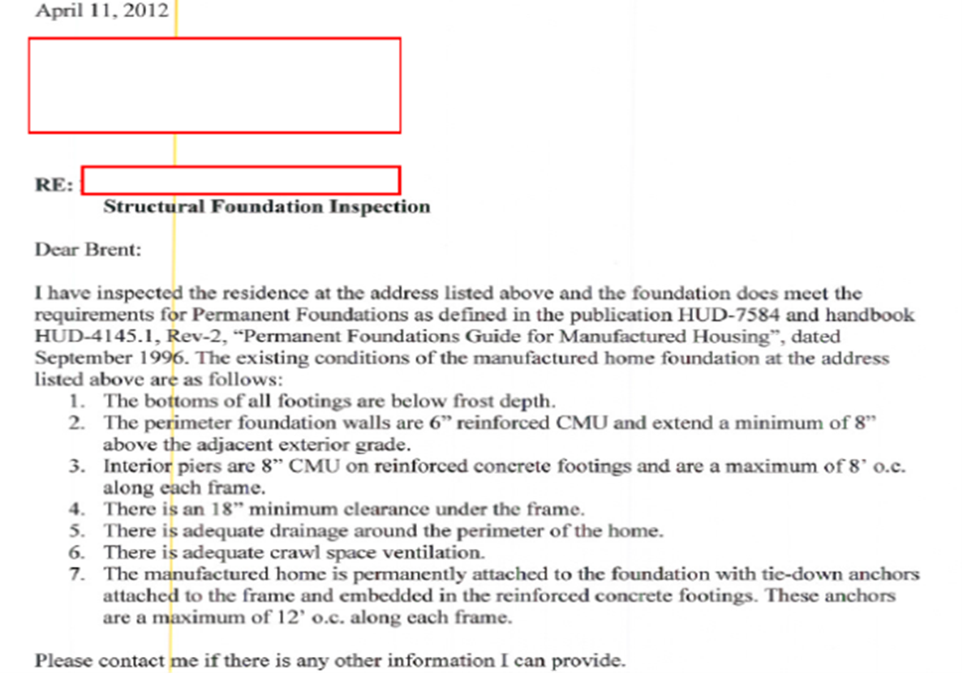

Slide 14
Can proof be provided that the home was not installed in a prior location (moved more than once)?
Structurally
Documentation

Slide 15
For lending purposes, are the HUD Tag Label(s) located on the outside of the home AND/OR is the Data Plate/Compliance Certificate affixed inside the home? If not, you may need IBTS.
Scott Florez, Owner/Founder
Title Land Consulting LLC
505.217.8988
scott@titlelandconsulting.com or
titlelandconsulting@gmail.com

