Slide 1
Lending Considerations for Manufactured Homes
Presented for
New Mexico Mortgage Finance Authority
February 28th, 2018

Slide 2
Title Deactivation Rule
18.19.3.16 DEACTIVATION OF TITLE TO A MANUFACTURED HOME: Title issued pursuant to the provisions of the Motor Vehicle Code to a manufactured home shall be deactivated by the department when:
A. the person in whose name the manufactured home is titled requests in writing that the department deactivate the title;
B. the title is free and clear of all recorded liens and encumbrances; and
C. the valuation authority certifies to the department that, once title is deactivated, the housing structure will be taxed as real property.
[7/15/98; 18.19.3.16 NMAC - Rn, 18 NMAC 19.3.18, 9/14/00]

Slide 3
Taxation as Real Property Rule
3.6.5.33 SPECIAL METHOD OF VALUATION -MANUFACTURED HOMES
D. MANUFACTURED HOMES - WHEN VALUED AS REAL PROPERTY
(1) A manufactured home becomes a housing structure that is to be valued and taxed for property taxation purposes as real property when:
(a) the valuation authority has received a request from the owner of a (b) the tongue and axle have been removed from the manufactured home and the manufactured home has been affixed to a permanent foundation in accordance with Part 14.12.2 NMAC;
(c) the owner of the manufactured home owns the real estate to which the manufactured home has been affixed; and
(d) title to the manufactured home, issued pursuant to the provisions of the Motor Vehicle Code, is deactivated in accordance with Section 18.19.3.16 NMAC and evidence of the deactivation has been provided to the valuation authority.

Slide 4
Originating a Loan with a Manufactured Home
Has the title been deactivated with MVD?
Has the home been taxed (assessed) as real property by the County Assessor?

Slide 5

Case Study – 5400 Don Luciano Court SW, Albuquerque
Step One – Determining if the home title has been deactivated
NOTE: We need the serial number (VIN) number.

Slide 8
Where can we obtain the serial (VIN) Number for the manufactured home
Prior Manufactured Home Title
Data Plate
HUD Verification Label Letter from IBTS (www.ibts.org)
Prior MSO/MCO (Manufacturer’s Statement/Certificate of Origin) Copy

Slide 9
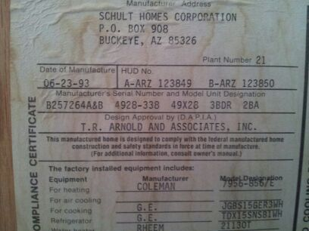
Data Plate

Slide 10

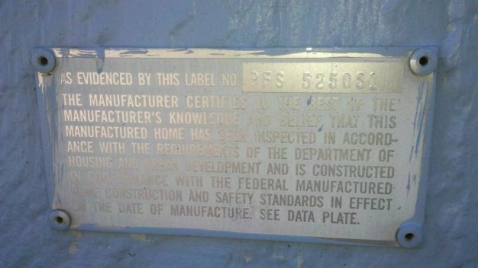
HUD Verification Label Letter
You will need the HUD Certification Label Numbers (aka HUD Tags):

Slide 11

Case Study – 5400 Don Luciano Court SW, Albuquerque
Step Two – Determining if the home has been taxed (assessed) as real property
NOTE: Taxation as real property does not guarantee the home is on a permanent foundation.

Slide 14
Permanent Foundation Proof – Engineer’s Certification

Slide 15
Permanent Foundation Proof – State (MHD) Foundation Inspection Permit (aka Green Tag)

Slide 16
Troubleshooting the Common Title Scenarios
1. The home is taxed as real property; however, the title is still "Active" (aka not deactivated) in the seller's name OR in the name of a prior owner.
2. The home is taxed as real property; however, the home was never titled with MVD.
3. The home is taxed as personal property (separate from the land) and the title is still "Active" (aka not deactivated) in the seller's name OR in the name of a prior owner.
4. The home is taxed as personal property (separate from the land) and the home was never titled with MVD.
5. The home was never rendered for assessment (no tax bill) and the home was never titled with MVD.

