Slide 1


Housing New Mexico
MFA
New Mexico Housing Strategy 2026 Update
Robyn Powell
Senior Director
Policy & Planning

Slide 2

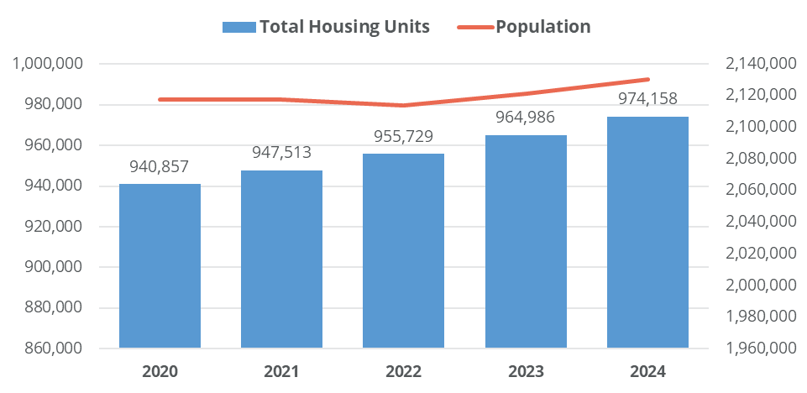
Population Trends
Housing Units and Population, New Mexico, 2020-2024
Population and housing units:
Between 2020 and 2024, the population is estimated to have grown by 12,701 (0.6%) residents and the housing stock is estimated to have increased by 33,301 units (3.5%).
Increased production helped address needs and respond to population changes.
Source: U.S. Census Annual Estimates of the Resident Population and Housing Units for Counties in New Mexico: April 1, 2020 to July 1, 2024.

Slide 3
Population Trends
Population and Households by County, 2010-2023
Source: U.S. Census Annual Estimates of the Resident Population and Housing Units for Counties in New Mexico: April 1, 2020 to July 1, 2024.
Population and households:
Between 2010 and 2023—households grew faster (9% increase) than residents (5% increase). This demographic trend is reflective of declining household sizes due to an aging population, declining birth rates, and fewer families with children.
Population growth was concentrated in Doña Ana, Sandoval, Valencia, Santa Fe, and Otero counties; but according to Census Address Count Files, all counties gained housing units. Housing was built regardless of population loss.

Slide 4
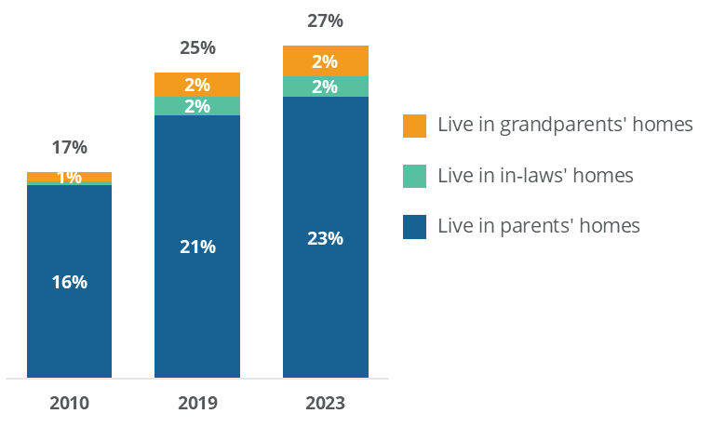
Population Trends
Share of Adults Aged 25 to 34 Living in Homes of Older Relatives, New Mexico, 2010, 2019, and 2023
Adults living with older relatives:
Approximately 27% of New Mexico young adults aged 25 to 34 live in the homes of older relatives as of 2023, up from a much lower 17% in 2010, suggesting significant pent-up housing demand.
Source: U.S. Census Annual Estimates of the Resident Population and Housing Units for Counties in New Mexico: April 1, 2020 to July 1, 2024.

Slide 5
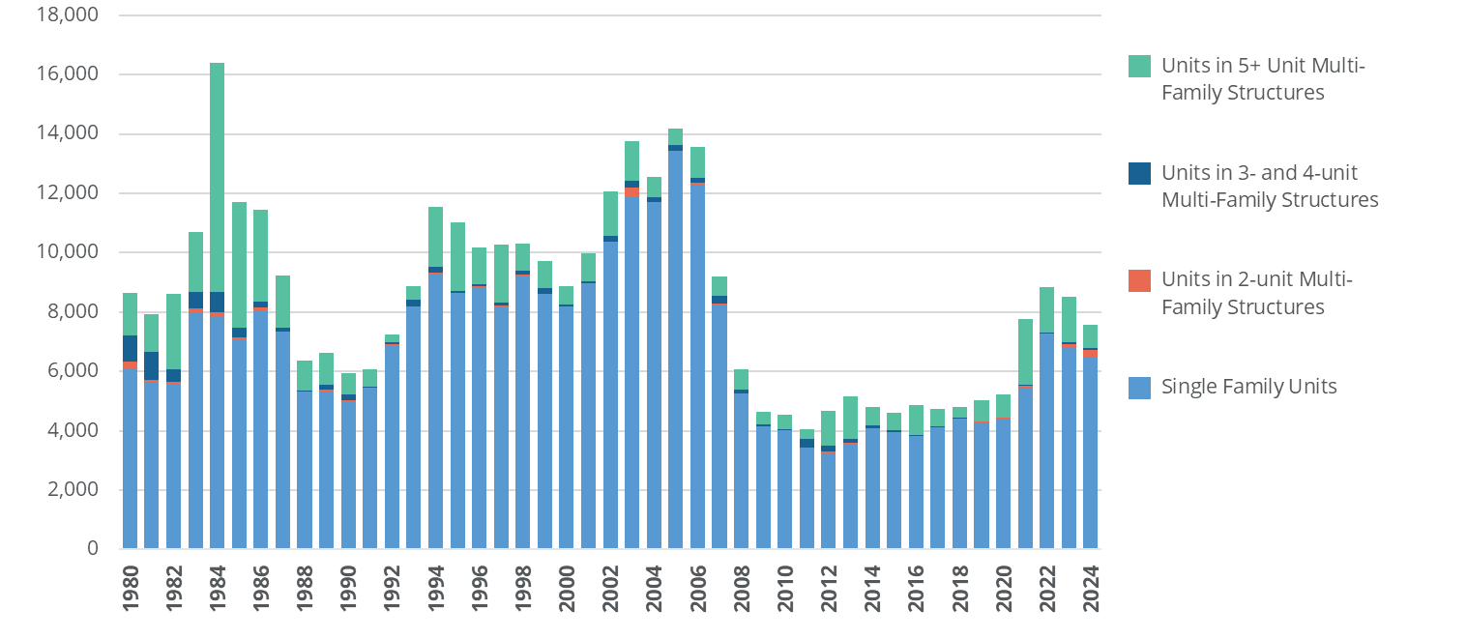
Housing Type
Building Permits, 1980-2024
Permit trends:
The vast majority of new housing built has been single family detached homes, which made up 80% of residential permits issued between 2020 and 2024.
This underscores the continued need for more diverse housing types to meet the full range of household sizes, incomes, and housing preferences across the state.
While permitting of multifamily units increased in 2021 and duplex permitting rose notably in 2024, these unit types remain a small share of overall production.
Source: U.S. Census Building Permit Survey, and Root Policy Research.

Slide 6
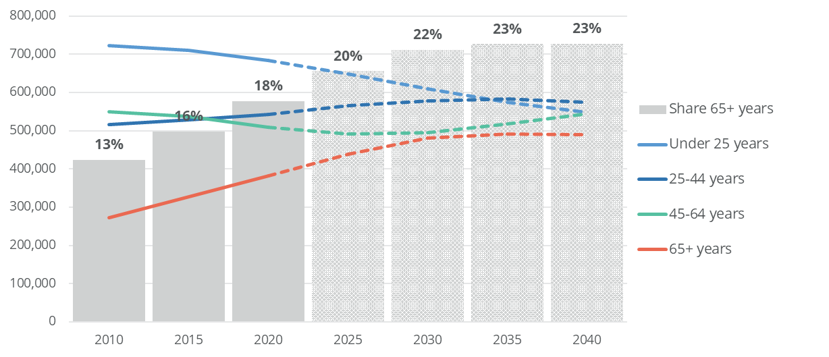
Population and Population Projection
Population and Population Projections, 2010-2040
An aging population:
The share of residents aged 65 and older is projected to nearly double, from 13% in 2010 to 23% by 2035.
Older adults have the highest household formation rate of any age group at 64%—meaning that a rapidly increasing share of New Mexico’s households will be older adults.
Most will remain in their homes as they age.
Source: The University of New Mexico Geospatial and Population Studies, and Root Policy Research.

Slide 7
Projected Housing Needs
An aging population:
Given older adults’ higher household formation rates, household growth will continue even as the overall population declines.
The number of households is projected to grow through 2040 before tapering slightly, meaning housing demand will remain elevated longer than population trends alone would suggest.
Population and Household Projections
Note: 2010 and 2020 data are from the Decennial Census.
Source: The University of New Mexico Geospatial and Population Studies, ACS 2023 5-year estimates, and Root Policy Research.
.

Slide 8
Projected Housing Needs
Projected Total Units Needed by 2045, by County, AMI
Total projected needs:
Statewide, nearly 58,000 new units will be needed by 2045 to accommodate projected household growth.
Need is heavily concentrated in four counties. Bernalillo, Sandoval, Doña Ana, and Santa Fe together account for nearly 90% of the projected unit need statewide.
Note: Holding 2023 household formation rates and 2021 AMI distributions constant. Numbers assume a 2% ownership vacancy rate and a 5% rental vacancy rate.
Source: The University of New Mexico Geospatial and Population Studies, 2023 5-year ACS, 2021 CHAS, and Root Policy Research.

Slide 9
Projected Housing Needs
Projected Ownership Units Needed by 2045, by County, AMI
Projected needs for ownership units:
The ownership needs of very low income (0-50% AMI) households will largely be met by older residents aging in place, as long as they can afford to remain in their homes, and if their homes meet their mobility needs.
As such, the ownership very low income needs estimates can be thought of as an upper bound estimate of need and are largely reflective of owner households who need assistance with utilities, home maintenance, and home rehabilitation.
Note: Holding 2023 household formation rates and 2021 AMI distributions constant. Numbers assume a 2% ownership vacancy rate.
Source: The University of New Mexico Geospatial and Population Studies, 2023 5-year ACS, 2021 CHAS, and Root Policy Research.

Slide 10
Projected Housing Needs
Projected Rental Units Needed by 2045, by County, AMI
Projected needs for rental units:
The projected rental units needed show need for tenant subsidies and new construction of affordable units. The split between tenant subsidies and new construction will be driven by the actual filtering of older units into more affordable price brackets, income changes, the in- and out-migration of renters, and broader economic conditions.
While new construction is essential to improving overall housing affordability, it is unlikely on its own to reach very low-income households. Deliberate efforts to build income-restricted units and provide rental subsidies are therefore necessary.
Note: Holding 2023 household formation rates and 2021 AMI distributions constant. Number assume a 5% rental vacancy rate.
Source: The University of New Mexico Geospatial and Population Studies, 2023 5-year ACS, 2021 CHAS, and Root Policy Research.

Slide 11
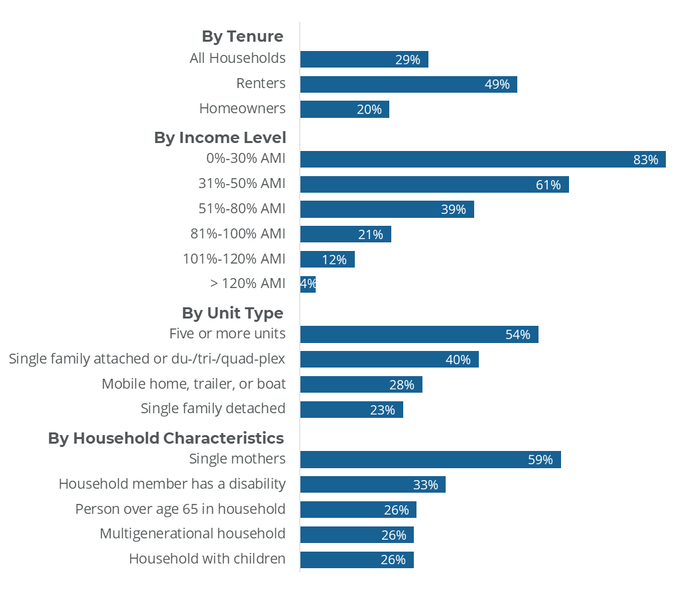
Current Housing Needs
Cost Burden by Tenure, Unit Type, and Household Characteristics, 2023
Note: Figure uses PUMA-level AMI limits. PUMA-level AMI limits are calculated by applying a population-weighted average of each county’s 30%, 50%, 80%, 100% and 120% AMI limit by household size for each PUMA.
Source: 2023 ACS 5-year IPUMS and Root Policy Research.
Nearly half of renters (49%) and one in five homeowners (20%) face cost burden.
This issue is particularly acute for households below 30% AMI, affecting more than four in five of them (83%), as well as single-mother households (59% are cost burdened).

Slide 12
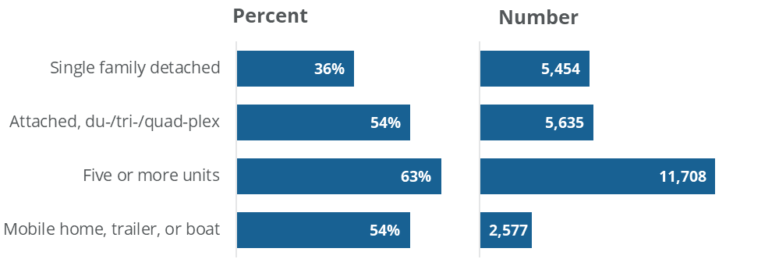
Current Housing Needs
Percent and Number of Cost Burdened Senior Renter Households by Housing Type, 2023
Sixty-three percent of seniors renting in multifamily developments are cost burdened, up from 58% in 2019.
Senior renters in mobile homes have seen the sharpest increase in cost burden (from 41% in 2019 to 54% in 2023), driven by a 53% increase in average rents for that type of housing between 2019 and 2023.
Note: Includes renter households with at least one person over age 65 in the household.
Source: 2023 ACS 5-year IPUMS and Root Policy Research.

Slide 13
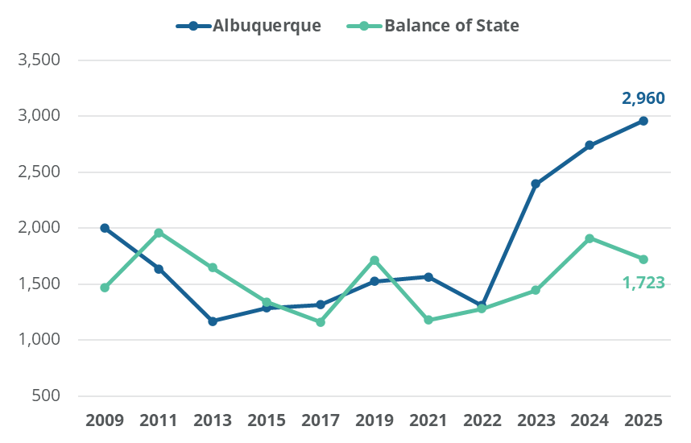
Current Housing Needs
The 2025 PIT Count identified 2,960 persons experiencing homelessness in Albuquerque and 1,723 in the Balance of State.
Approximately 84% of households who accessed homelessness services in New Mexico through CoC agencies in 2025 contained only adults, 11% contained adults and children, and 3% contained only children.
Point-in-Time (PIT) Counts, 2009–2025
Households who Accessed Homelessness Services by Household Type, 2025
Source: ABQ CoC HMIS and NM BoS CoC HMIS.
Source:
2025 Point-In-Time Count
Notes:
Note: 2021 and 2022 PIT Counts were affected by pandemic-related complications. 2023 and 2024 Albuquerque unsheltered counts were more comprehensive than previous years. The 2025 Balance of State count of unsheltered individuals was less comprehensive than in past years due to staff and resource constraints.

Slide 14
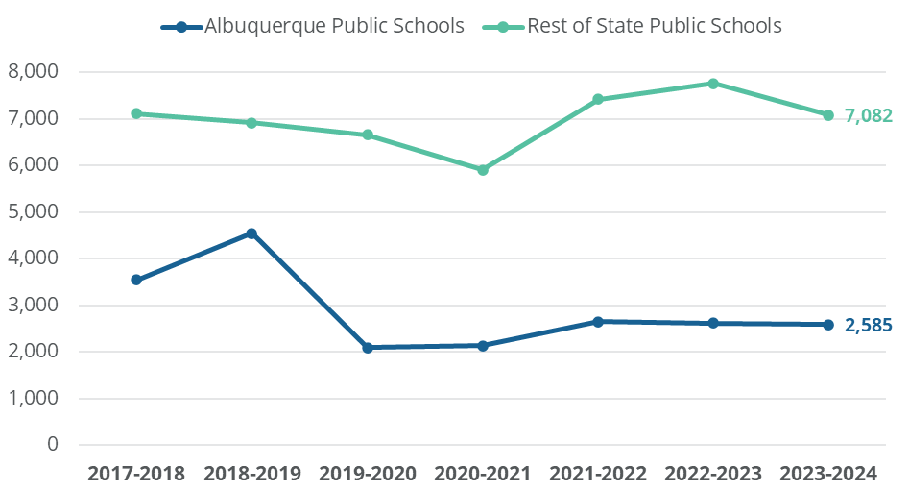
Current Housing Needs
Children Enrolled in New Mexico Public Schools Experiencing Homelessness
Homelessness trends:
In academic year 2023-2024, the most recent year with complete data available, there were 9,667 students experiencing homelessness in New Mexico public schools, down 7% from 10,374 in 2022-2023.
Source: New Mexico Public Education Department Homeless Student Counts and Root Policy Research.
Notes:
Note: Dates follow the academic calendar. Smaller school districts had suppressed numbers when counts were below 10. “Rest of State Public Schools” count assumes that school districts where fewer than 10 students were counted had 9 students counted. According to the 2025 NMCEH Point-in-Time Count Report, 10,533 total students were experiencing homelessness in 2024-2025—a 9% increase from 9,667 in 2023-2024.

Slide 15
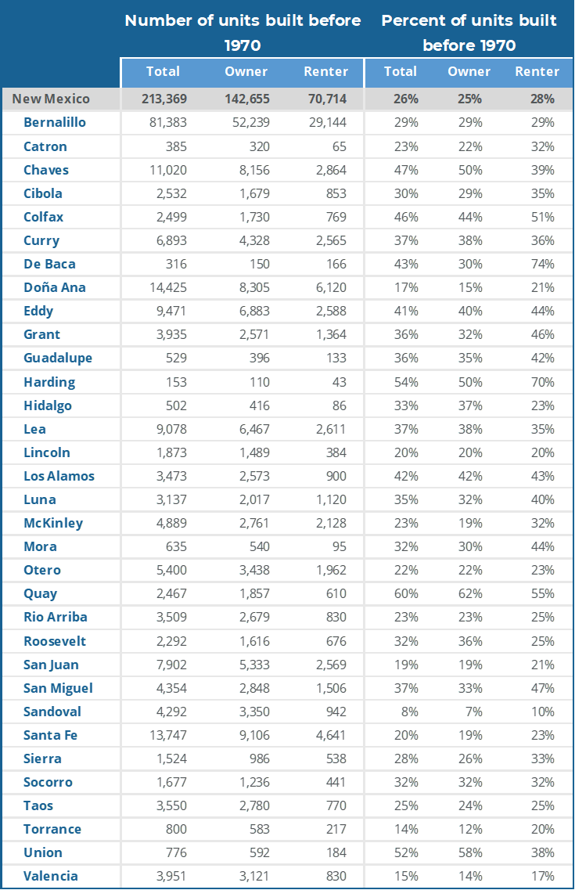
Current Housing Needs
Number and Percent of Occupied Housing Units Built Before 1970 by Tenure and County
Source: 2023 ACS 5-year, and Root Policy Research.
Population and households:
More than one in four occupied housing units (26%) statewide were built before 1970, with significantly higher concentrations in rural counties.

Slide 16
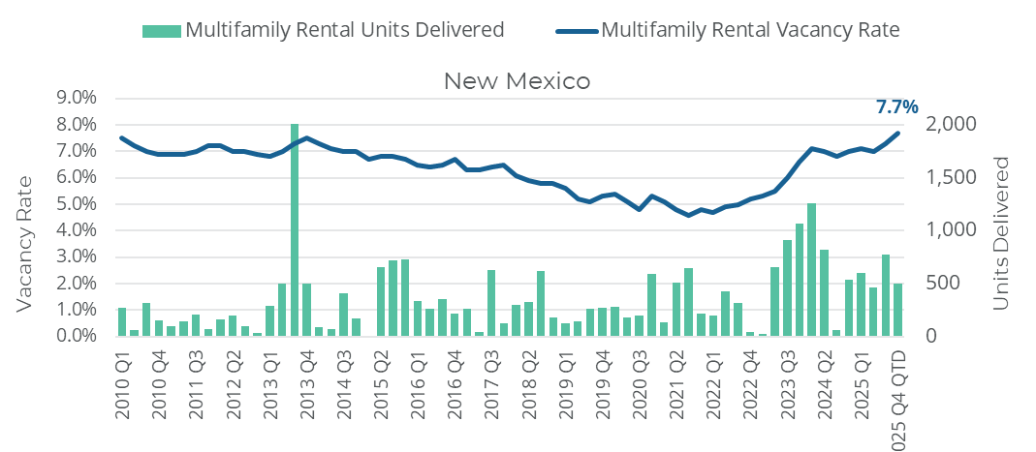
Market Trends
Multifamily Rental Vacancy Rate and Units Delivered, 2010 Q1-2025 Q4 QTD
Rental market trends:
New Mexico's multifamily rental vacancy rate fell to a low of around 4.6% during the pandemic before rebounding to approximately 7.7% in Q4 2025, driven by strong trends in new construction.
Excluding recently built units still in lease-up, the effective vacancy rate is about 6.5%.
Source: CoStar.
Notes:
Note: 2025 Q4 QTD is current as of November 19, 2025.

Slide 17
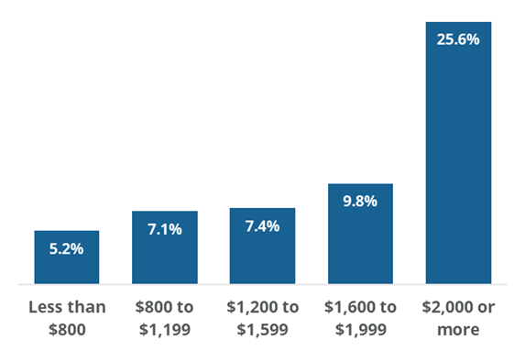
Market Trends
Multifamily Rental Vacancy Rate by Average Effective Rent, 2025 YTD
Rental market trends:
The vacancy rate for units priced below $800/month is 5.2%, compared to rates over 7% for higher priced units.
Renters with lower incomes who need units priced at or below $800 to avoid cost burden face a much tighter market than renters who can afford units at higher price points.
Source: CoStar.
Notes:
Note: 2025 YTD includes January to November.

Slide 18
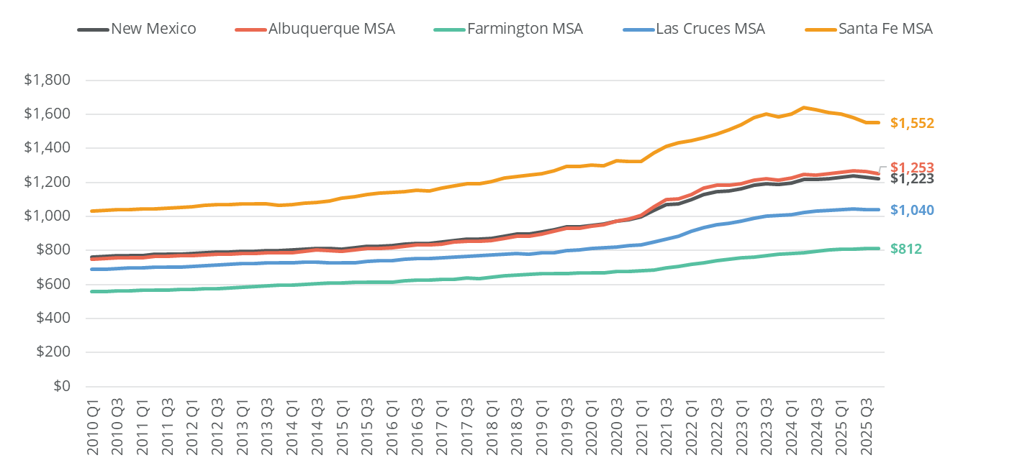
Market Trends
Average Effective Rent for Units in Multifamily Buildings, by MSA, 2010 Q1-2025 Q4 QTD
Rental market trends:
Average multifamily rents in New Mexico increased 48% over the past decade, from $826 in Q4 2015 to $1,223 in Q4 2025.
Rent growth is now stabilizing statewide.
Source: CoStar.
Notes:
Note: 2025 Q4 QTD is current as of November 19, 2025.

Slide 19
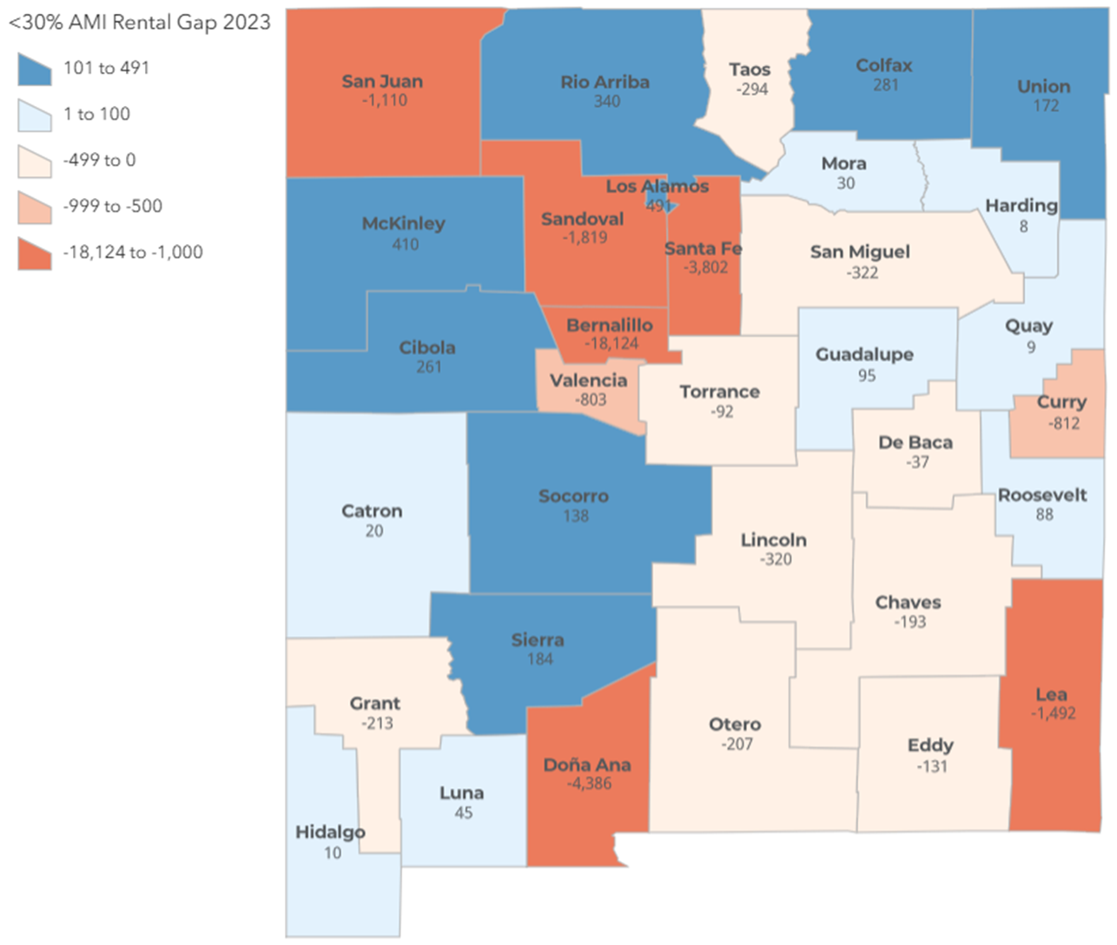
Market Trends
Rental Gap for Households Below 30% AMI by County, 2023
Source: 2023 5-year ACS, and Root Policy Research.
Rental market trends:
The statewide rental gap for households below 30% AMI grew from approximately 32,000 units in 2019 to 34,000 in 2023.
Given the significant increase in rents, a widening of the gap was expected.
The growth of the rental gap is modest, which is reflective of the state’s efforts to add housing affordable to very low income households.
Notes:
Note: Uses the 4-person AMI for each county.

Slide 20
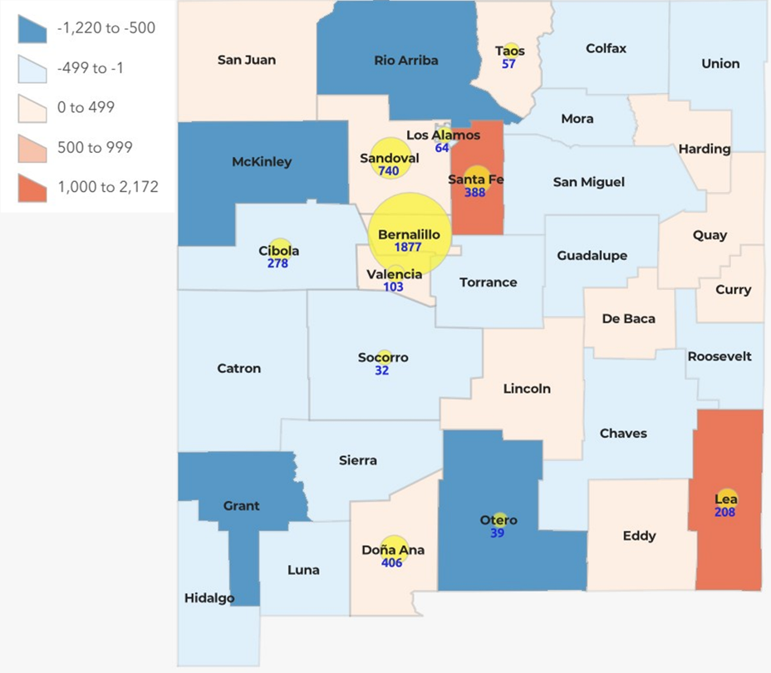
Market Trends
Change in Rental Gap for Households Below 30% AMI and Tax Credit Units Produced by County, 2019-2023
Source: 2019 and 2023 5-year ACS, and Root Policy Research, Housing New Mexico.
Rental market trends:
Production was concentrated in urban counties that experienced the largest gaps. Despite strong production in Santa Fe and Lea Counties, the rental gaps expanded significantly between 2019 and 2023.
In Taos, Sandoval, Bernalillo, Valencia, and Doña Ana, the production coincided with a smaller increase in the gap, and in Cibola, Los Alamos, Otero, and Socorro, affordable housing production coincided with a reduction in the gap.
Notes:
Note: Uses the 4-person AMI for each county.

Slide 21
Market Trends
Median Property Value of Originated Mortgages and Estimated Down Payment Requirements by County, 2020 and 2024
Source: HMDA and Root Policy Research.
Ownership market trends:
Rising property values have significantly increased down payment barriers.
A 20% down payment on the statewide median home now requires $67,000, up from $47,000 in 2020; in Los Alamos and Santa Fe, a 20% down payment exceeds $100,000.

Slide 22
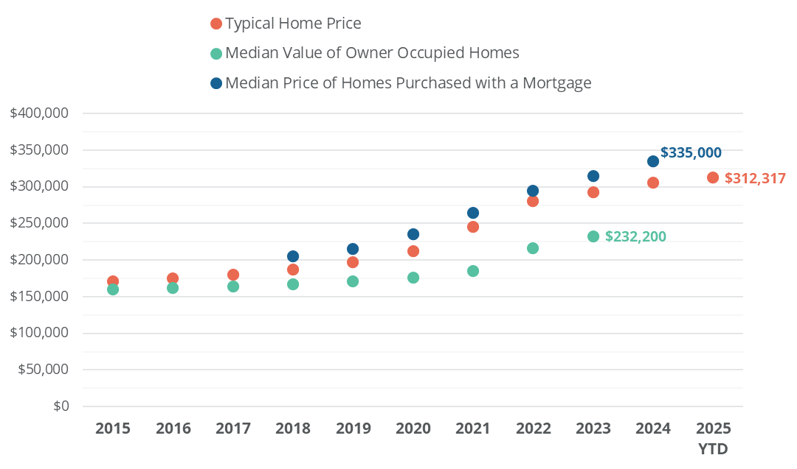
Market Trends
Estimates of Average Home Prices, New Mexico, 2015–2025
Ownership market trends:
New Mexico's typical home value according to Zillow rose 85% over the past decade to approximately $312,000 in 2025, with prices more than doubling in Los Alamos, Valencia, and Sandoval counties.
The median price of homes purchased with a mortgage increased 63% from 2018 to 2024.
Source: 5-year ACS estimates, HMDA, Zillow Home Value Index, and Root Policy Research.
Notes:
Note: “Median value of owner occupied homes” reflects 5-year ACS estimates. “Typical home price” reflects the Zillow Home Value Index. “Median price of homes purchased with a mortgage” reflects HMDA data which include 30-year mortgages originated for homes purchased for principal residence.
2025 YTD “Typical Home Price” includes January-September 2025.
HMDA data not available for years before 2018, ACS estimates not yet available for 2024, 2025 YTD data only provided by Zillow.

Slide 23
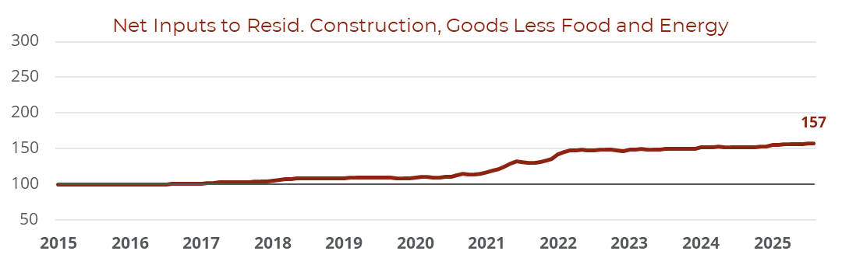
Market Trends
Ownership market trends:
Building material costs remain well above pre-pandemic levels, contributing to slower residential construction and resulting in higher-priced housing.
Softwood lumber and steel saw the largest price increases, and while both have partially moderated, neither has returned to 2019 levels.
Estimates of Average Home Prices, New Mexico, 2015–2025
Source: U.S. Bureau of Labor Statistics Producer Price Index by Commodity, FRED from the Federal Reserve of St. Louis.
Notes:
Note: Prices are indexed to 100 in January 2015. Data are current through August 2025. Data not available for gypsum building materials from June 2016 to August 2018.

Slide 24
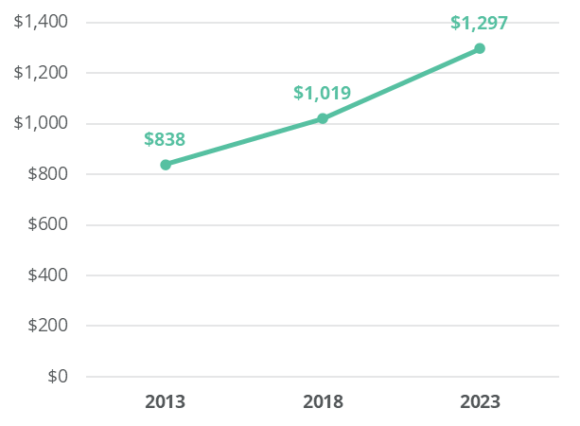
Market Trends
Average Annual Amount Paid for Homeowner’s Insurance, New Mexico, 2013, 2018, and 2023
Ownership market trends:
New Mexico homeowners paid $1,297 annually for homeowner’s insurance on average in 2023.
This is up 27% from $1,019 in 2018 and up 55% from $838 in 2013.
Source: 2023 ACS 5-year IPUMS and Root Policy Research.
Notes:
Note: Includes all types of homeowner’s insurance policies.

Slide 25
Market Trends
Change in Average Quoted Homeowner’s Insurance Premiums, New Mexico and United States, 2021–2024
Ownership market trends:
Insurers in New Mexico raised average premiums by $459 or 19% from 2021 to 2024.
New Mexico’s premiums increased at a slower rate than premiums in the United States overall.
Source: Consumer Federation of America and Quadrant Information Services.
Notes:
Note: Data presents changes algorithmically generated estimates of average quoted homeowner’s insurance premiums in New Mexico and in the United States using data published in a Consumer Federation of America report summarizing changes in average quoted homeowner’s insurance premiums between 2021 and 2024 using purchased industry data.

Slide 26
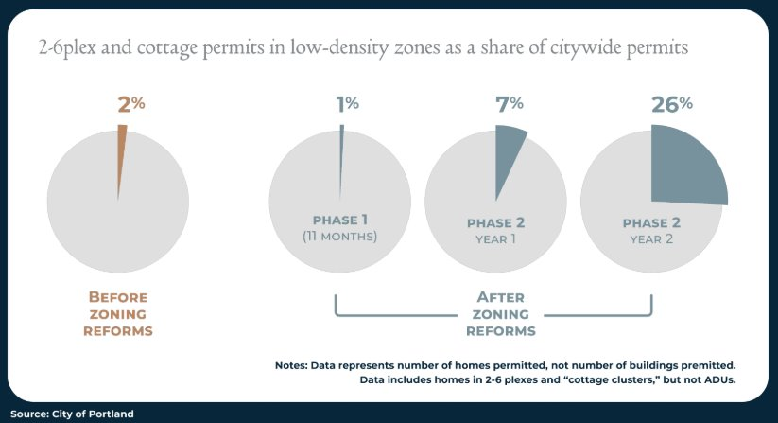
Housing Production Strategies
Oregon Example:
In 2019, House Bill 2001 mandated that cities with populations over 10,000 allow duplex construction. Additionally, cities with populations exceeding 25,000 are required to permit duplexes, triplexes, and quadplexes on lots previously zoned for single-family homes.
It is too early to determine the long-term impact of these smaller housing options. However, data indicate that they have significant potential; within three years of their legalization in Portland, these units accounted for 26% of new residential units approved in the city—and Portland went above and beyond the statewide mandate.
Missing Middle Percent of Citywide Permits in Low Density Zones
Notes:
Source: https://www.sightline.org/2025/06/04/oregons-zoning-reforms-are-working-but-they-need-some-upgrades/

Slide 27
Housing Production Strategies
Minneapolis Example:
“Minneapolis 2040” land-use reform:​ Allows residential or mixed-use buildings up to six stories as-of-right in designated commercial and transit-corridor areas. ​Allows up to three units in residential parcels that previously allowed only detached single family homes.
The Federal Reserve Bank of Minneapolis created a data dashboard to track impacts of the Minneapolis 2040 Plan using a synthetic control of comparable cities.
The tool shows little change so far; expectations are that any evidence of impact will take more time after the plan’s implementation to appear.​
Dashboard shows no statistically significant difference in the volume of multifamily housing construction.​
Missing-middle production remains low. However, Hennepin County District Court issued an order that blocked development of housing with 3+units in previously single-family zoned areas. Minnesota Court of Appeals lifted this injunction in May 2024.​
The Fed emphasizes that implementation lags, phased zoning changes, litigation, and limited post-reform time mean impacts may not be visible yet.
Notes:
Source: https://www.sightline.org/2025/06/04/oregons-zoning-reforms-are-working-but-they-need-some-upgrades/

Slide 28

Housing Production Strategies
In summary:
Direct investments in affordable housing—like New Mexico and localities have recently achieved—have the most immediate and targeted impact on affordable housing shortages. Relying on market rate development (filtering) alone can take decades and is less effective in high demand markets. ​
Several studies have found that adding larger market rate developments can modestly reduce area rents, but ​local factors such as pent-up demand, demand for second homes, and out-of-metro migration mean the effects market-rate construction can have on rents may be slow to materialize.
Given that market developers do not have incentives to provide adequate inventory at levels where the required affordable rent is lower than the operating costs, subsidies and continued investment in affordable housing will be necessary.

Slide 29
Questions?
Robyn Powell
Senior Director
Policy & Planning Department
rpowell@housingnm.org
7425 Jefferson St. NE, Albuquerque, NM 87109
Tel: 505-843-6880
www.housingnm.org
We Are Housing New Mexico

