Slide 1


Housing New Mexico
MFA
Affordable Housing Act Compliance for Local Governments
Prepared for Ruidoso Regional Housing Forum
April 9, 2026
Stephanie Gonzales
Research & Development Manager II
Policy & Planning Department

Slide 2

Housing Needs in the Region
 | New Mexico | Lincoln County | Chaves County | Eddy County | Otero County | Dona Ana County
5-Year Population Change | 1.3% | 3.9% | -1.4% | 5.8% | 4.1% | 3.8%
Median Household Income | $64,059 | $53,303 | $52,938 | $78,426 | $55,876 | $56,848
Median Home Sale Price | $352,500 | $430,000 | $200,000 | $295,000 | $254,250 | $319,000
Income Needed to Afford Median Priced Home | $113,721 | $133,558 | $65,794 | $93,197 | $81,012 | $100,372
Median Gross Rent | $1,067 | $956 | $867 | $1,245 | $962 | $934
Cost Burdened Renters | 48.6% | 16.5% | 40.8% | 30.0% | 41.7% | 48.6%
Cost Burdened Renter Households that Earn Less than $50,000 Annually | 76.6% | 81.5% | 69.2% | 67.3% | 68.9% | 76.6%
Notes:
Sonja

Slide 3
What is the Affordable Housing Act (AHA)?
Constitutional Amendment 4 – Passed in General Election of 2004, created the Affordable Housing Act (Section 6-27-3 NMSA 1978): Exempts government donations to affordable housing from the Anti-Donation Clause of the New Mexico State Constitution
Eligible Donors:
Eligible Donations to Affordable Housing Projects:
The State of New Mexico
Counties
Municipalities
School Districts or Post-Secondary Educational Institution
Land or an existing building
Provide or pay for infrastructure
Provide financing (pay for the cost of acquisition, development, construction, financing, operating or owning)
Abatement of locally-imposed fees
Notes:
Sonja

Slide 4
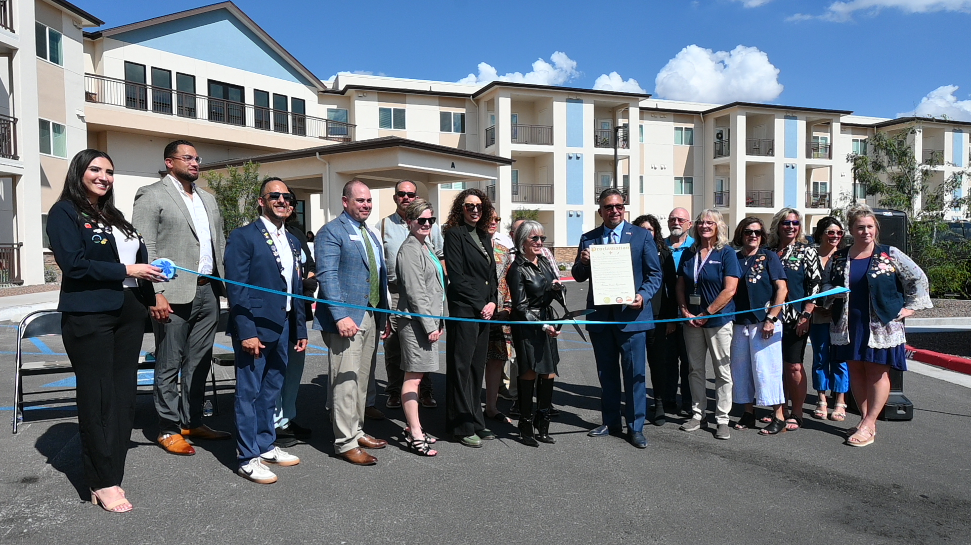
Example of AHA Projects for Local Governments
Examples of Eligible Projects and Partnerships
Financing for on-site infrastructure for affordable housing development
Donating land to an housing developer for affordable housing development
Gap financing to a developer for construction of affordable housing
Mortgage reduction/downpayment assistance assistance to homebuyers
Waive impact fee waivers for affordable developments
Rental assistance
Program funding to a non-profit that administers home repairs
Funding to support for homeless shelters and homeless services
Ribbon cutting of Pedrena Apartments, an 80-unit multifamily development for seniors age 55 and older. The City of Las Cruces waived impact fees as a compliant activity under the Affordable Housing Act.
Notes:
Stephanie

Slide 5

What isn’t the AHA?
The AHA does not supersede other regulation or statue, such as the New Mexico Administrative Code, State Board of Finance rules, local government ordinances or resolutions, and capital outlay rules. The scope of the AHA is limited to allowing for the affordable housing exception to the anti-donation clause and governing the requirements for the exception.
The AHA does not regulate procurement of qualified grantees to receive donations for affordable housing. Local governments must follow their procurement policies and procedures in selecting a qualified grantee that will receive a donation for an affordable housing project or program. Capital outlay funds for affordable housing projects or programs are also subject to a local government’s procurement process.
The AHA does not regulate how federal funds are used for affordable housing.
A mural adorns Three Sisters Apartments in Las Cruces, New Mexico, a 70-unit affordable housing development that opened its doors in May 2025.

Slide 6
AHA Donations to Date
Notes:
Sonja

Slide 7
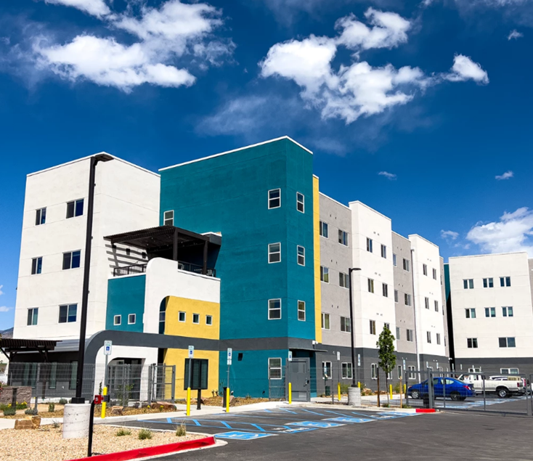
Affordable Housing Plan
Affordable Housing Plan Components:
Community and Housing Profile – Demographics & Housing Market Statistics
Housing Needs Assessment - Existing & Projected Housing Needs
Land Use and Policy Review – Analysis of Land Use & Construction Constraints
Goals, Policies, and Quantifiable Objectives – Identification of Resources & Actions Needed to Expand Affordable Housing Opportunity
Draft plan
Submit plan to Housing New Mexico for review and approval
Adopt plan via resolution
Luminaria Senior Community, a 92-unit new construction rental housing development in Albuquerque, was completed in 2022.
Notes:
Stephanie

Slide 8
Affordable Housing Ordinance
The ordinance establishes local rules for affordable housing donation but must be at least as restrictive as the Affordable Housing Act.
Ordinance must be drafted by local government, submitted to and approved by Housing New Mexico, and approved version passed by local government, with a copy of recorded Ordinance sent to Housing New Mexico.
The ordinance must define the process for selecting a qualified grantee, define income limits and affordability periods for donations.
Housing New Mexico can provide a template ordinance.
Affordable housing ordinances are the local enabling legislation to permit the exception to the anti-donation clause.
Notes:
Stephanie

Slide 9
Compliant Local Governments and Counties
Entity | Type of Entity | Approved Plan/Ordinance
Alamogordo | Municipality (City) | Yes
Albuquerque | Municipality (City) | Yes
Artesia | Municipality (City) | Yes
Belen | Municipality (City) | Yes
Bernalillo | Municipality (Town) | Yes
Bernalillo County | County | Yes
Carlsbad | Municipality (City) | Yes
Deming | Municipality (City) | Yes
Dona Ana County | County | Yes
Espanola | Municipality (City) | Yes
Eunice | Municipality (City) | Yes
Farmington | Municipality (City) | Yes
Gallup | Municipality (City) | Yes
Hobbs | Municipality (City) | Yes
Jal | Municipality (City) | Yes
Las Cruces | Municipality (City) | Yes
Las Vegas | Municipality (City) | Yes
Lea County | County | Yes
Lordsburg | Municipality (City) | Yes
Entity | Type of Entity | Approved Plan/Ordinance
Los Alamos County | County | Yes
Los Lunas | Municipality (Village) | Yes
Lovington | Municipality (City) | Yes
Luna County | County | Yes
Portales | Municipality (City) | Yes
Rio Arriba County | County | Yes
Rio Rancho | Municipality (City) | Yes
Roswell | Municipality (City) | Yes
Ruidoso | Municipality (Village) | Yes
Santa Clara | Municipality (Village) | Yes
Santa Fe | Municipality (City) | Yes
Santa Fe County | County | Yes
Santa Rosa | Municipality (City) | Yes
Silver City | Municipality (City) | Yes
Socorro | Municipality (City) | Yes
Socorro County | County | Yes
Taos | Municipality (Town) | Yes
Taos County | County | Yes
Truth or Consequences | Municipality (City) | Yes
Valencia County | County | Yes
Notes:
Sonja

Slide 10
Qualifying Grantees
Qualified grantees are entities eligible to receive donations under the Affordable Housing Act.
A qualified governmental housing agency
Any type of for-profit or non-profit organization that has among its purposes significant activities related to providing housing or services to low- or moderate-income persons or household
A qualified individual
Notes:
Stephanie

Slide 11
Qualifying Grantees – Non-Individuals and Non-Profits
Organized Entity
Housing Activities:
A summary of projects and/or statements that describe recent affordable housing activities in the community
Compliance
Good Standing Certification
Reputation Certification
Proof of no HUD suspension or debarment from sams.gov
A contract(s) with an entity or individuals that have benefited the community
Charter
Articles of Incorporation
Business Licenses
Financial Systems:
A statement from the organization
Documentation from a Certified Public Accountant
Its most recent independent financial audit, mandatory for all applicants legally required to have an independent financial audit
An approved audit summary
Non-Profits
Applicant has a primary mission to provide housing or housing-related services to Persons of Low or Moderate Income, as evidenced by either
Applicant must have received its 501(c)(3) designation prior to submitting an Application, as evidence by either
Applicant must have no part of its net earnings inuring to the benefit of any member, founder, contributor, or individual
Notes:
Stephanie

Slide 12
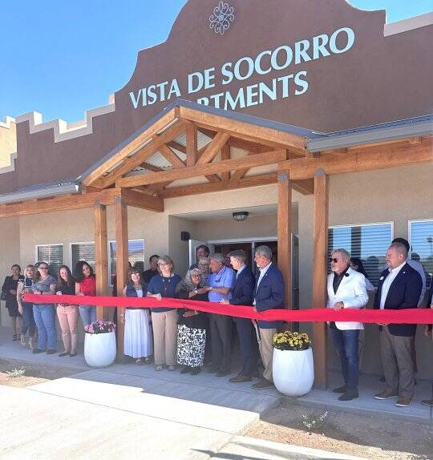
How to “Qualify” a Grantee – Non-Individual
Local governments must use the “Qualifying Grantee Certification for Non-Individual Applicants” form to verify that an entity meets, and evidences Qualifying Grantee criteria.
Local governments must submit the completed Qualifying Grantee Certification for Non-Individual Applicants form and supporting documentation for Housing New Mexico’s approval.
Local governments may certify an entity as a Qualifying Grantee, without any commitment or obligation, to make an affordable housing donation to that entity.
Qualifying Grantees that do receive an AHA donation must be recertified annually by the local government to ensure they remain in good standing.
The grand opening of Vista de Socorro, a 32-unit multifamily rental community with 7 units reserved for households experiencing homelessness or have a disability in Socorro, New Mexico.
Notes:
Stephanie

Slide 13
Qualifying Grantees –Individuals
Using Affordable Housing Funds to Directly Benefit an Individual
Examples include, but are not limited to, downpayment assistances, home rehabilitation and weatherization.
Individuals must be income qualified, consistent with an entity’s AHA ordinance.
Entity must establish program guidelines to that regulate other program parameters, like including but not limited to additional eligibility requirements (such as seniors, veterans) and funding terms (grants versus loan).
For individual qualifying grantees, local governments must develop program guidelines that stipulate criteria for beneficiary eligibility. The criteria, at a minimum, must include income limits that are consistent with the local government’s Affordable Housing Act ordinance. The program guidelines must be submitted to Housing New Mexico for review and approval.
Notes:
Stephanie

Slide 14
Making Affordable Housing Awards
Local governments must select a qualified grantee, and evaluate a proposed project or program, to receive an affordable housing donation/award (funding, land, infrastructure) through a process that is consistent with its procurement code and funding source regulation.
Request for Proposals
An RFP is a solicitation document issued by a government agency when they want organizations to submit detailed proposals to carry out a specific project or provide certain services.
Notice of Funding Availability
A NOFA is a public announcement that funding is available. It’s usually broader than an RFP and serves as the official notice to potential applicants that they can apply for funding.
RFP = detailed instructions for what’s needed and how to apply (the “playbook”).
NOFA = announcement that funding is available (the “heads up”).
Affordable Housing Program
Impact fee abatement for affordable housing developments.
Home rehabilitation program.
A program with guidelines on how and to whom funding may be awarded – typically used to make affordable housing awards to individuals.
Notes:
Sonja

Slide 15
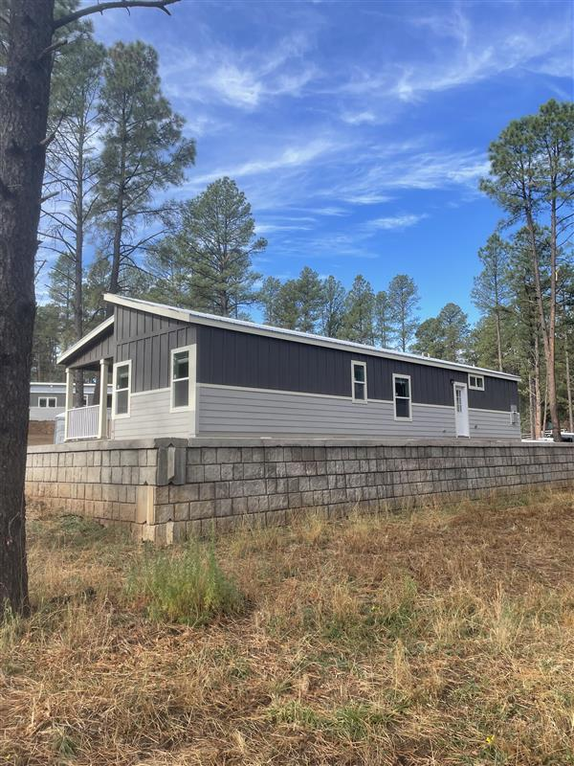
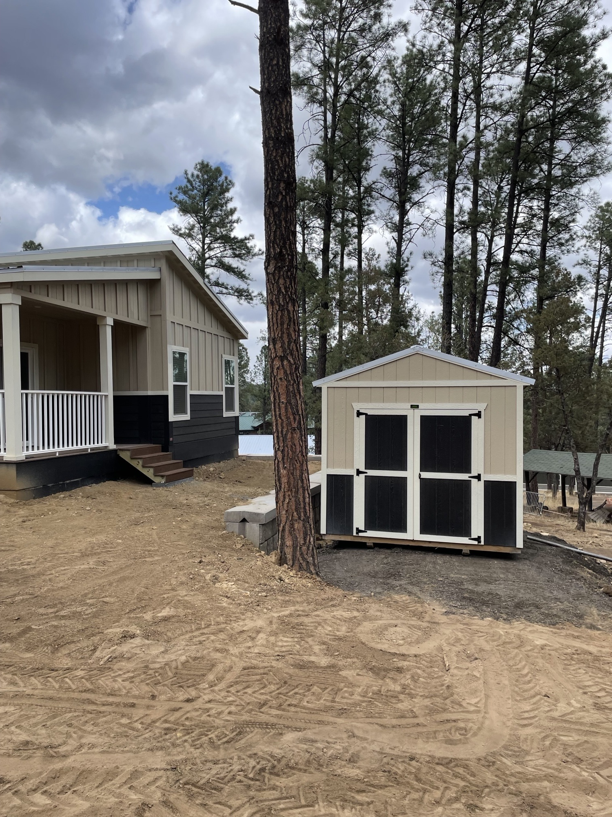
Award Application Certification
After completing a selection and evaluation process to make an affordable housing donation/award, local governments must submit the “Affordable Housing Funds Application Certification for Non-Individual Applicants” form to Housing New Mexico, along with the application packet, that attest to the following:
Completion of its review of the Application
Determination that the Application is complete
Determination that the requirements of these Rules and the Act have been satisfied
Determination that the Applicant is a Qualifying Grantee
Housing New Mexico will then approve the application certification.
Village of Ruidoso received a Housing Innovation award for $712,498 for Mechem Meadows, a single-family development.
Notes:
Sonja

Slide 16
Affordability Period
If the fair market value of any Housing Assistance Grant, or the total amount of Affordable Housing Funds which have been awarded, loaned, donated, or otherwise conveyed to the Qualifying Grantee is: | Then the Affordability Period must be not less than:
$1 to $14,999 | 5 years
$15,000 up to and including $40,000 | 10 years
From $40,000 up to and including $100,000 | 15 years
Greater than $100,000 | 20 years
The Governmental Entity and/or Housing New Mexico, in its discretion, may increase the Affordability Period in any contract, note, mortgage, loan agreement, land use restriction agreement, restrictive covenant agreements.
In the discretion of Housing New Mexico, weatherization funds from the State, and/or any other similar conveyances where an Affordability Period is not practical, may not necessarily be subject to the Affordability Period requirements. However, any such conveyances may be subject to recapture on some pro-rated basis as determined by the Governmental Entity and/or MFA.
Notes:
Sonja

Slide 17
Affordability Period Security Instruments
Land Use Restriction Agreement (LURA)
A LURA is a legally binding contract, typically recorded against a property’s deed, that requires the property to be used for affordable housing purposes for a set period of time.
Restrictive Convents Agreement (RCA)
Because it is attached to the deed, the agreement “runs with the land,” meaning future owners are also bound by its restrictions. Restrictions often include the following:
Rent limits: Owners cannot charge more than a certain rent level, usually tied to a percentage of Area Median Income (AMI). Income eligibility: Units must be rented to households whose incomes fall below a specified threshold. Affordability period: Typically ranges from 20 to 40 years, during which the affordability rules must be followed.
Similar to a LURA, an RCA binds a property to affordability obligations. RCAs are typically used for projects serving single family housing needs to prevent homes assisted from being “flipped.” Restrictions often include the following:
Income eligibility: Units must be rented or sold to households below a certain % of Area Median Income (AMI).
Affordability period: Duration for which the RCA terms are lock in. May be structured as a forgivable loan.
Occupancy rules: May require the unit to be the primary residence of the tenant or homeowner.
Notes:
Sonja

Slide 18
AHA Donation Reporting
Donation Description | Recipient | *Category | Value | Date (MM/YEAR) | Number of Beneficiaries | Beneficiaries Type
Twelve-acre lot to a developer for the construction of affordable housing. | NM Development Corporation | A. Land | $1,500,000 | 03/ 2023 | 55 | Units
Rental Assistance Program | Income qualified renters | E. Cost of acquisition, development, construction, financing, operating or owning affordable housing | $100,000 | On going program | 20 | Households
As a participating entity under the Act, each local government must maintain compliance by completing a donation reporting form to account for any donations made during the Housing New Mexico fiscal year (October through September).
*Category
Land for the construction of affordable housing
Conversion or renovation of an existing building into affordable housing
Infrastructure necessary to support affordable housing
Abatement of taxes or fees (such as waiver or reimbursement of impact and permitting fees, reduction of taxes for an affordable housing project, etc.)
Cost of acquisition, development, construction, financing, operating or owning affordable housing (such, down payment assistant, donations to the Housing Trust Fund, and other grants or loans, etc.)
Notes:
Stephanie

Slide 19
AHA Compliance Process Recap
AHA Requirement | Local Government Responsibility | Housing New Mexico Responsibility
Affordable Housing Plan | Develop in-house, or contract with a consulting firm, an affordable housing plan. Submit draft plan to Housing New Mexico for review and approval. Adopt plan and provide resolution of adoption to Housing New Mexico. | Review and provide feedback to the local government on draft plan. Approval final version of plan, once it includes all required elements. Archive plan and plan adoption resolution.
Affordable Housing Ordinance | Draft an affordable housing ordinance, may use the Housing New Mexico template. Submit draft ordinance to Housing New Mexico for review. Enact ordinance and provide enacted ordinance to Housing New Mexico. | Review and provide feedback to the local government on draft ordinance. Approval final version of ordinance, once it includes all required elements. Archive enacted ordinance.
Qualifying Grantee Eligibility Certification | Complete the “Qualifying Grantee Certification for Non-Individual Applicants” form to determine that an entity is eligible to receive donations under the AHA. Submit the completed form and supporting documents to Housing New Mexico for its review. | Review “Qualifying Grantee Certification for Non-Individual Applicants” and supporting documents. Provide feedback if there are any issues or provide concurrence if the form and supporting documents are complete.
Qualifying Grantee Application Certification | Initiate a selection and evolution process to make an AHA donation. Complete the “Affordable Housing Funds Application Certification for Non-Individual Applicants” form to verify that the affordable housing donation has been evaluated. Submit the completed form and supporting documents to Housing New Mexico for its review. | Review Affordable Housing Funds “Application Certification for Non-Individual Applicants” and supporting documents. Provide feedback if there are any issues or provide concurrence if the form and supporting documents are complete.
Affordable Housing Program Guidelines | Develop program guidelines for programs that will serve individual beneficiaries, which include income limits and affordability protections. Submit program guidelines to Housing New Mexico for its review. | Review program guidelines. Provide feedback if there are any issues or provide concurrence if the program guidelines satisfy AHA requirements.
Affordable Housing Donation Reporting | Respond to the Housing New Mexico survey to report donations made during the fiscal year October 1 through September 30. Recertify Qualified Grantees and submit recertification to Housing New Mexico for approval. | Issue via email AHA annual donation survey. Track and report on AHA donations made every year. Review and approve Qualifying Grantee recertification.
Notes:
Stephanie

Slide 20
Questions?
For more if information visit:
https://housingnm.org/about-us/affordable-housing-act
Stephanie Gonzales
Research & Development Manager II
Policy & Planning Department
sgonzales@housingnm.org
505-767-2287

Slide 21
Achieving AHA Compliance
Develop an affordable housing plan. Submit affordable housing plan to Housing New Mexico for approval.
Pass ordinance along with resolution to adopt the affordable housing plan. Provide proof of plan adoption and ordinance enactment to Housing New Mexico.
Develop an affordable housing ordinance. Submit affordable housing ordinance to Housing New Mexico for approval.
Define a project, solicit and evaluate qualified grantee to receive an AHA compliant donation.
Report donations annually to Housing New Mexico
Submit qualifying grantee application & certification to Housing New Mexico for approval.
Submit qualifying grantee’s application & certification for affordable housing funds (donation) to Housing New Mexico for approval.
Qualifying Grantee recertification
Annual Compliance Requirements
Notes:
Sonja

