Slide 1



Housing New Mexico | MFA
Overview:
Homeownership Programs
Rene Acuña
Director of Homeownership

Slide 2

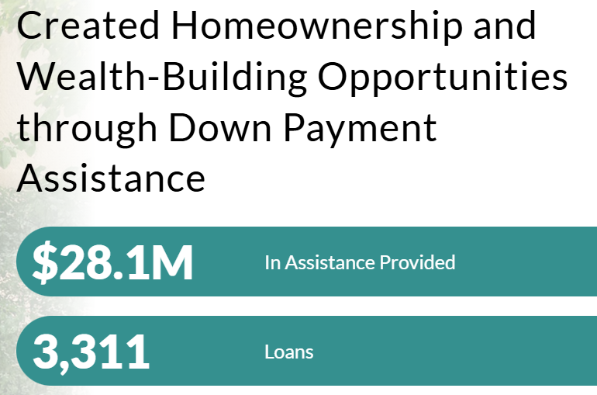
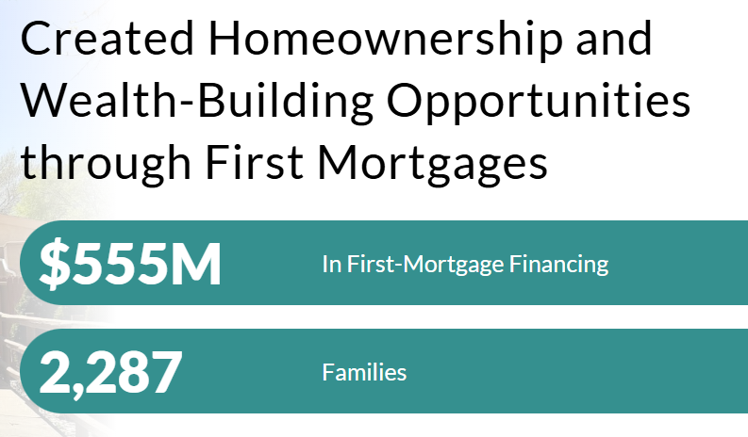

2025 Impact

Slide 3
2025 Impact cont.
Lincoln County
First mortgages - $687,366
Down payment assistance - $13,800
Chaves County
First mortgages - $18,9709,580
Down payment assistance - $539,697
Otero County
First mortgages - $8,424,908
Down payment assistance - $247,354
Doña Ana County
First Mortgages - $46,040,083
Down Payment Assistance - $1,269,093
Figures represent the total amount of first mortgages and down payment assistance loans purchased in fiscal year 2025

Slide 4
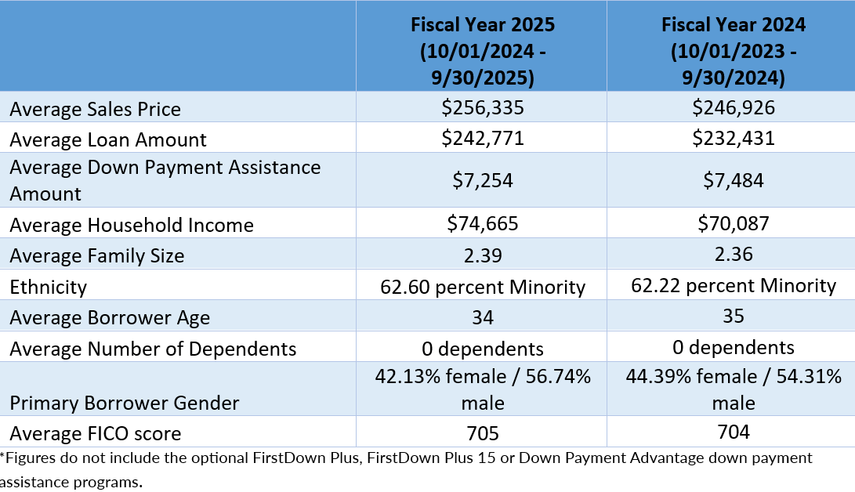
Borrower Demographics

Slide 5
Overview
Housing New Mexico | MFA has programs available for first-time AND repeat homebuyers. All programs have income and purchase price limits.
The home must become the buyer’s primary residence within 60 days of closing.
The minimum credit score is just 620; alternative credit is allowed.
These programs work in conjunction with standard loan types such as FHA (& 203k), VA, USDA-RD, HUD Section 184, and Freddie Mac’s HFA Advantage® and Fannie Mae’s HFA Preferred™ conventional loans.
Down payment assistance loans are always optional.

Slide 6
How to Access Programs
Only lenders that have been approved by Housing New Mexico have access to our programs.
See a complete list of participating lenders here:
https://housingnm.org/programs/homebuyers/mfa-participating-lenders

Slide 7
Use to Finance Single-family Properties
Detached site-built
Townhomes
Condominiums
Homes in a Planned Unit Development (PUD)
Single or multi-section manufactured homes on a permanent foundation and taxed as real property. Must meet HUD guidelines and have a deactivated title.
Modular Housing

Slide 8
FirstHome Program
Borrower(s) must be a first-time homebuyer.
All first-time homebuyers receive homebuyer education.
First-time homebuyers are persons who have not owned and occupied a home as their primary residence in the past three years.
U.S. military veterans who served in the active military, naval, or air service, and were discharged or released under conditions other than dishonorable are exempt from the first-time homebuyer requirement .

Slide 9
FirstHome Program
Provides a 30-year, fixed-rate first mortgage. Housing New Mexico |MFA sets the rates.
Lenders may charge their normal and customary fees and up to 0.5 percent origination fee. Discount points are not allowed.
May be used as a stand-alone first mortgage to take advantage of the interest rate; or combined with optional down payment assistance second and third mortgage loans, as available.

Slide 10
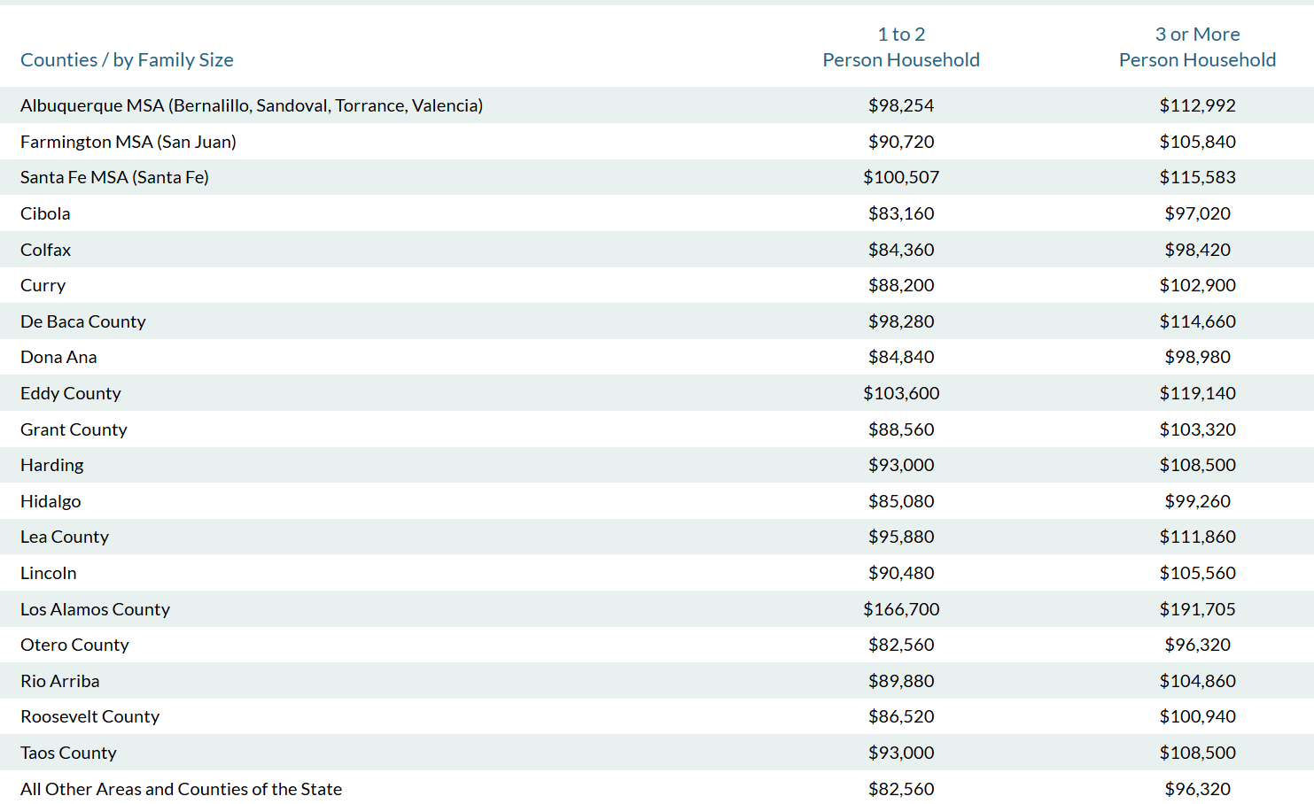

FirstHome Income Limits
.

Slide 11
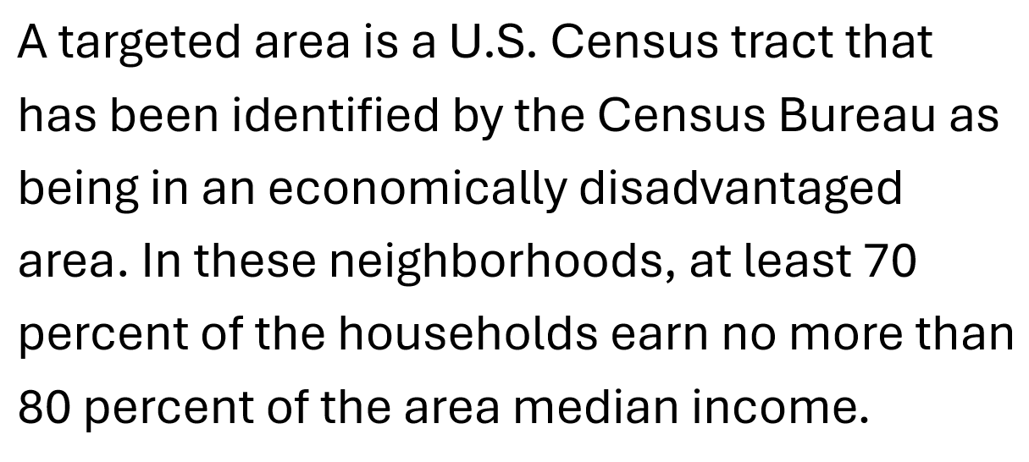
Targeted Areas

Slide 12
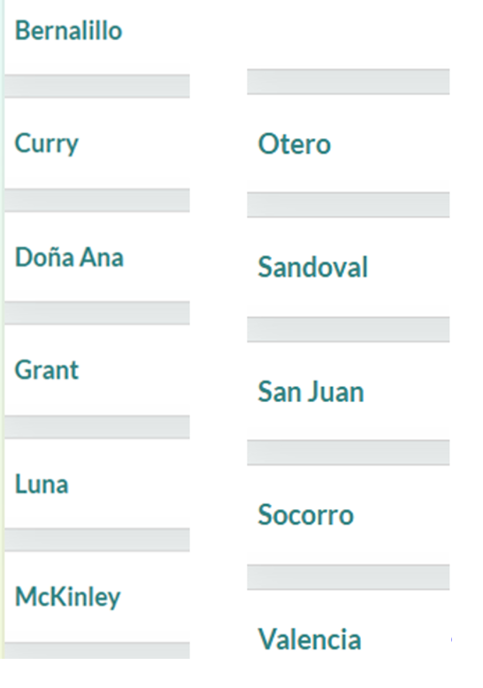
Counties Having Targeted Areas

Slide 13
Targeted Area Benefits
Borrowers using FirstHome to purchase a home in a targeted census tract will receive the following benefits:
May qualify for a lower first mortgage interest rate offered by Housing New Mexico | MFA;
Income and purchase price limits are higher than the standard limits;
No need to be a first-time homebuyer.

Slide 14
FirstDown (second mortgage)
Second mortgage provides up to 4 percent of the sales price. Minimum loan amount is $1,000*
Lender may charge a $100 origination fee.
Funds may be used towards down payment and/or closing costs.
Amortizes over a 15 or 30-year term.
*If using the minimum loan amount, must be on 15-year term only.

Slide 15
FirstDown Plus 15 (third mortgage)
Available to borrowers using both FirstHome & FirstDown
This is a third mortgage loan program which provides $10,000 towards down payment only (no closing costs).
The loan is repayable over 15 years and is not forgivable.
Features a zero-percent interest rate, so monthly payments are $55.56 principal-only.

Slide 16
HomeForward
Available to first-time and repeat homebuyers.
Has higher income and purchase price limits (charts available on website).
Total qualifying income is used to determine whether borrower fits within program income limits.
This loan amortizes over 30 years; Housing New Mexico sets the rates.

Slide 17
Optional HomeForward DPA
Second mortgage down payment assistance (DPA) loan provides up to 3 percent of the sales price to be used towards down payment only.
  Exception: If the first mortgage is VA, USDA or HUD Section 184, then proceeds may also be used towards closing costs.
Fully amortizes over 15 years.

Slide 18
Transaction Timeline
Free lock period is 60 days. Lenders control the timeline and may lock any time after they have a signed purchase agreement.
Lender uploads a compliance package and Housing New Mexico performs a pre-closing compliance review. Once approval is given, the lender moves forward with closing.
Lenders must allow three full business days for the initial compliance file review and 1 – 2 days additional if the file has conditions.

Slide 19
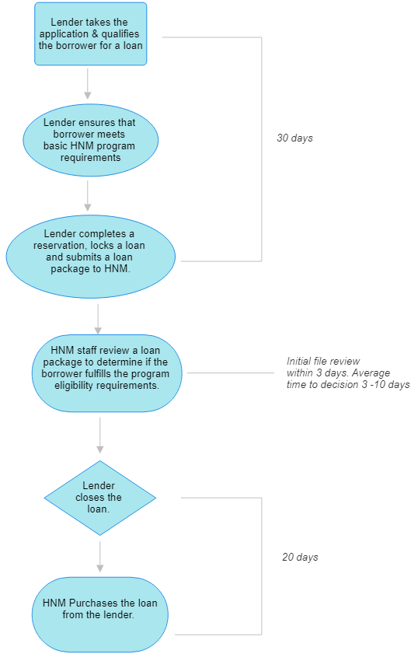
Loan Process Timeline
Lender takes the borrowers loan application and qualifies them for different loan products. This may or may not include HNM single family programs.
If lender determines HNM single family programs best assist their client. Lender completes a reservation, locks a loan and submits a loan package to HNM.
HNM staff review a loan package to determine if the borrower fulfills the program eligibility requirements.
A program eligibility approval is provided to the lender If borrower meets program eligibility requirements.
Lender closes the loan.
HNM purchases the loan from the lender.
The entire loan process from application to closing takes an average of 45 – 60 days.

Slide 20
Thank you!
Please feel free to contact us for more information:
505.843.6880
housingnm.org

