Slide 1


Housing New Mexico
MFA
Funding Resources to Support Multifamily Development in New Mexico
George Maestas
Director
Housing Development Department

Slide 2

Overview of the Housing Development Department
The Housing New Mexico’s Housing Development Department was founded in 1991 to administer the Resolution Trust Corporation (RTC) Technical Assistance program and Housing Trust Fund Program (now known as the Housing Opportunity Fund). The Department was given purview over other major federal housing programs in 1997. In 2000, the department took over Multifamily development underwriting and financing, and eventually, single-family development underwriting and financing, which together are now the primary functions of the Department.

Slide 3
Overview of the Housing Development Department
For proposed affordable multifamily developments, the Department provides financing in the interim, construction, and/or permanent phases of development, which is accomplished through the allocation of tax credits for the federal Low-Income Housing Tax Credit (LIHTC) program through either a competitive round for the more lucrative 9% tax credits or on a rolling basis for non-competitive 4% tax credits. The Department also provides loans via a variety of programs, most often used to supplement tax credit funding but may also be utilized by projects not receiving credits including:

Slide 4
Overview of the Housing Development Department
U.S. Department of Housing and Urban Development (HUD) HOME Investment Partnerships program, including Community Housing Development Organizations (CHDO)
HUD National Housing Trust Fund
New Mexico Housing Trust Fund
Primero Investment Fund
Land Title Trust Fund Program
HUD/FHA Risk Sharing 542(c) Loans
United States Department of Agriculture (USDA) Section 538 Loan Guarantee Program
Ventana Fund

Slide 5
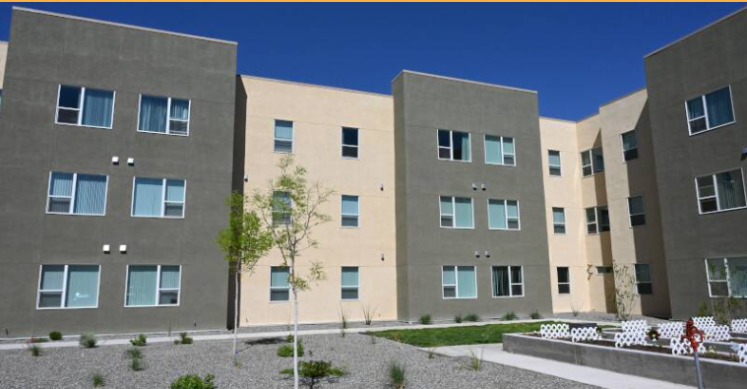
Multifamily Development Process Outline
Due Diligence
Design and Feasibility
Financing
Closing and Construction
Post Construction

Slide 6
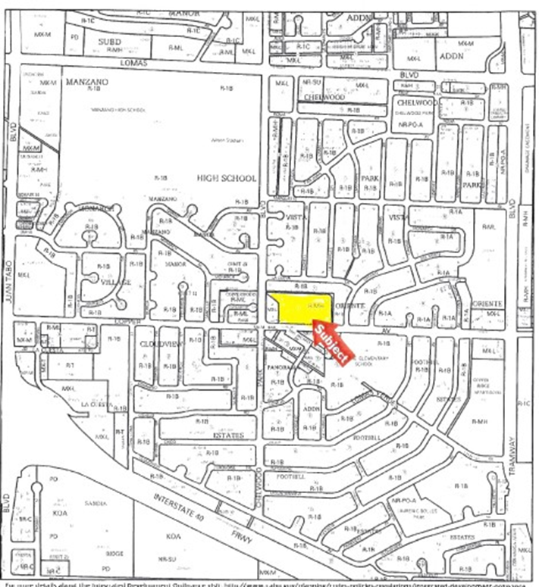
Part I: Due Diligence - Program Planning & Concept
Establish population served:
Assess housing needs & market
What housing problems are you trying to solve?
Locational and design implications
Build a basic site criteria:
Access to
Utilities
Public transportation
Employment
Services
Health care
Schools
Nearby residential communities
Building type
Number of units needed

Slide 7
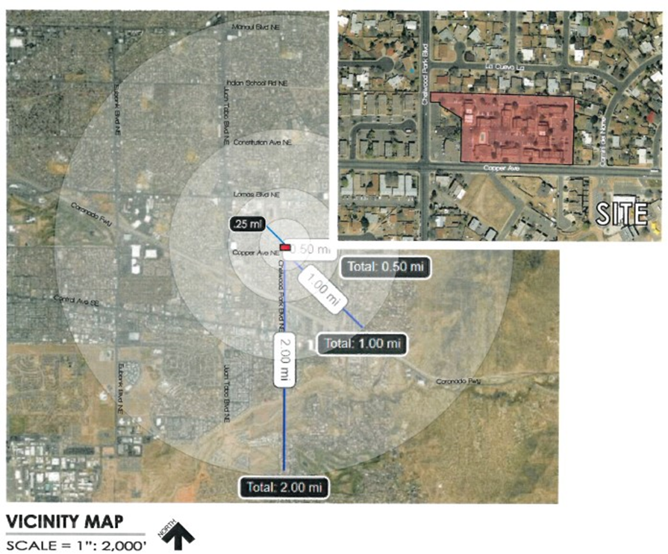
Part I: Due Diligence - Site Selection
Identify a site:
Land availability and cost are significant challenges to affordable housing development
Research sites with planning department, local housing authority, and/or assessor’s office
Identify land or building(s) the city owns which can be used for housing development
Notes:
Where do we find good sites for affordable housing?
Find sites with Public Partners
Govnt Land
Vacant Land
Churches
Access to critical amenities

Slide 8
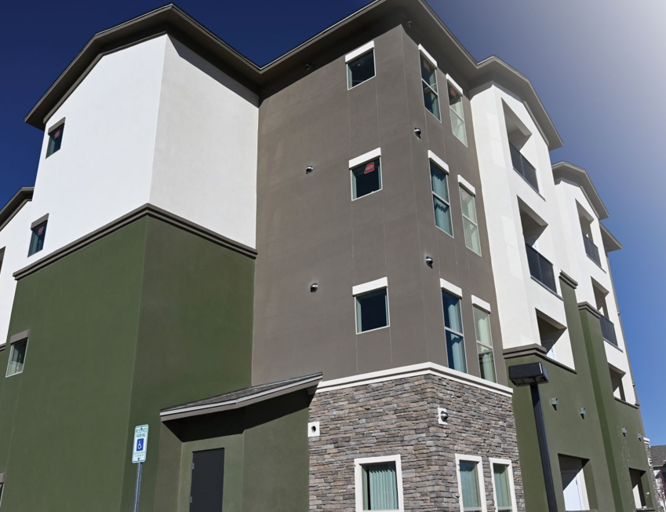
Part I: Due Diligence - Site Evaluation
Entitlements and Access
Confirm seller and clear title
Accuracy of legal description
Recent surveying/plat maps
Free of tax liens, judgments, encumbrances
Review property search for any covenants, conditions, restrictions, reservations, and easements
Access to utilities
Notes:
Back of envelope analysis

Slide 9
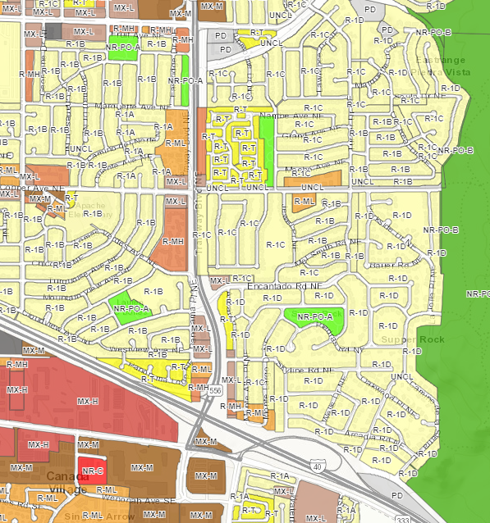
Part I: Due Diligence - Site Evaluation (continued)
Land Use & Zoning
Residential code
Permissible Density
Floor area ratio (FAR) and setbacks
Assess adjacent uses
Parking requirements
Right of way and road access
IDO Zone Look-Up Map

Slide 10


Part I: Due Diligence - Site Evaluation (continued)
Environmental Due Diligence
Historical structures and materials
Adjacent properties and uses
Wetlands and sensitive habitats
FEMA Flood Map
Phase I Environmental Site Assessment or other recent reports
Environmental issues may pose serious challenges but may also present unique opportunities…..

Slide 11
Part II: Design & Feasibility - Preliminary Site Feasibility
Now that you’ve selected a site that meets your basic criteria and established site control…
Determine number of units
Determine unit mix and size
Approximate space needed for community rooms and amenities
Approximate outdoor and landscaping space
Assess market need/demand for your initial concept (market study)
Develop community support for your project early on

Slide 12
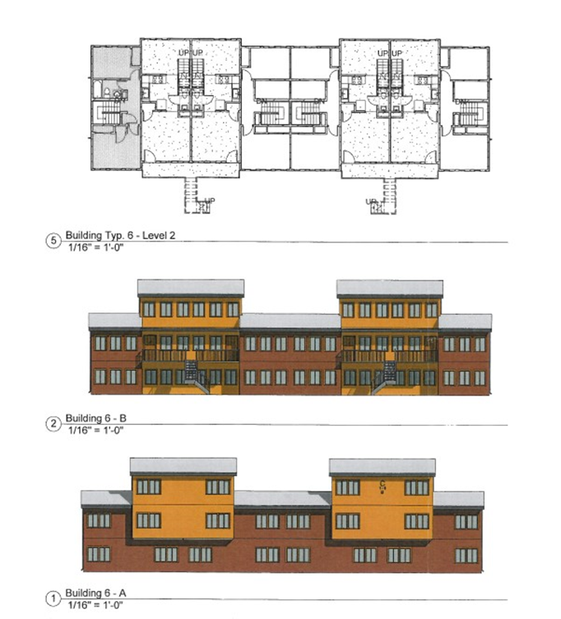
Part II: Design & Feasibility– Preliminary Site & Building Design
Site and Building Design
Select an architecture firm with experience on similar projects
Architect produces preliminary building design and floor plans (emphasis on preliminary!)
Likely will work through several iterations throughout development lifecycle
Ensure compliance with funding source design standards

Slide 13
Part III: Financing – Development Budget
Develop a budget
Discuss materials and level of finishes with architect
Architect completes preliminary site and building design
Establish relationship with general contractor(s) for a preliminary cost estimate
Utilize historical data from previous projects
Consultant may be essential to developing more complete budget
Determine Total Development Cost budget
Calculate annual rents, vacancy, and operating budget to determine Net Operating Income (NOI)
Notes:
What is the total development cost?
Acquisition costs
Construction costs
Soft cost
What is the revenue your going to get across the rents and income levels?
IS there subsidy?
What is the cost to run this building
Maintenance
Long term costs
LOI-Debt coverage ratio
1:2 to 1:4
Development Timeline
Concept Design & Entitlement (6-12 months)
Securing all financing (2+ years)
Construction drawing and permitting (concurrent with last phase of financing)
Construction phase (15-20 months)
Lease up and stabaliztion (6-9 months)
How much can you afford through a conventional loan?

Slide 14
Part III: Financing – Capital Stack
Secure funding
Conventional first mortgage (almost always largest loan source)
First mortgage lender will base loan size on maximum Loan-to-Value (LTV) or Loan-to-Cost (LTC)
Consider construction vs permanent funding
Permanent first mortgage critical to securing other funding
Lenders require project’s NOI to cover annual debt service with cushion of income left over (Debt Service Coverage Ratio)
How much debt can the project afford?

Slide 15
Part III: Financing – Low Income Housing Tax Credit
Low Income Housing Tax Credits (LIHTC)
IRS Program created in Tax Reform Act of 1986
In New Mexico, LIHTC Program is administered by the New Mexico Mortgage Finance Authority (Housing New Mexico)
Purpose: to stimulate private investment in affordable housing
Mechanism: investors fund projects, and, in exchange, they can claim dollar for dollar credit against their tax liability for 10 years
Qualified Allocation Plan governs allocation of tax credits
Credit amount is based on the depreciable cost of acquiring, constructing, or rehabilitating affordable housing units (known as “Eligible Basis”)

Slide 16
Part III: Financing – Low Income Housing Tax Credit
9% and 4% Tax Credits
9% credits are competitive
Application due in January, one round per year
States receive a finite allocation of tax credits each year
~$3.42 per capita to each state (2026)
NM 2,130,256 people x $3.416 = $7,276,954
Provides the deepest federal subsidy, funding roughly 65% of total development cost
4% credits are non-competitive
“As of right” with the use of tax-exempt bonds
Applications on a rolling basis
Limited by available private activity bond volume cap
Attract less equity, funding roughly 30% of total development cost

Slide 17

Part III: Financing - Tax-Exempt Bond Issuance
Application Process for Multifamily Private Activity Bonds:
Apply for 4% LIHTC
Once approved, draft 42(m) letter provided
Inducement Resolution issued
Applicant prepares State Board of Finance (SBOF) application for Housing New Mexico to submit to SBOF for approval
TEFRA hearing
Bond Resolution to Housing New Mexico Board for approval
Closing

Slide 18
Part III: Financing – Low Income Housing Tax Credit
Tax Credit Affordable Use
Minimum set aside elections:
20% of units for households earning no more than 50% of Area Median Income (AMI), or
40% of units for households earning no more than 60% AMI (most common), or
Average Income: can serve households up to 80% AMI if at least 40% of total units are restricted, and the average of the imputed income limits of all restricted units does not exceed 60% AMI
Land Use Restriction Agreement (LURA) effective for a minimum of 30 years required (income and rent limits).

Slide 19
Part III: Financing– Low Income Housing Tax Credit
Partnership Structure to Receive LIHTC
General Partner controls and operates the project, provides guarantees
The passive Limited Partner invests equity in return for 99.99% ownership
Limited Partner gets its return almost exclusively from the tax credits and tax losses from the project
Equity from the sale of credits reduces need for debt & other financing needs of the project, allowing for lower rents
Development Partnership (LLLP/LLP) or LLC
General Partner or Managing Member (0.01%)
Limited Partner Investor or Investor Member (99.99%)

Slide 20
Part III: Financing Low Income Housing Tax Credit (LIHTC) (Continued)
Part III: Financing– Low Income Housing Tax Credit
9% Low-Income Housing Tax Credit Process
Allocation
Tax credits are allocated to the designated Allocation Agency on a per-capita basis
$7.3 million allocated to NM in 2026
Awards
9% credits are awarded to proposed development projects through a competitive process, outlined by the Qualified Allocation Plan.
Ex. Project A: $1,000,000 in credits awarded.
Equity Produced
Projects “sell” 10-years worth of credits to investor looking to off-set federal tax liability (around 82 cents per dollar of credit), producing around 65% of the total development costs.
Ex. Project A:
$1,000,000 x 10 years =
$10,000,000 in total credits
$10,000,000 x $0.82 =
$8,200,000 in equity
Compliance
While the investor takes credits annually for only the first 10 years, credits can be recaptured if the project is not in compliance for 15 years. Additionally, extended compliance periods range from 15-35 more years, following the initial 15 years.

Slide 21
Part III: Financing – Gap Financing
Fill the Gap
Almost all LIHTC projects will have a funding gap
Lower rents= lower NOI= lower appraised value= smaller 1st Mtg
Determine gap left after first mortgage and tax credit equity
Five or more funding sources for a project is common
Understand eligibility and constraints of funding programs
Expect to meet the most conservative of overlapping requirements
Adjust preliminary rents/NOI accordingly in projections
Apply for gap funding with full proforma (projected capital stack, rents, operating expenses, and resulting cash flow)

Slide 22

Part III: Financing – Housing New Mexico Financing Sources
Housing New Mexico offers:
HOME Investment Partnerships (federal)
National Housing Trust Fund (federal)
New Mexico Housing Trust Fund (state)
Primero Investment Fund
Land Title Trust Fund
542(c) FHA-Insured Multifamily (Risk Share)
Housing New Mexico- Access Loans
Federal Financing Bank
538 Guaranteed Rural Rental Housing Program
State Tax Credit (Donation based)
Ventana Fund
Universal Rental Development Application for most sources; apply for all Housing New Mexico financing concurrently

Slide 23
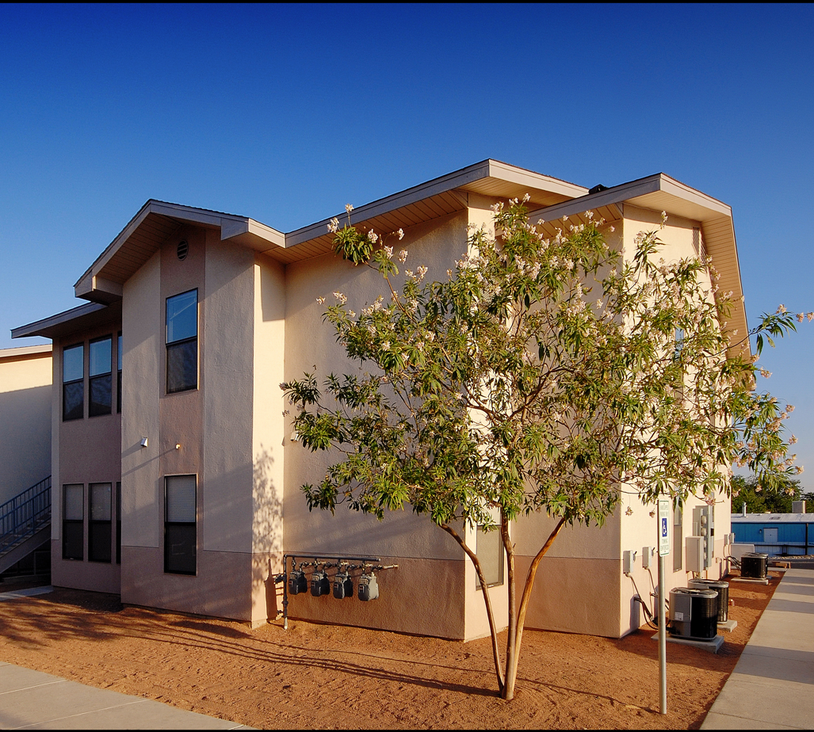
Part III: Financing – Other Gap Financing Sources
Other Gap Financing Examples:
Deferred developer fee
Developer or contractor contributions
Other tax credits (solar, historic)
Federal Home Loan Bank- Affordable Housing Program grants
Local government contributions made under New Mexico’s Affordable Housing Act
City or County land
Impact fee waiver
Property tax abatement
Infrastructure contribution
Low-interest rate loans
Grants and soft loans
Mesquite Village, Las Cruces

Slide 24
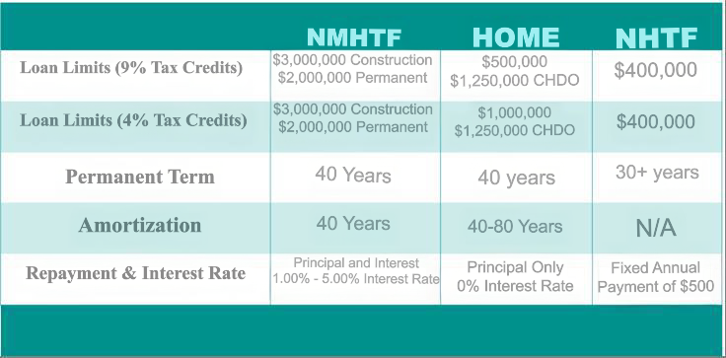
Part III: Financing – Gap Financing

Slide 25
Part III: Financing – Capital Stack
Capital Stack Example:
Financing Sources | Amount
First Mortgage – XYZ Bank | $ 1,800,000
Second Mortgage – HOME Loan | $ 800,000
Third Mortgage – National HTF Loan | $ 400,000
Fourth Mortgage – New Mexico HTF Loan | $ 2,000,000
Fifth Mortgage – Developer Cash Flow Loan | $ 1,000,000
City Soft Loan | $ 3,500,000
County Grant | $ 780,000
Tax Credit Equity | $13,000,000
Deferred Developer Fee | $ 180,000
TOTAL: | $23,460,000

Slide 26
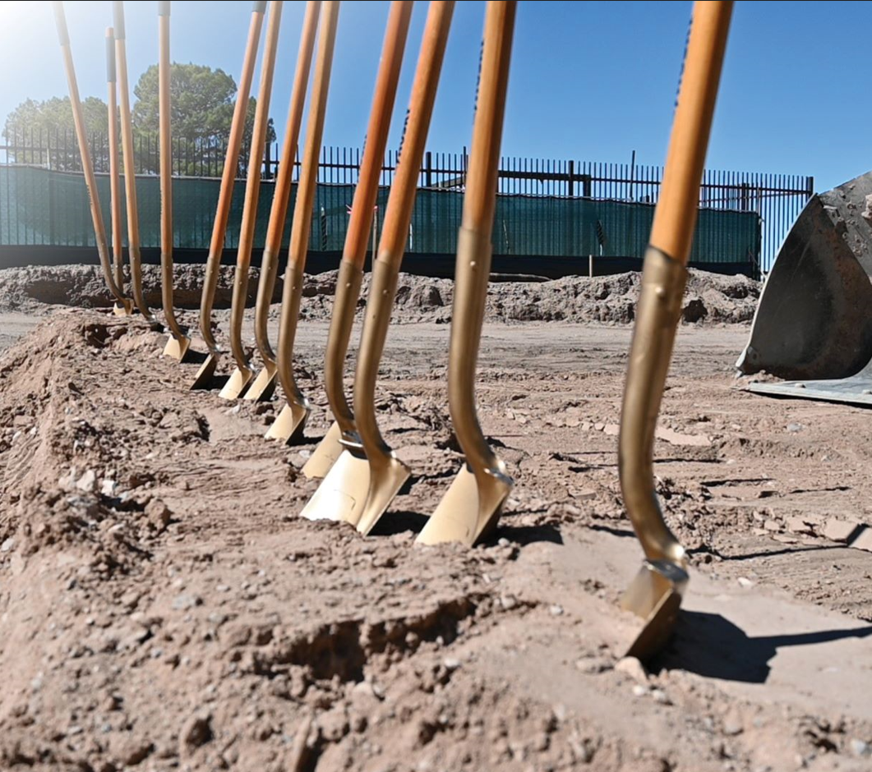
Part IV: Closing and Construction
Closing calls begin between all lenders, the developer, tax credit investor, attorneys, title, etc.
Lenders draft loan documents and language is negotiated between attorneys for the developer, lenders, and the tax credit investor
Documents fully executed and all encumbering documents recorded at closing
Initial draws disbursed to the partnership
Construction period takes roughly 24-months
Housing New Mexico monitors construction progress with on-site inspections at 33%, 66% and 100% completion milestones (which may be more frequent depending on funding source.

Slide 27

Part V: Post Construction
Final draw made
Permanent financing pays off construction financing (conversion)
Monthly principal and interest payments begin
Project placed-in-service and LIHTC LURA recorded
IRS Form 8609 issued allowing tax credits to flow to investor
Project is complete and moves from Housing Development to Asset Management department
Asset Management monitors for long-term compliance (income/LURA requirements, property inspections, annual compliance reporting, etc.)

Slide 28
Questions?
George Maestas
Director
Housing Development Department
Tel: 505-767-2243
Email: jmartinez1@housingnm.org
Jeanne Redondo
Tax Credit Program Manager II
Housing Development Department
Tel: 505-767-2210
Email: jredondo@housingnm.org
We Are Housing New Mexico

