Slide 1


Housing New Mexico’s Single Family Home Rehabilitation Programs
HOME Homeowner Rehab
Home Improvement Program (HIP)
Restoring our Communities Program (ROC)
John A. Garcia
Assistant Director of Community Development

Slide 2

Housing New Mexico’s Single Family Home Rehabilitation Programs
Today’s Discussion
HOME Homeowner Rehabilitation
Home Improvement Program (HIP)
Restoring Our Communities (ROC)
Homeowner Testimonials

Slide 3
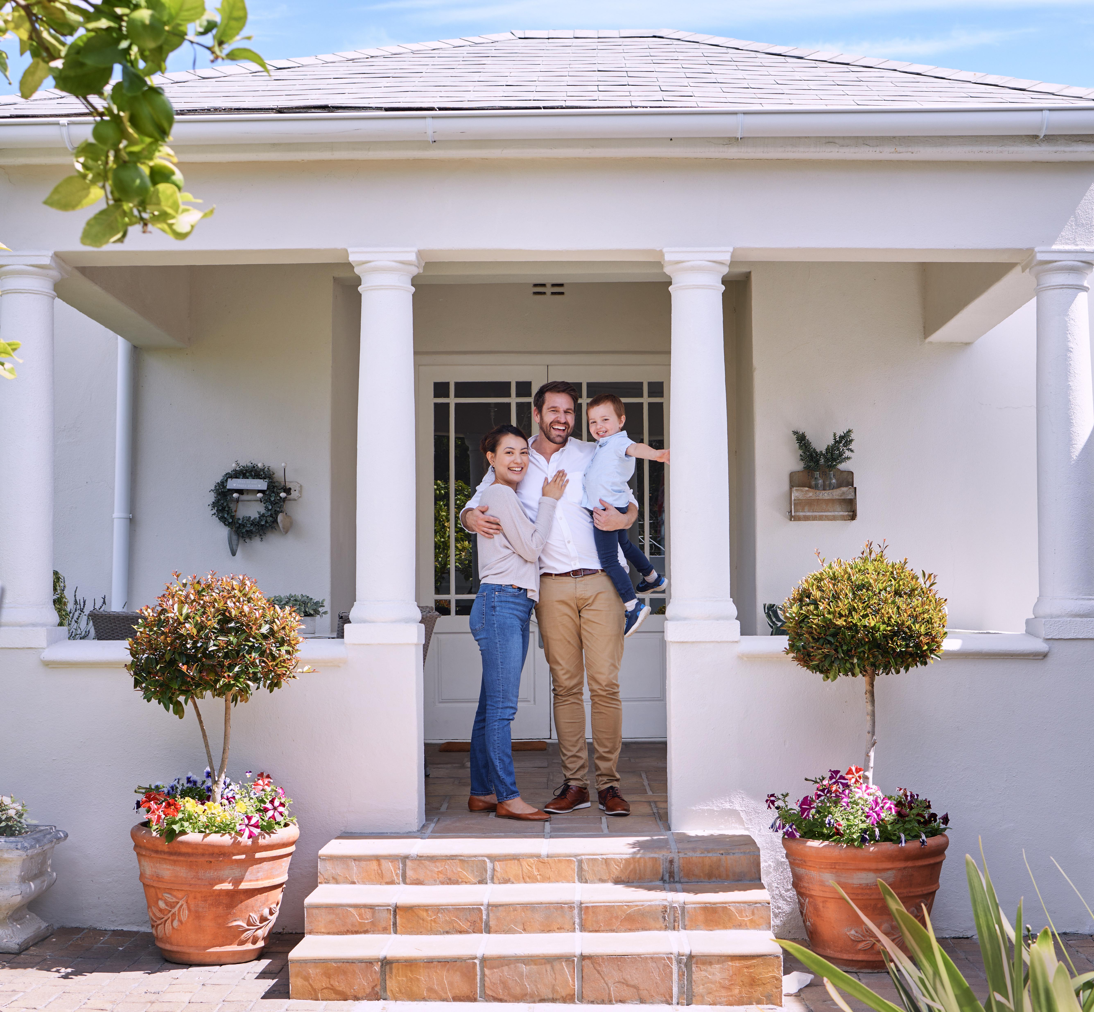
HOME Homeowner Rehabilitation Program
Program Goals
Support low-income homeowners with essential repairs
Preserve affordable housing statewide
Improve accessibility for elderly and disabled New Mexicans

Slide 4
HOME Rehab
How Home Rehab is Administered
HUD funds and oversees the program
Housing New Mexico is the Participating Jurisdiction (PJ)
Subrecipients work directly with homeowners
Housing New Mexico remains fully responsible for compliance
HUD
Housing New Mexico’s - Home Improvement Program
Housing New Mexico (PJ)
Homeowners
Subrecipients
Homeowners

Slide 5
Subrecipient Responsibilities
Market the program and manage waitlists
Determine homeowner eligibility
Oversee construction and inspections
Ensure compliance with all funding requirements
Notes:
Subrecipient Responsibilities
Non-profit, tribal, or government agency
Market program
Create and manage waiting list
Determines eligibility for assistance
Oversee project construction in compliance with State, local and Housing New Mexico standards
Responsible for adhering to program funding requirements
Housing New Mexico retains full responsibility for ensuring that HOME funds are properly administered and expended in accordance with all applicable federal and state requirements. The engagement of state recipients, subrecipients, or contractors does not relieve Housing New Mexico of this obligation.
The performance and regulatory compliance of each subrecipient must be reviewed no less than annually.
Housing New Mexico is required to establish and adhere to written policies and procedures governing the HOME program, including a formal system for assessing the risk associated with activities and projects, as well as a structured process for monitoring participating entities.

Slide 6
Funding and Limits
Funding & Key Limits
~$3M available through open NOFA
Max project cost are determined by Housing New Mexico but must not exceed HUD limits.
Admin allowance: 5%
Soft + service delivery costs ≤ 20% of hard costs

Slide 7
Eligible Costs
Eligible Cost Breakdown
Hard Costs: Construction & Rehabilitation work
Soft Costs: Appraisals, environmental reviews, permits
Project Delivery: Staff time tied to a specific project
Administrative*: Not directly tied to a specific project
*Salaries, reporting, costs for projects that do not proceed, not to exceed 5% of award
Notes:
When administering the HOME Investment Partnerships Program for homeowner rehabilitation, costs must be categorized correctly under 24 CFR Part 92. Below are the regulatory definitions and how they apply specifically to homeowner rehab activities.
1. Administrative Costs (Admin)
Definition: Costs incurred by the Participating Jurisdiction (PJ) for overall program management, oversight, and compliance — not directly tied to a specific property.
Regulatory Limit: Capped at 10% of the PJ’s annual HOME allocation plus program income.
Examples:
General program oversight
Staff salaries for compliance monitoring
Environmental review oversight (broad program level)
Financial management and reporting (IDIS reporting)
Fair housing compliance
Training and general legal services
Audit costs
Key Point: Admin costs support the HOME program as a whole, not an individual rehabilitation project.
2. Hard Costs
Definition: Actual, direct construction costs associated with rehabilitating a specific property.
These are eligible project costs under 24 CFR 92.206.
Examples:
Roofing replacement
Electrical, plumbing, HVAC repairs
Structural repairs
Accessibility modifications
Energy efficiency improvements
Lead hazard control work
Demolition (if part of rehabilitation)
Construction labor and materials
Key Point: Hard costs are physical improvements to the housing unit.
3. Soft Costs
Definition: Project-specific costs necessary to complete rehabilitation but not physical construction.
These are also eligible under 24 CFR 92.206(d).
Examples:
Architectural or engineering services
Work write-ups and specifications
Cost estimates
Appraisals
Environmental reviews (project-specific)
Title search and recording fees
Construction inspections
Permits
Lead risk assessments
Legal fees directly related to the property
Relocation costs (if applicable)
Key Point: Soft costs are directly attributable to a specific address.
4. Project Delivery Costs (PDC)
Definition: Costs incurred by the PJ or subrecipient that are directly related to implementing and delivering assistance for a specific HOME-assisted unit.
These are considered eligible project costs, not administrative costs.
Examples:
Staff time to:
Inspect the property
Prepare work write-ups
Underwrite the project
Process homeowner eligibility
Oversee construction
Mileage to inspect properties
Direct project-related office expenses
Important Distinction: Project Delivery Costs:
Are tied to a specific property
May be charged to the project
Count toward the per-unit HOME investment
Do not count toward the 10% admin cap
Admin costs:
Are not tied to a specific address
Do count toward the 10% cap

Slide 8
Project Life Cycle
1. Intake
Affirmative marketing
Income eligibility
3. Procurement
Integrated scope of work
4. Project Approval
5. Construction
6. Completion
Final inspection
Property ownership
Relocation
Waitlist/Priorities
Final draw
After-rehab value
Project Acceptance Notice
RCA recording
Tier II ER (incl. LBP & Radon)
Contractor procurement
Reservation Request
Construction supervision
LBP hazards/ clearance
Completion report & docs
Project Eligibility Approval Request
IDIS Setup
Restrictive Covenant (RCA)
Application
2. Eligibility & Approval Request
Cost estimate
Contract execution
Kickoff/Proceed Order
Draw requests & payment
LBP clearance
Change orders
Underwriting
Request PAN
3-Party contract
IDIS Setup
RCA
Disbursement
Completion/ Closeout
Monitoring
Completion Report & Documentation
Draw reviews
Monitoring inspections
Project Eligibility
Homeowner & property eligible
Tier II approval/ release
Reservation

Slide 9

Homeowner Rehabilitation Service Providers
Ohkay Owingeh Housing Authority
Ohkay Owingeh Pueblo
Bernalillo County Housing Authority
Bernalillo
Sandoval
Rebuilding Together Sandoval County
Sandoval
Santa Fe Habitat for Humanity
Santa Fe
San Miguel
Tesuque Pueblo
El Camino Real Housing Authority
Catron
Socorro
Torrance
Valencia
Cibola
Colfax
Mora
Taos
Southwestern Regional Housing & Community Development Corporation
Doña Ana
Eddy
Grant
Hildago
Luna
Sierra
Curry
De Baca
Lincoln
Chavez
Roosevelt
Otero
Lea
Luna
Housing New Mexico
San Felipe Pueblo
Guadalupe
Quay
Harding
Union
Rio Arriba
Los Alamos
San Juan
McKinley

Slide 10

Home Improvement Program (HIP)
Housing New Mexico’s First Direct Service Program
Follows HOME rules and requirements
Created to address unserved counties in New Mexico
Notes:
Federal HUD HOME funds are used for this program and all of the requirements just described are required
The Home Improvement Program aka HIP, is Housing New Mexico’s first direct services program
HIP is an extension of the HOME Rehab Program – follows same rules and requirements
Created to expand coverage across the State where providers were not available.

Slide 11
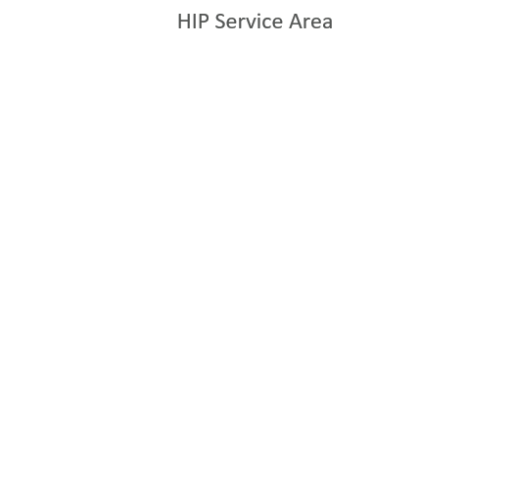
HIP Service Area
Los Alamos
Current Service Area:
8 counties + San Felipe Pueblo
These areas previously lacked service providers
Coverage shown on map
San Felipe Pueblo
Notes:
We currently cover 7 counties and one tribal territory.
The areas we cover are highlighted in yellow, on the map.
These counties did NOT previously have a service provider

Slide 12
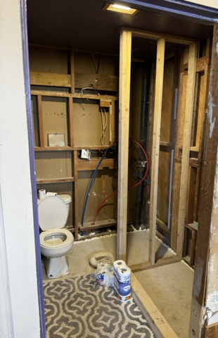
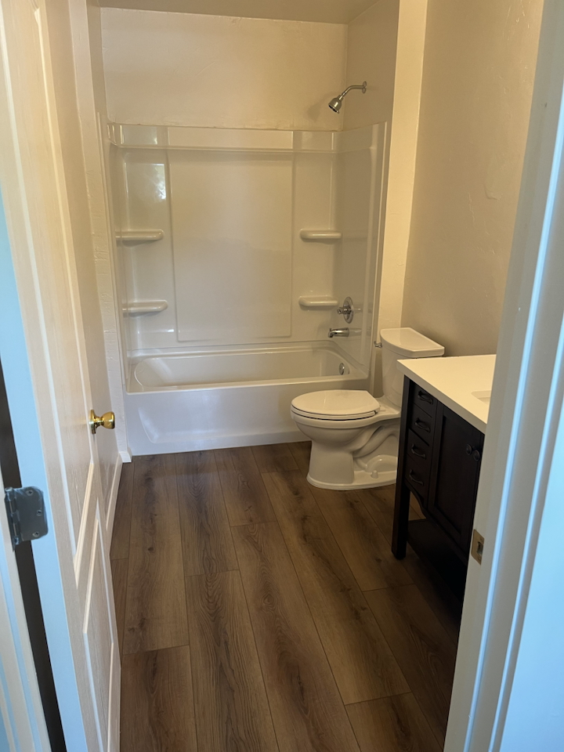
HIP Production
HIP Program Milestones
Launched: February 2024
Applications Received: 30
Completed Projects: 10 to date
Total Allocation: $4.5M
Total Expenditures: $1,957,391 (43%)
In Progress: 6 new projects in various stages of eligibility or procurement
Bathroom – BEFORE Bathroom-AFTER
Notes:
We launched our program in February 2024 where we accepted applications only for the month of February.
We received a total of 30 applications.
Our first project broke ground in September 2024
Since then, we have completed 6 projects total .
We were allocated $1.6M from both NMHTF and HOME funds.
We have spent roughly 73% of that
Currently we have 6 NEW projects in various stages of eligibility or procurement
The photos are from one of the first HIP projects. On the left is you can see the bathroom was gutted and they were only able to use the toilet. The photo to the right is the after the rehab result.

Slide 13
HIP: Lessons Learned
Project Costs
Increasing costs make it difficult to keep projects within funding limits while addressing health & safety
Environmental Review Compliance
Adds a significant amount of time to the project
Manufactured Home Replacement
Requires coordination of complex tasks such as site prep, delivery, installation and utility connections
Homeowner Expectations
Most are unfamiliar with federal program requirements and timelines
Contractor Capacity
Maintaining a pool of contractors able to comply with program requirements
Notes:
LESSONS LEARNED SO FAR:
Acting as a subrecipient gave us first-hand insight into process gaps
This vantage point allowed us to identify bottlenecks, inefficiencies, and opportunities for streamlining services.
We haved developed targeted solutions based on real project experience and Key Policy Updates Informed by Lessons Learned
For instance:
The 95% After Rehab Value Policy– We adjusted the threshold for better project feasibility.
Waiting List Management – We enacted clearer process to ensure fairness and transparency.
Contractor Eligibility – We refined criteria to ensure quality and compliance across the board.
Project cost escalation: Construction costs have fluctuated significantly, which can make it difficult to keep projects within program limits while still addressing all health and safety needs. This has highlighted the importance of strictly adhering to the Rehab Standards realistic cost estimating and contingency planning.
Environmental and compliance timelines: Federal requirements such as environmental review, lead-based paint regulations, and other compliance steps can add time to project startup. A key lesson has been the importance of setting clear expectations with homeowners about timelines and ensuring documentation is well organized early in the process.
Manufactured housing replacement logistics: When projects involve replacing a manufactured home, coordinating site preparation, delivery, installation, and utility connections across multiple parties can be complex. Clearly defining scopes of work and phased deliverables has been helpful in improving project coordination.
Homeowner communication and expectations: Many homeowners are unfamiliar with federal program requirements and timelines. We have learned that proactive communication and clear explanations early in the process greatly improve the homeowner experience.
Contractor capacity and procurement: One of the biggest challenges has been maintaining an adequate pool of qualified contractors willing to participate in federally funded rehabilitation projects. 2 CFR 200 compliance requirements, insurance thresholds, and administrative processes can sometimes deter smaller contractors. As a result, strengthening contractor outreach and refining procurement methods has been an important lesson.
Please let me know if you would like us to expand on any of these points or provide additional examples that may be helpful for the presentation.

Slide 14

Planning for HIP’s Future
Expand to additional counties
Strengthen administrative capacity
Grow rural contractor participation
Scale to meet community demand
Notes:
Planning for HIP’s Future
We hope to expand program reach to more underserved counties.
And adjust program guidelines as needed based on lessons learned.
Build Capacity as the Program Grows
By Strengthening administrative processes for faster project turnaround.
Add staff or cross-train existing team members to manage workload.
We would like to grow Contractor Participation
By Recruiting more contractors, especially in rural areas.
As well as Increase Capacity to Meet our Communities Needs
By scaling up resources to handle higher application volume.
AND Develop targeted outreach to high-need areas.

Slide 15
Restoring Our Communities (ROC)
Funds the acquisition & rehabilitation of vacant properties
Creates affordable homeownership opportunities
Total funding: $5.5M (FY23-FY25)
The Notice of Funding Availability (NOFA) will remain open as long as there are available funds.

Slide 16
ROC Eligible Activities
ACQUISITION
Obtain a pre-purchase appraisal to negotiate the purchase of the property
REHABILITATION
Perform an inspection and document the condition of the property
Obtain/provide detailed cost estimates for improvements needed
RESALE
Obtain an after-rehab appraisal to market
List the property for the lesser of the total project cost or the after-rehab value
Confirm clear title of the property
Identify vacant properties
Property must be sold to an eligible homebuyer and must be the homebuyer’s principal residence (owner-occupied).

Slide 17
ROC Service Provider Role
Manage projects from acquisition to resale
Project Management Fees
Rural fee: 15% (max $25K)
Urban fee: 10% (max $15K)
Fee provided upon sale of home
Project Feasibility is defined by a recovery of 85% percent of the total project cost.

Slide 18
Project Feasibility Example
A ROC project was completed earlier this year and sold for $295,000. After closing costs were deducted, the net proceeds of the sale were $275,000. The property was acquired for $161,500, while rehabilitation and soft costs totaled $158,500.
Net proceeds from sale of property
$275,000
__________________________
Acquisition + Rehabilitation + Soft costs
$320,000
= 85.9%

Slide 19
ROC Lessons Learned and a Look Ahead
Service provider challenges:
Finding qualified contractors
Competing with house flippers
Some providers are struggling to start on projects
A look ahead:
Expand outside of the Albuquerque area
Explore a direct service model for this program

