Slide 1
New Mexico Affordable Housing Tax Credit (State Tax Credit) Program

Slide 2
Table of Contents
What is it?
Who can use State Tax Credits to develop affordable housing?
How much funding is available?
How do developers get State Tax Credits?
What can developers use State Tax Credit funding for?
What does it mean for developers to receive State Tax Credits?
When can they use the Credits?
Who is eligible to receive State Tax Credits?
How do you get State Tax Credits?
Benefits of State Tax Credits
Program accomplishments
Program limitations
Past Issue

Slide 3
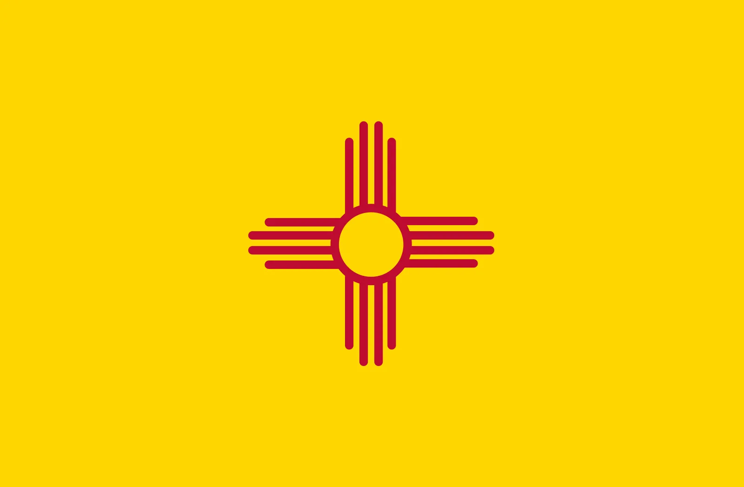
WHAT IS IT?
New Mexico Affordable Housing Tax Credit (“State Tax Credit” or “STC”)
State tax credit to incentivize development of affordable housing in New Mexico
Directly reduces a donor’s state tax liability by 50% of the value of their donation
Notes:
For 2nd bullet: meaning housing restricted to those earning 30-120% of Area Median Income (AMI)
For 3nd bullet: excluding local option GRT imposed by a municipality or county, or the government GRT.

Slide 4
WHAT IS IT? (CONTINUED)
Origins
Created by the Affordable Housing Tax Credit Act of 2005
Passed by the state legislature, signed by Gov. Richardson
Designated MFA as the issuer of investment vouchers used to claim State Tax Credits
Allowed MFA to create a trust fund
New Mexico Affordable Housing Charitable Trust Fund (Charitable Trust)
Created by MFA, received 501(c)(3) status in 2008
Able to issue investment vouchers for donations to fund future projects and other affordable housing activities
Notes:
Last bullet point: like MFA weatherization program, housing rehabilitation programs etc.

Slide 5
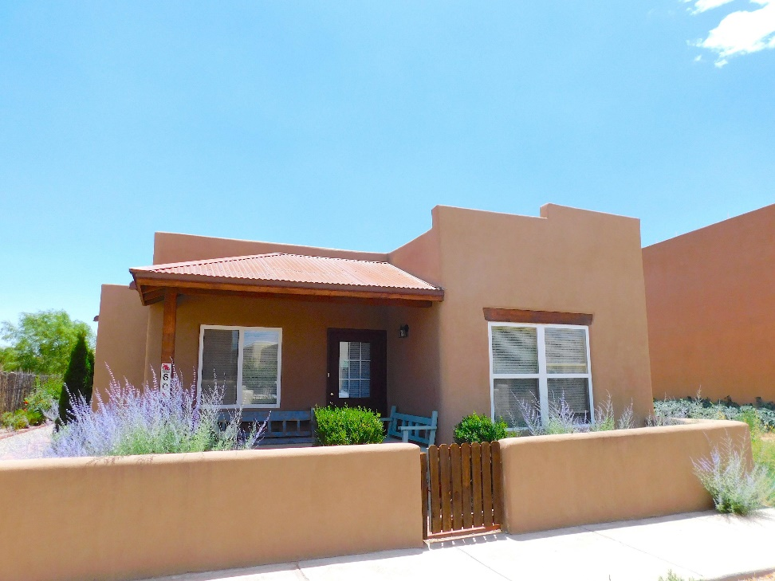
WHO CAN USE STATE TAX CREDITS TO DEVELOP AFFORDABLE HOUSING?
Eligible Applicants:
Nonprofit developers
For-profit developers
Governmental and Tribal Instrumentalities
Eligible Projects:
Single family homes
Multifamily rental projects
Transitional housing
Emergency shelters
Notes:
Picture of Oshara Village in Santa Fe, a single-family home development funded exclusively with State Tax Credits

Slide 6
HOW MUCH FUNDING IS AVAILABLE?
$5,115,454 in State Tax Credits available for reservation as of January 2022
Notes:
First bullet point: Amount equal to a base rate of $1.85 in 2008 dollars, adjusted annually for inflation, multiplied by the state population

Slide 7
HOW DO DEVELOPERS GET STATE TAX CREDITS?
Apply for a State Tax Credit reservation or Trust Fund allocation from MFA
Meet MFA threshold requirements to receive a reservation or allocation:
Providing documentation including:
Resumes
Organizational financial statements
Complete MFA schedules
Scoring high enough to be eligible for an award
Awards must receive approval
Notes:
First bullet point: using materials we make available to them on our website
Last bullet point: depending on the amount of tax credits being requested from MFA’s Chief Lending Officer, Policy Committee comprised of all the chiefs and the executive director of MFA, and/or the MFA Board of Directors

Slide 8
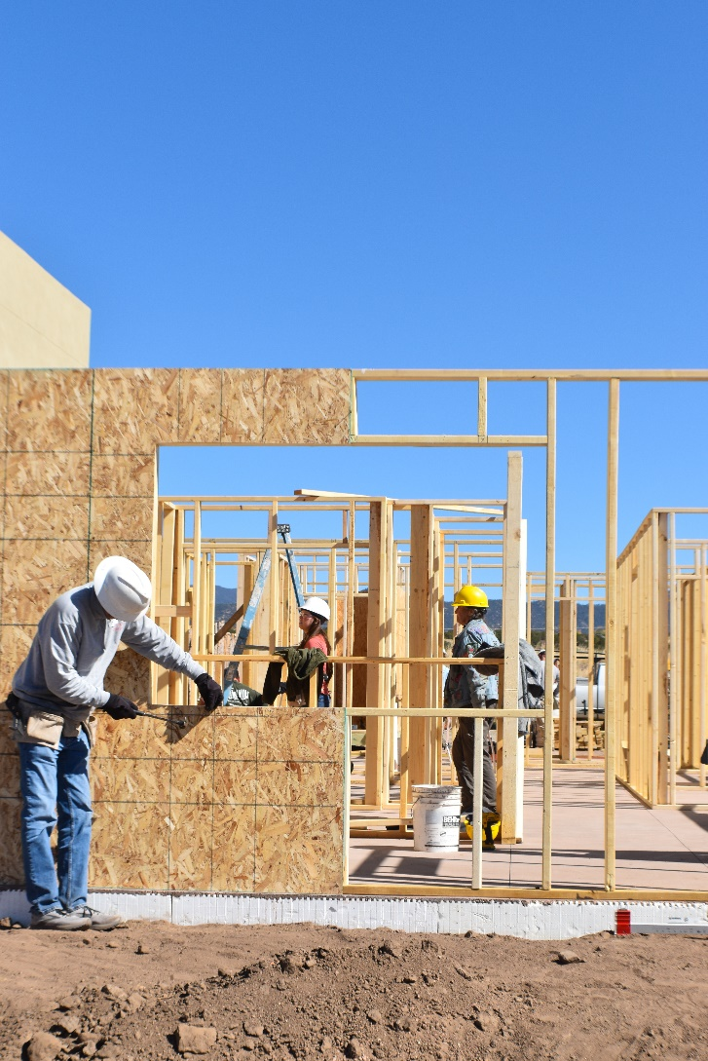
WHAT CAN DEVELOPERS USE STATE TAX CREDIT FUNDING FOR?
Land and building acquisition
Construction
Remodeling
Rehabilitation
Conversion
Weatherization

Slide 9
WHAT DOES IT MEAN FOR DEVELOPERS TO RECEIVE STATE TAX CREDITS?
A State Tax Credit Reservation
Awarded reservation of Affordable Housing Credits for the project
The developer can then solicit donations eligible for those State Tax Credits
A Charitable Trust Allocation
Awarded allocation of earmarked Charitable Trust funds for the project
State Tax Credits are given to the donor at the time they donate to the Charitable Trust
Notes:
First bullet point: Developers are awarded either a State Tax Credit reservation or Trust Fund allocation from MFA
Third bullet point: Those donations are how projects are funded.
Fourth bullet point: after the project has successfully applied and been approved by MFA
Fifth bullet point: Usually in the form of a check

Slide 10
WHEN CAN DEVELOPERS USE STATE TAX CREDIT FUNDING?
Start once
Reservation Contract has been executed
Master LURA has been executed
Other financing commitments have closed
Reservation Contract enables the developer to solicit donations eligible for State Tax Credits
Lasts until the Certificate of Occupancy for the last unit or home is issued

Slide 11
WHO IS ELIGIBLE TO RECEIVE STATE TAX CREDITS?
Any of the following donating to a project with a State Tax Credit Reservation or the Charitable Trust:
Individuals
Business entities
Corporations
Companies
Partnerships
Pass-through entities

Slide 12
HOW DO YOU GET STATE TAX CREDITS?
Donate any of the following to a project with a State Tax Credit reservation
Buildings
Land
Materials
Money
Services
The Charitable Trust can only accept monetary donations
Find these projects or how to donate to the Charitable Trust on our website: housingnm.org
Notes:
Last bullet point: and searching for “state tax credit” in the search bar on the webpage
After the last bullet point: Donating to a project requires the project to be soliciting donations eligible for state tax credits and for you to know that to receive state tax credits. Donating to the Charitable Trust can occur at any time and only requires you to visit our website for guidance.

Slide 13
HOW DO YOU GET STATE TAX CREDITS? (CONTINUED)
Minimum accepted donation is $200; maximum is $2,000,000
Developer reaches out to you with an Investment Voucher Form to fill out to claim state tax credits
That form and donation proof are sent to MFA
MFA processes the form and sends it back to the donor
Notes:
First bullet point after dollar amounts: in value

Slide 14
HOW DO YOU GET STATE TAX CREDITS? (CONTINUED)
State Tax Credits received equal 50% of the value of the donation
When you file your taxes, you use the Investment Voucher Form, along with the appropriate state tax forms to claim the credits
Donor may transfer all or a fraction of the amount of the credits to an eligible individual or entity
Notes:
Third bullet point: using the appropriate forms

Slide 15
BENEFITS OF STATE TAX CREDITS
Credits cover liability associated with taxes imposed by the state government in the amount of 50% of your donation
Your donation may be eligible for a federal tax deduction
The whole tax credit or a fraction thereof may be redeemed the 1st year or carried forward for up to 5 years

Slide 16
PROGRAM ACCOMPLISHMENTS
Credits issued since 2006 = $7.3MM
Total funding provided by donations = $14.6MM
WHICH TRANSLATES INTO…
57 total projects*
365 single-family homes
380 multifamily units
*see Appendix A for a full list of project and locations
Notes:
Picture of Soleras Station in Santa Fe, a multifamily development funded in part with State Tax Credits

Slide 17
PROGRAM LIMITATIONS
Doesn’t fund operating costs
Funds up to a maximum of $2MM of development
Notes:
Last bullet point: Potentially ask Board to change this from “the lessor of $1,000,000.00 or 25 percent of the annual amount of state tax credits available” (as in the “Program Rules”) to “in excess of 25 percent of the annual available amount” (as in the “NOFA”); this would raise the maximum award amount to nearly $1.3 MM and the potential development funding to over $2.5 MM. Could also ask them to remove the cap entirely?

Slide 18
PAST ISSUE
MFA received a request to donate land for a future project
There are issues with the Charitable Trust accepting non-monetary donations
We’re still evaluating how MFA might receive and hold property
There are potential liability issues with MFA holding real estate
NMTRD advised us against issuing credits for donations that have no demonstrable benefit to affordable housing in the year they are issued.
Notes:
Fourth bullet point: including that in the event the project never comes through, MFA would be stuck with land that it would be responsible for maintaining and/or disposing of.

Slide 19
I’d be happy to answer your questions. Thank you.

Slide 20
Appendix A: STC Projects & Locations

