Slide 1

NM Energy$mart Weatherization
Program Overview
Dimitri Florez
Green Initiatives Manager II
April 9, 2026
Notes:
Dimitri

Slide 2
What is Weatherization?
Housing New Mexico Energy$mart weatherization assistance program (WAP) provides energy-saving retrofits and home modifications at no charge to eligible homeowners and renters.
Department of Energy (DOE) Definition:
Reduces energy costs for low-income households by increasing the energy efficiency of their homes, while ensuring health and safety. It is the nation’s single largest residential whole-house energy efficiency program. WAP has created an industry, producing new jobs and technologies, all while helping the most vulnerable families across the country.
Notes:
Dimitri

Slide 3
NM Energy$mart Funding
Federal
U.S. Department of Energy (DOE), IIJA, and innovative grants
Federal but passes through state
State Funding
Coronavirus State and Local Fiscal Recovery Funds (CSLFRF)
Capital Outlay and other funds (NMHTF)
Utilities
New Mexico Gas Company
Low Income Home Energy Assistance Program (LIHEAP)
Community Energy Efficiency Development Block Grant (CEED)
Public Service Company of NM (PNM)
El Paso Electric (EPE)
Notes:
Dimitri

Slide 4
Six Simple Steps for Low-Income Client Weatherization
Rehabilitate and Repair
Full Energy Efficiency Measures
If switching to electricity, use heat pumps with fossil fuel back-up
Solar
When switching the main fuel source from natural gas to electricity, always include solar, or find a way for them to obtain community solar.
Find the Client
Income, fuel source, energy burden, vulnerability
NEVER LEAVE A LOW- INCOME CLIENT WITH HIGHER UTILITY BILLS THAN BEFORE IMPLEMENTATION
Do No Harm
Under no circumstances will the low-income client's utility bill be allowed to increase.
Upgrade panels where needed
Dual fuel heat pumps will use the less expensive fuel.
Insulate entire building shell, seal air leaks and duct leakage, baseload measures such as appliances and bulbs, health and safety.
What does the home need for repairs?
Roof leaks or major structural problems will cause work to be ineffective.
Notes:
Dimitri

Slide 5
Funding Levels
PY 2025/2026 Awards
Source | Award
DOE | $ 2,908,301
LIHEAP | $ 2,500,000
IIJA-DOE (9/2022-6/2027) - On Hold | $ 3,152,393
State Funding, NMHTF- Weatherization | $ 875,000
State Funding, NMHTF- Solar and Electrification | $ 2,500,000
WAP FRF (9/2022-6/2025) | $ 962,220
NM Gas | $ 2,015,000
PNM | $ 339,609
EPE | $ 191,971
CEED | $ 1,670,000
Total | $17,114,494
Notes:
Troy

Slide 6
WAP Coronavirus State and Local Fiscal Recovery Funds
Funding is used for emergencies and full weatherization.
Emergency is defined as: Repairs that if not made immediately are very likely to pose a material or imminent risk of injury to persons or substantial damage to property.
Enables the program to take care of the segment with the highest needs.
This has been a huge need of the program since it’s inception.
There are over 100 clients in our database in need of structural repairs and emergencies.
Once a home qualifies for emergency service, full weatherization is triggered.
Historically, these homes have been deferred.
Notes:
Dimitri

Slide 7
Future Grants
Potential Grants and Collaboration
Tri-State Electric Otero Electric Central Valley Co-Op Loan program to provide energy upgrades for over-qualified constituents Multi-Family Provider RFP coming out in a few weeks
Notes:
Troy

Slide 8
Current Service Providers
Central New Mexico Housing Corporation
Cyndi Hazzard, Executive Director
Serves the Northern Counties of the State
Weatherization Office is in Albuquerque, NM
Southwestern Regional Housing and Community Development Corporation
Veronika Molina, Executive Director
Serves the Southern Counties of the State
Weatherization Office is in Las Cruces NM and Main Office is in Deming, NM
Red Feather Development Group
Joe Seidenberg, Executive Director
Serves the Navajo Nation within the State
Weatherization Office is in Flagstaff, AZ
Housing New Mexico administers the program through community-based nonprofit organizations statewide.
Notes:
Dimitri

Slide 9
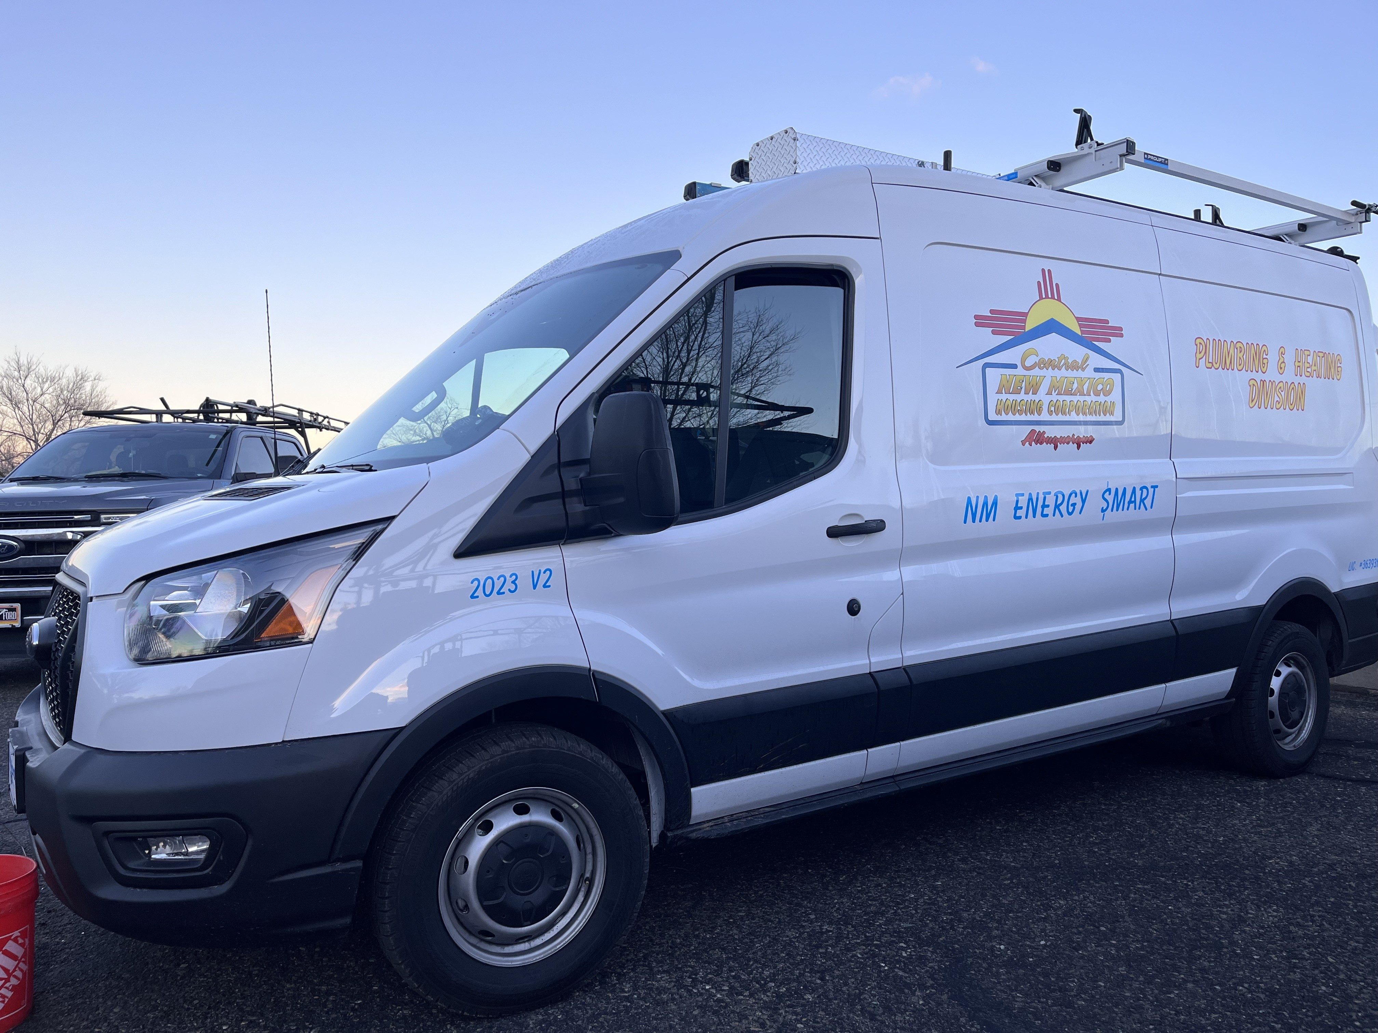
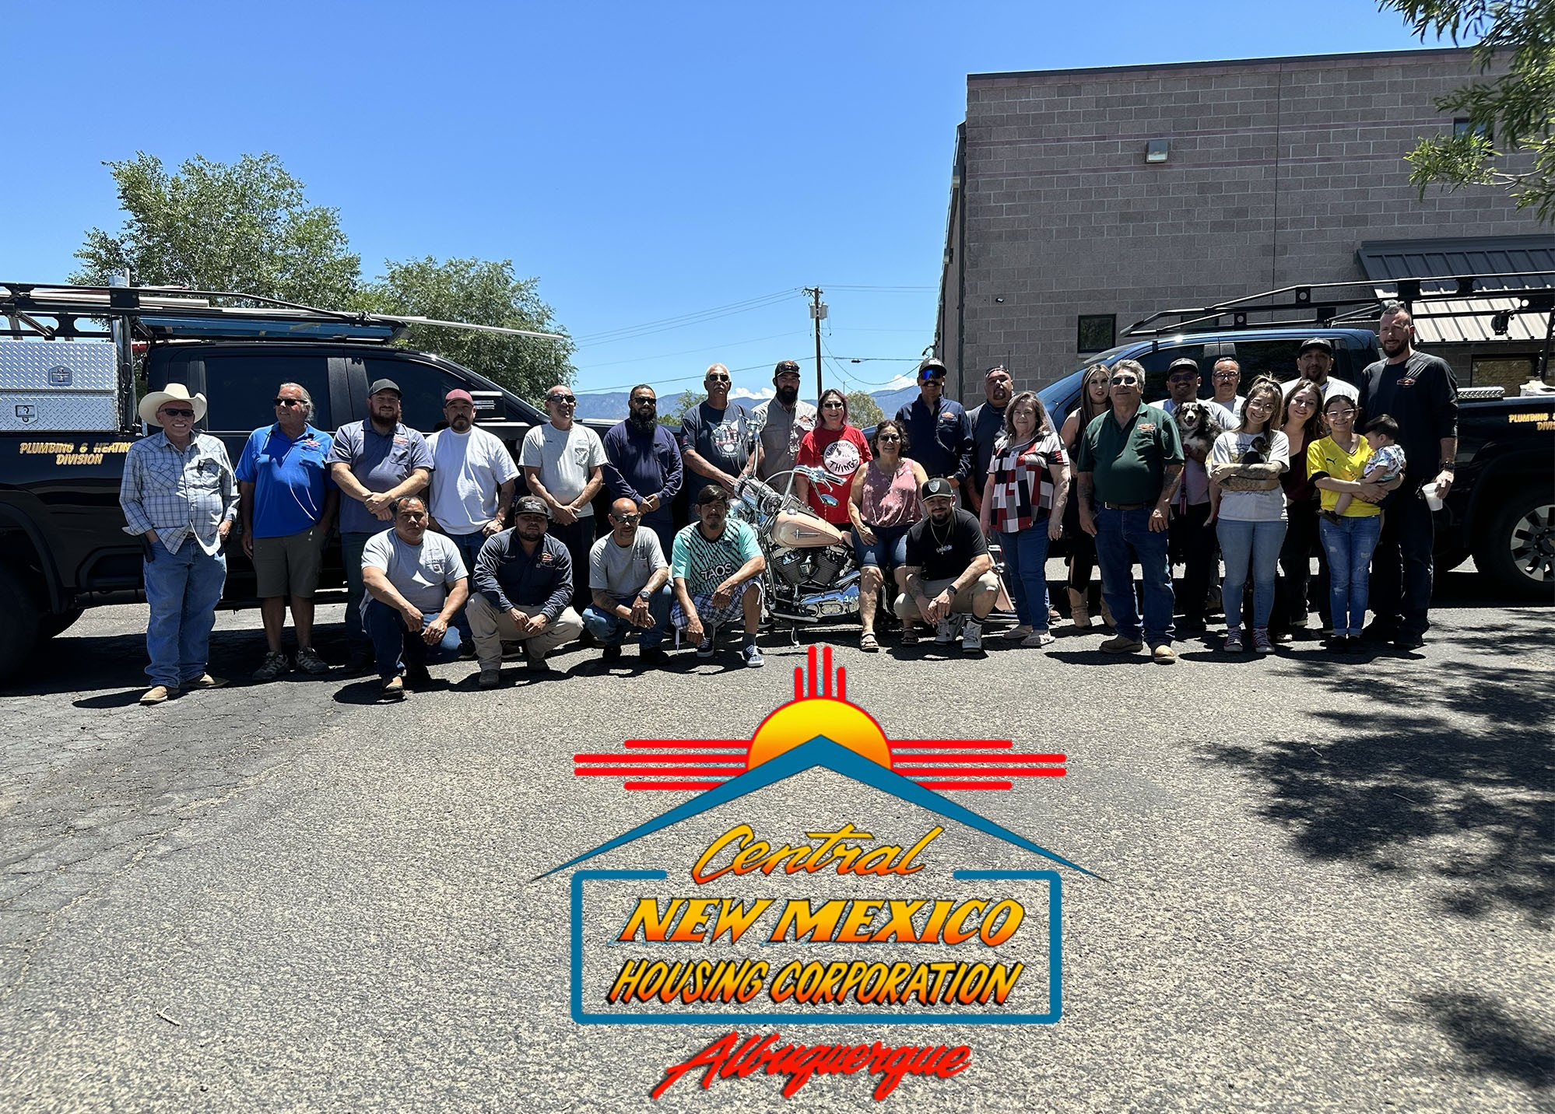
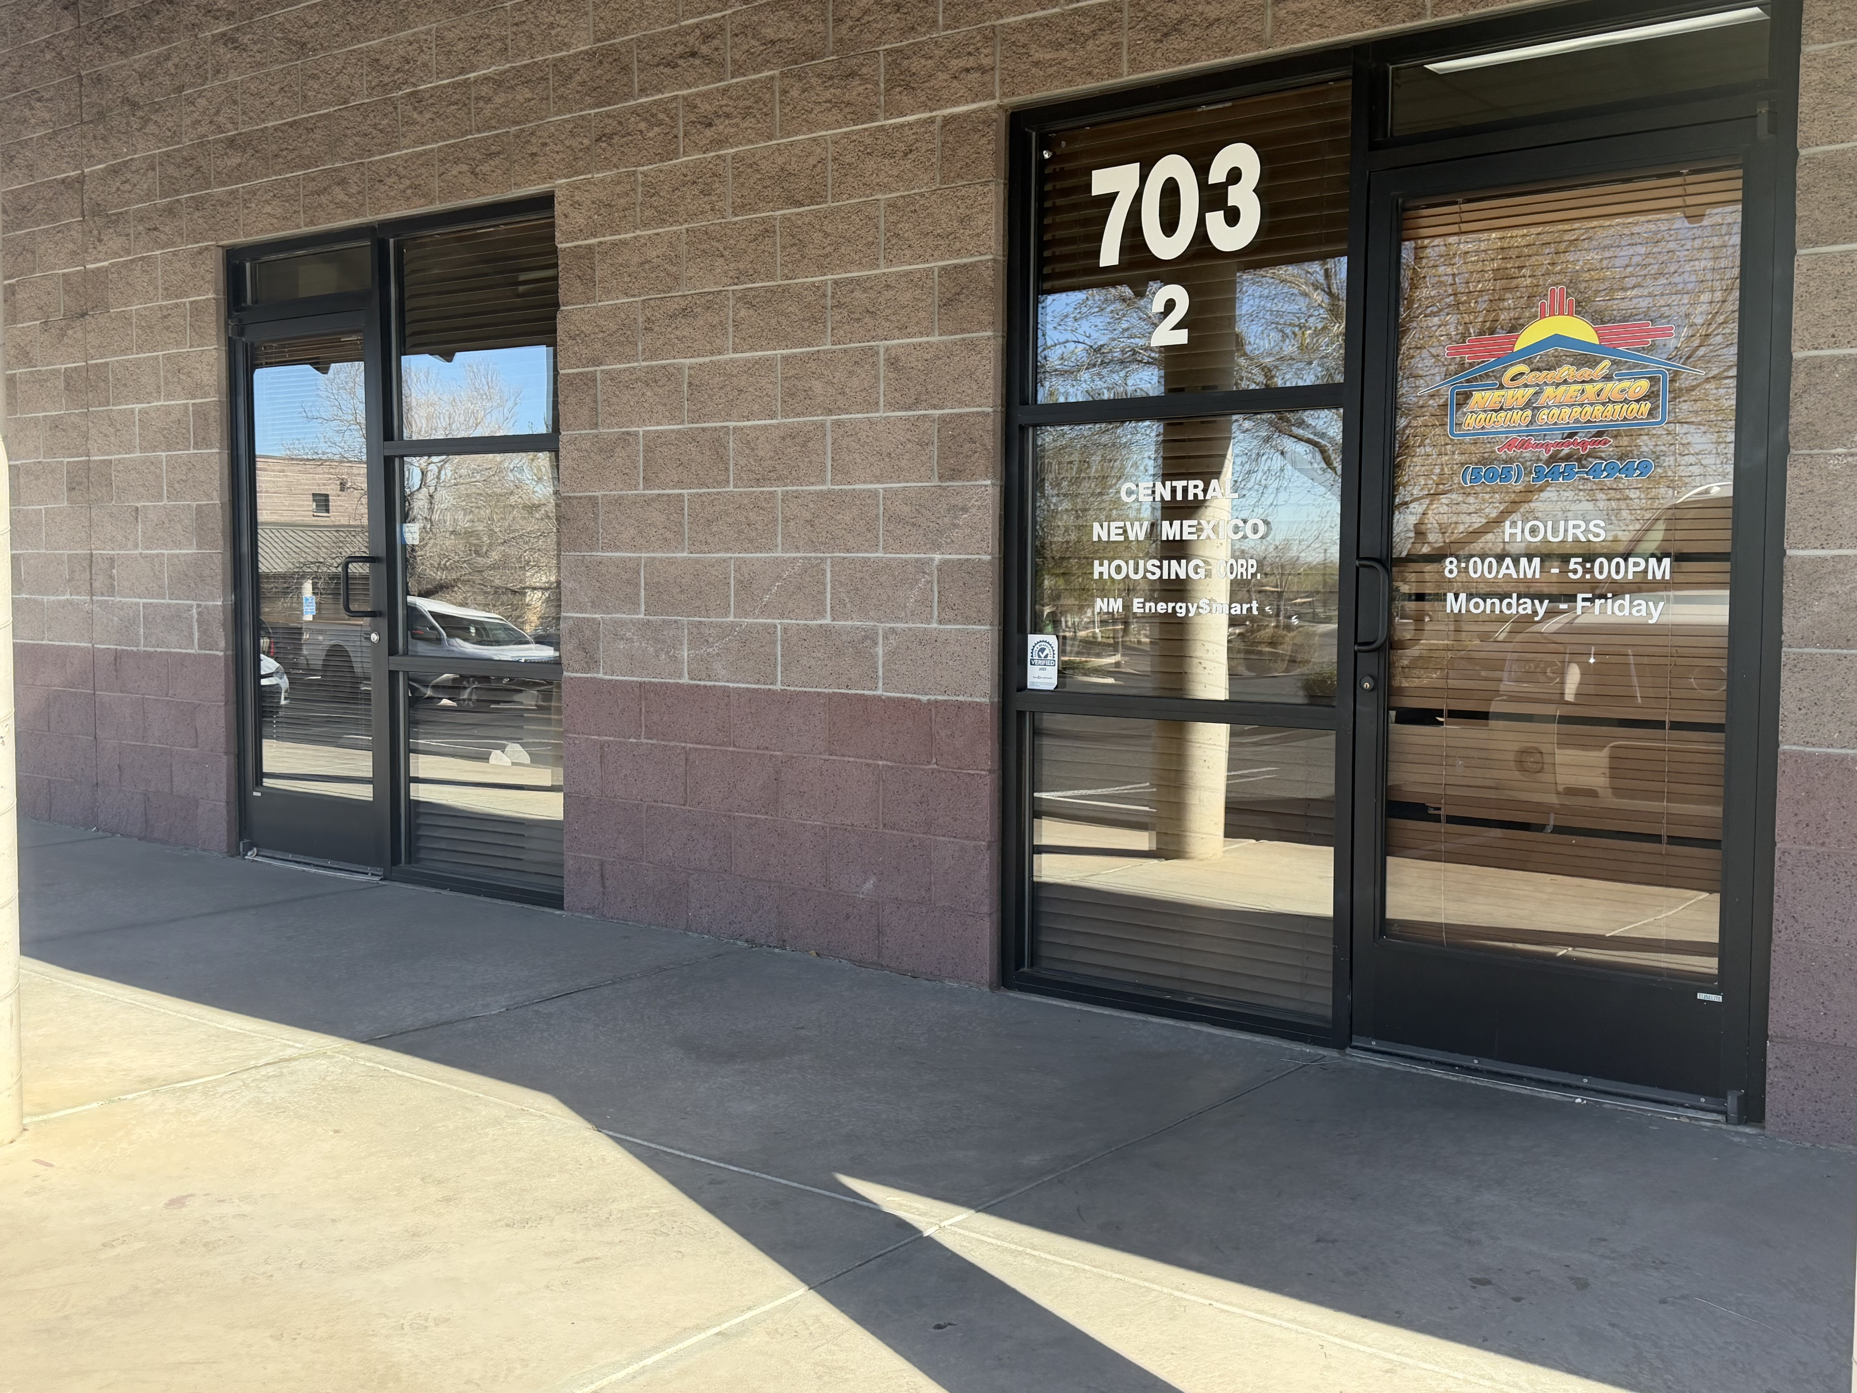
Central New Mexico Housing Corporation says hello!
Housing New Mexico administers the program through community-based nonprofit organizations statewide.
Notes:
Dimitri

Slide 10
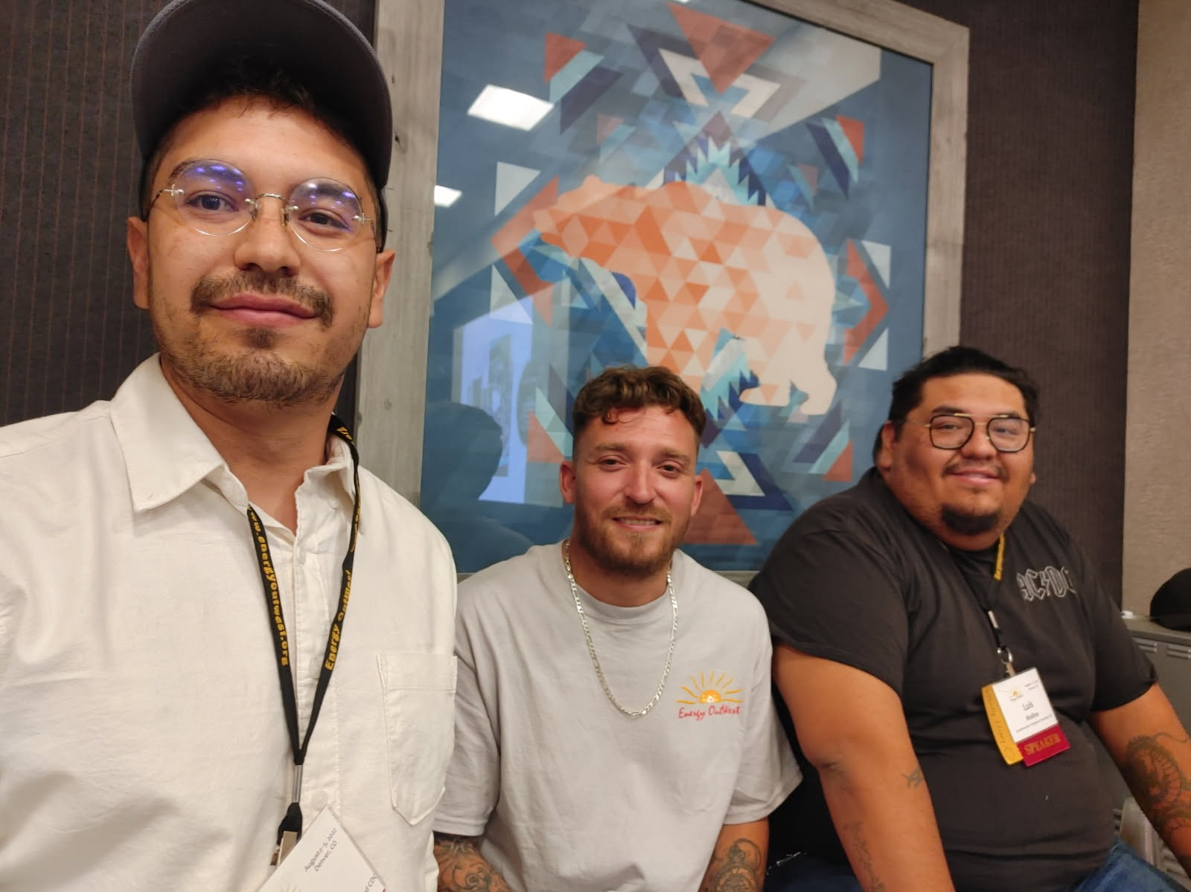

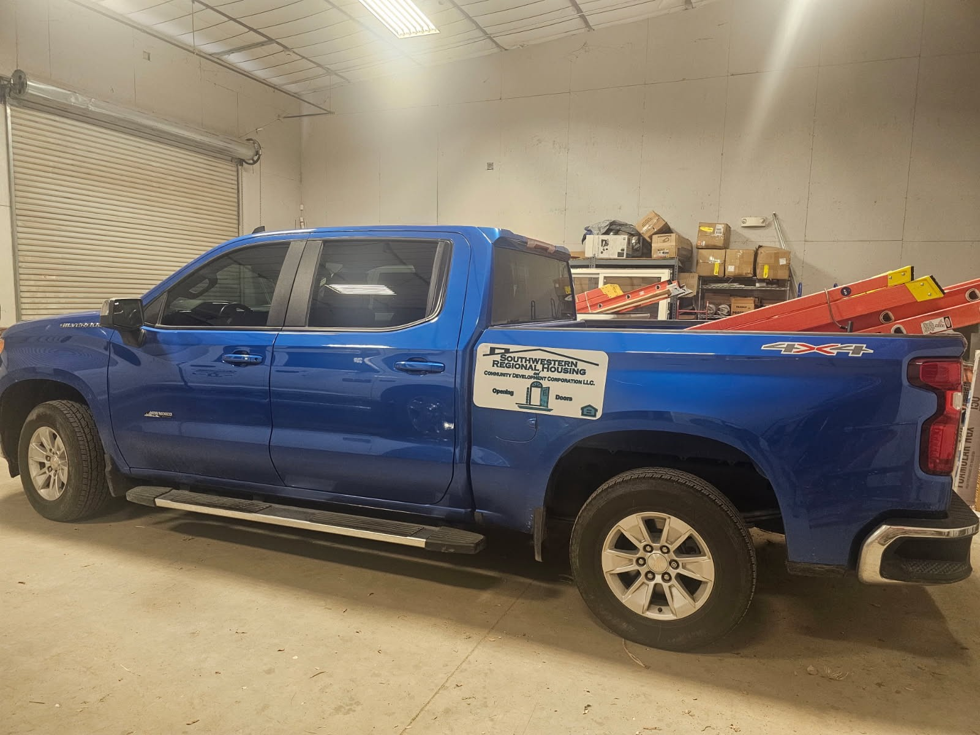

Southwestern Regional Housing and Community Development Corporation says hello!
Housing New Mexico administers the program through community-based nonprofit organizations statewide.
Notes:
Dimitri

Slide 11
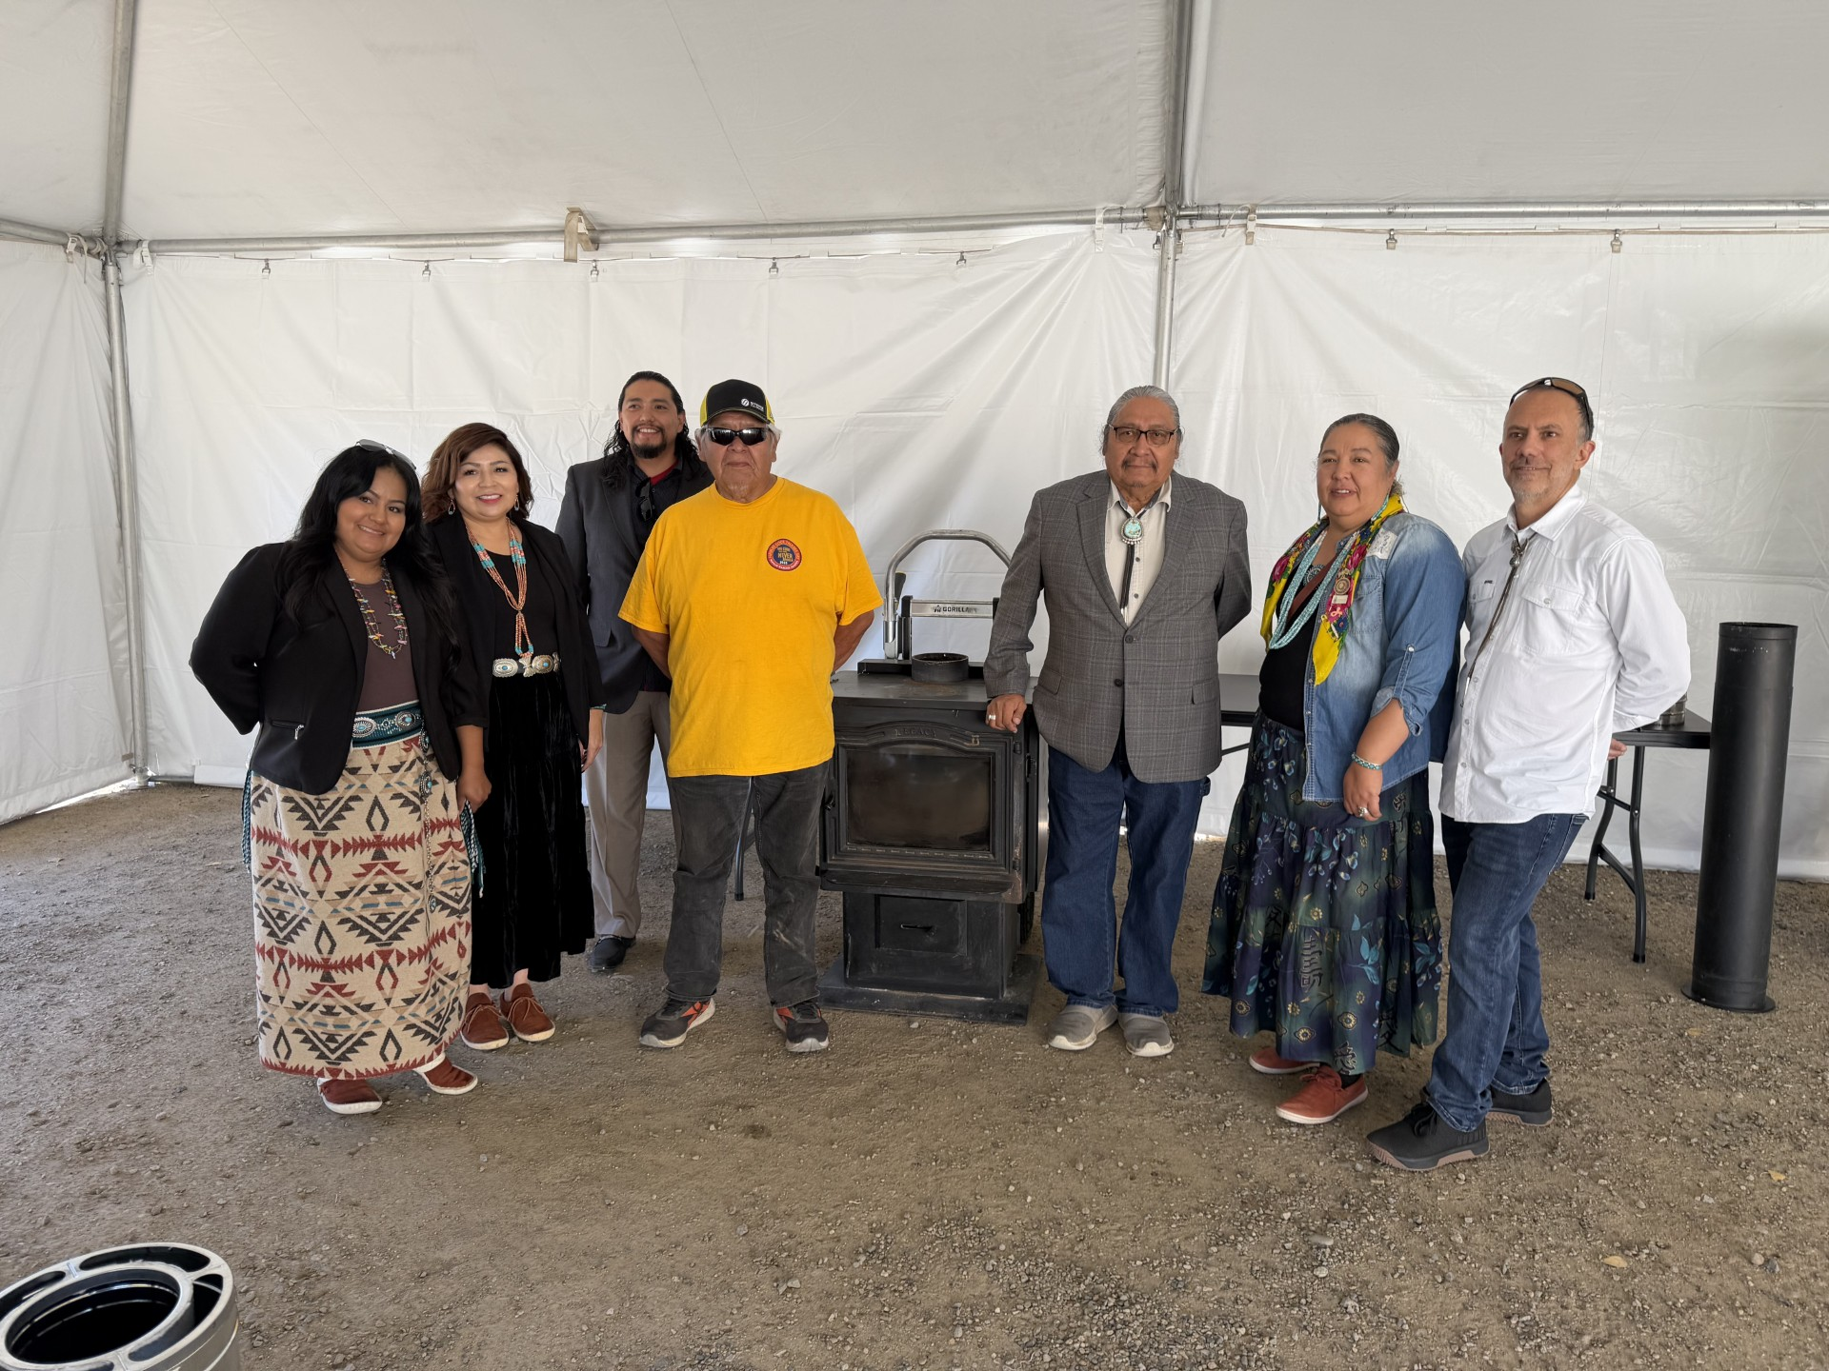
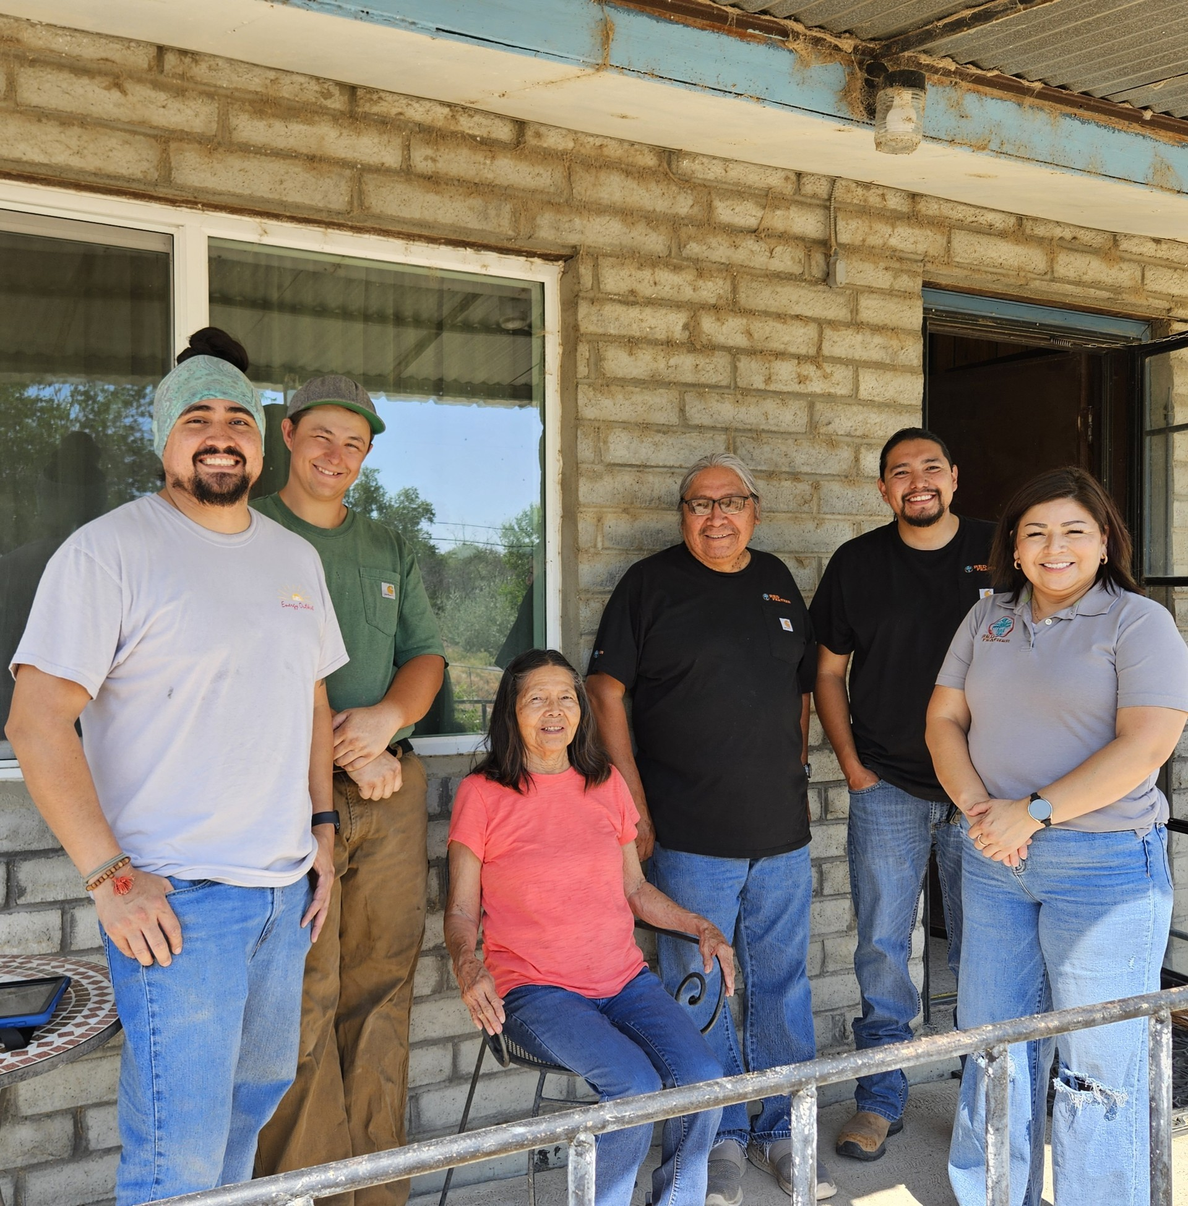
Red Feather Development Group says hello!
Housing New Mexico administers the program through community-based nonprofit organizations statewide.
Notes:
Dimitri

Slide 12
Service Provider Coverage
San Juan
Rio Arriba
Taos
Colfax
Union
Mora
Harding
Red Feather Development Group- Navajo Nation
Central New Mexico Housing Corporation
Southwest Regional Housing & Community Development Corporation
Sandoval
Los Alamos
McKinley
Santa
Fe
San Miguel
Cibola
Bernalillo
Quay
Valencia
Guadalupe
Torrance
De Baca
Curry
Catron
Socorro
Roosevelt
Lincoln
Chaves
Sierra
Grant
Lea
Otero
Eddy
Dona Ana
Luna
Hidalgo
Notes:
Dimitri

Slide 13
Housing New Mexico WAP Contact Information
Troy Cucchiara
tcucchiara@housingnm.org
505-532-1698
Dimitri Florez
dflorez@housingnm.org
505-532-1677
David Gutierrez
dgutierrez@housingnm.org
David Trembath
dtrembath@housingnm.org
505-532-1674
505-532-1676
Notes:
Dimitri

Slide 14

Thank you!
Comments/Questions?

